Slide 1
Start Team
Updates for 2026 season

Slide 2
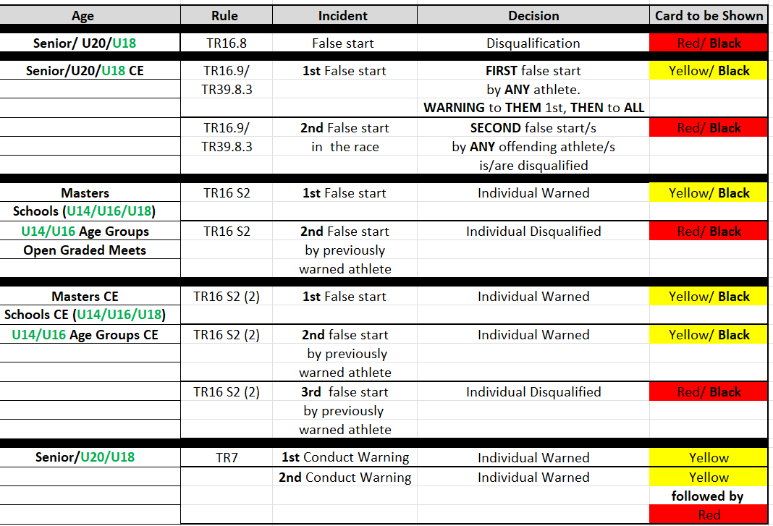
1 - DQ rules even age groups

Slide 3
2 – TR44.6.3 Short Track 800m
Aim of update To reduce physical contact and jostling between athletes in 800m races started lanes
For the start of races of 800m, each athlete may be assigned a separate lane, or up to two athletes may be assigned per lane, or a group start, as in Rule 17.5.2 of the Technical Rules, preferably commencing in lanes 1 and 4, may be used.
In races started in lanes, athletes may leave their lane only after the break line marked at the end of the second bend. In these cases, For group starts, athletes may leave their lane, or those running in the outer group may join
To summarise…
Two lanes run in bends, so would line the starts up on the 400m start lines

Slide 4
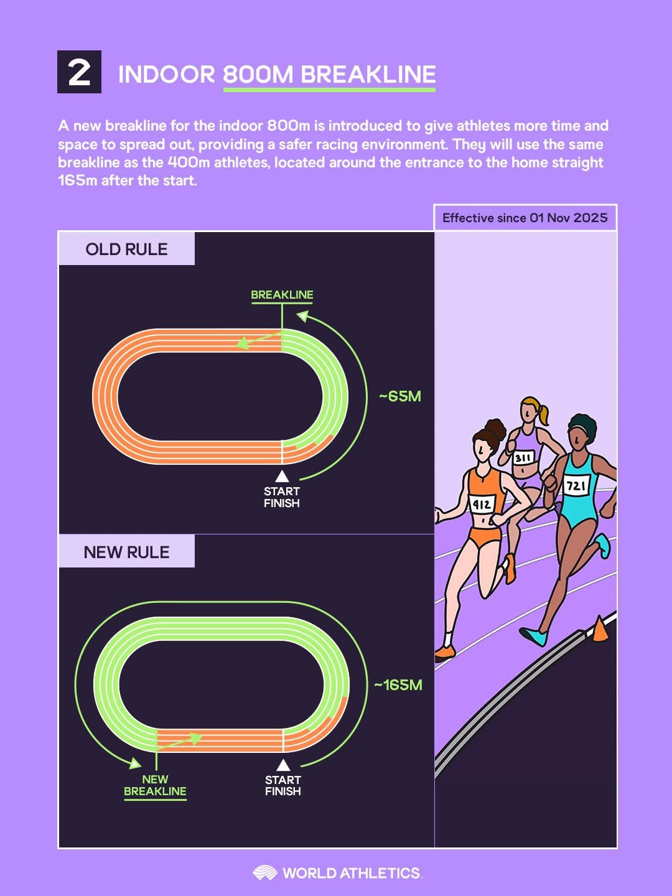

Slide 5
3 - TR16.5.3 The Start
(Twitching/disturbing at the start)
Aim of update to clarify when a race might need to be recalled, and the precise conditions when a yellow (or red) card be issued
Where an athlete in the judgement of the Starter, after the command “On your marks” or “Set” disturbs (an)other athlete(s) in the race through sound, movement or otherwise, regardless of whether it is resulting in such athlete(s) committing what would otherwise be a false start, the Starter shall abort the start.
In case of Rules 16.5.1 or 16.5.2 of the Technical Rules, the Referee may warn the athlete for improper conduct (disqualify in case of a second infringement of the Rule during the same competition), according to Rules 7.1 and 7.3 of the Technical Rules. A green card shall not be shown.
In case of Rule 16.5.3 of the Technical Rules, if the or action by the athlete results in (an)other athlete(s) committing what would otherwise be a false start, the Referee may warn the offending athlete for improper conduct (disqualify in the case of a second infringement) according to Rules 7.1 and 7.3 of the Technical Rules. Otherwise, a green card shall be shown.
However, in case of repeated movements by the same athlete at multiple aborted starts, even if they do not result in (an)other athlete(s) committing what would otherwise be a false start, the Referee may still warn the offending athlete for improper conduct (disqualify in the case of a second infringement) according to Rules 7.1 and 7.3 of the Technical Rules.
To summarise…
A “twitch” that requires the starter to stand the athletes up would not automatically result in a Conduct warning if no false start by other athletes has been caused, but repeated twitches by the same athlete would.

Slide 6
4 - TR15.1 starting blocks
Aim of update To clarify that the frame of the starting blocks may not overlap or extend in front of the start line.
Starting blocks shall be used for all races up to and including 400m (including the first leg of the 4 × 200m, the Medley Relay and 4 × 400m) and shall not be used for any other race. When in position on the track, no part of the starting block shall overlap the start line or extend into another lane, with the exception that, provided there is no obstruction to any other athlete, the rear part of the frame may extend beyond the outer lane line.
To be clear, the requirement that no part of the starting block shall overlap the start line includes the frame.

Slide 7
5 – CR18.1 Referees
Aim of update To give clear repartition between the referees.
Especially if the jury of appeal is not implemented, referees should know who has the final decision depending on the case.
Effort shall be made to reach consensus among the Referees.
However, when no final consensus can be reached, the Video Referee shall have the final decision based on the available video images, except in cases concerning starts, where the final decision shall be made by the Start Referee.

Slide 8
End

