Slide 1
scottishathletics
Start Team
Conduct Warnings
Val Murdoch
Training Day, March 2026

Slide 2
Conduct Warnings from a Start Team perspective
  How and why a warning is issued
  How it is communicated

Slide 3
Who can issue a Conduct Warning?
Generally, any applicable Referee
Within the Start team, this will be the Start Co-ordinator

Slide 4
Why is a Conduct Warning issued?
When an athlete/relay team fails to comply with Rule TR7
This rule states that athletes must compete in a bona fide manner and not engage in unsporting or improper conduct.

Slide 5
Who needs to know?
The athlete!
Photofinish, they will also need the Rule of the infringement, and they will advise Results.
Meeting Manager, who will advise others such as Call Room Manager, Seeding etc.

Slide 6
How will Conduct Warnings be communicated?
To the athlete:
  Yellow Card for 1st warning
  Yellow card followed by red card [DQ] for 2nd warning
  Can be straight red card [DQ] if infringement is severe
To other officials (by the CSA)
  Verbally (radio) to Photofinish
  Completion of the Conduct Warning Form (by the CSA) which can be found here…
  Starter & Starters' Assistant - Scottish Athletics
  The form is then given to the Meeting Manager

Slide 7
Previous Conduct Warnings
  Where a CW has been previously issued by a Referee you will see ‘YC’ against athlete’s name on Start List. It will probably look like this:
  John Smith_YC
  Who do you tell?

Slide 8
From a Start team perspective, what can constitute unsporting or improper conduct?
Discuss!

Slide 9
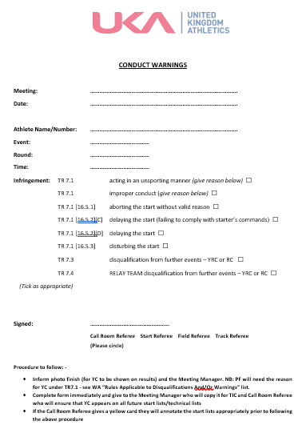

Slide 10
Further information on misconduct
Full details around unsporting or improper behaviour (misconduct) are in Rule TR7 of the UKA Rulebook
(Includes how CW within relay teams are handled)
In the associated UKA Supplement there is specific guidance about abusive language and spitting.
As a wee exercise: if you are an SA or S and you heard/saw this conduct, who would you report it to and why?

Slide 11
Any questions?

Slide 12
scottishathletics
Thank You
Val Murdoch
Training Day, March 2026

