Slide 1
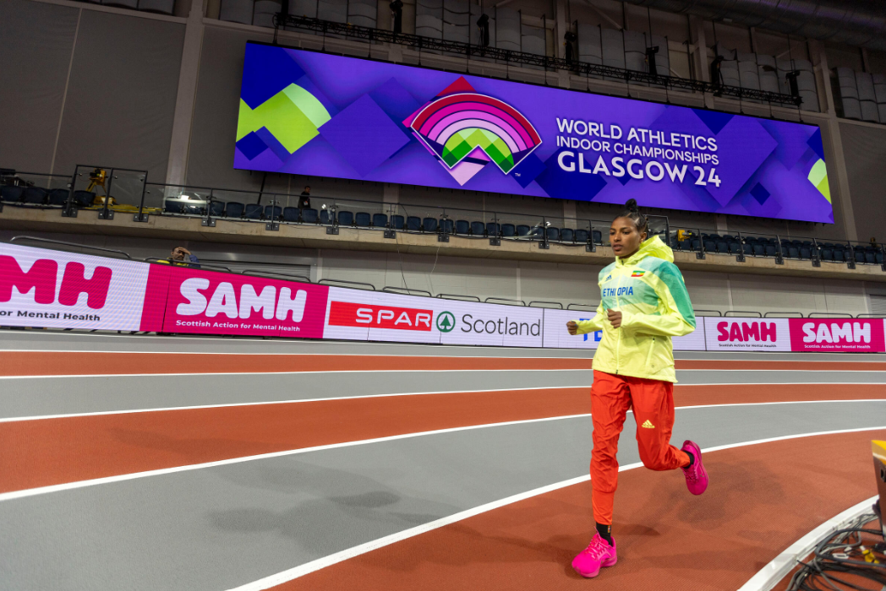



scottishathletics & SAMH
The Power of Sport
supporting mental health and wellbeing across
the scottishathletics officials workforce

Slide 2

Who are we?
100 years
Why focus on physical activity and sport
2016: a strategic partnership

Slide 3
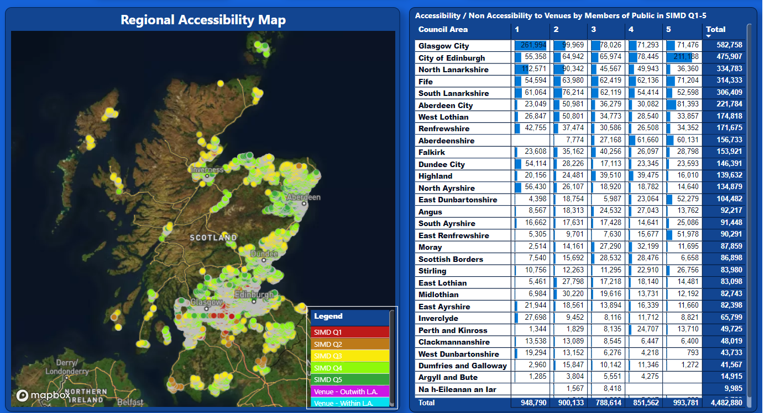
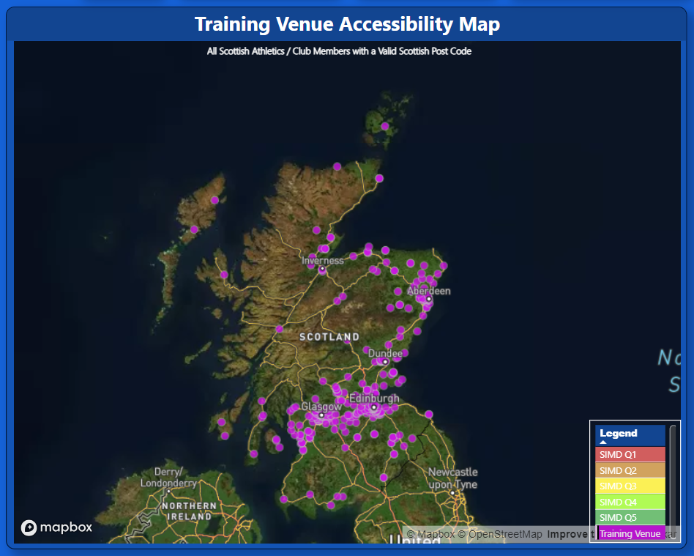
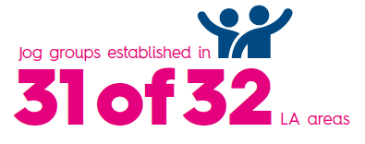
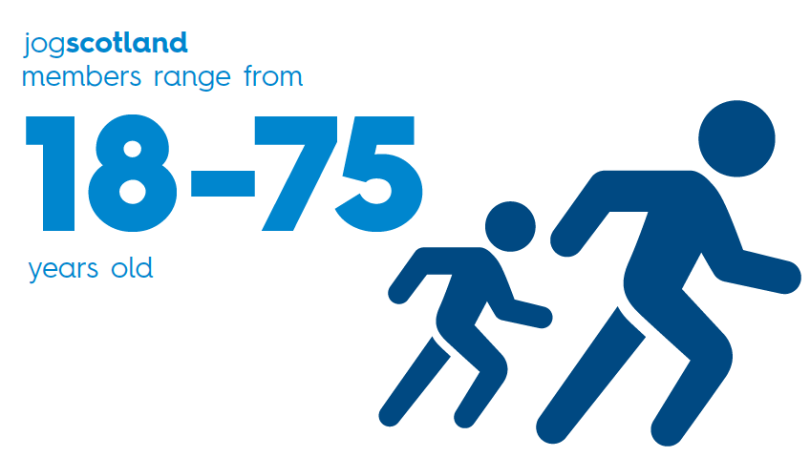
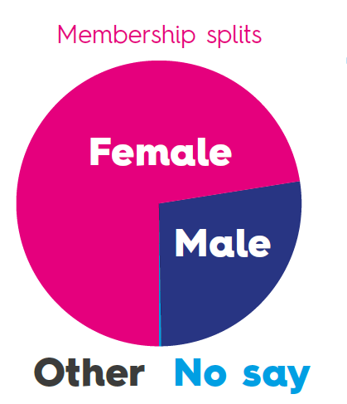
Why jogscotland….
41% of membership is female and 45+
41% of membership is female and 45+
72%
72%
28%
28%

Slide 4
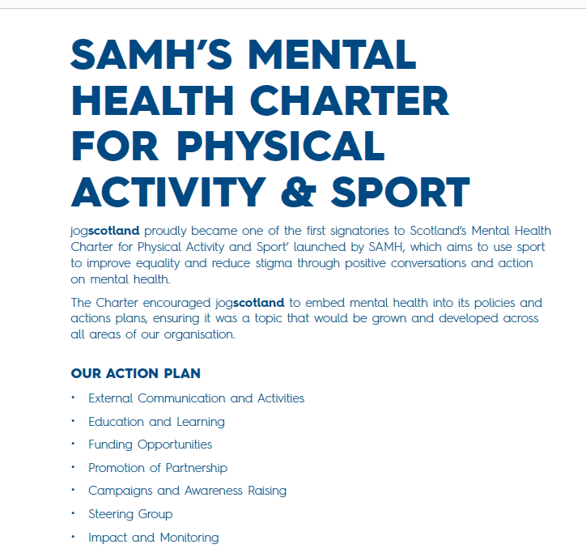
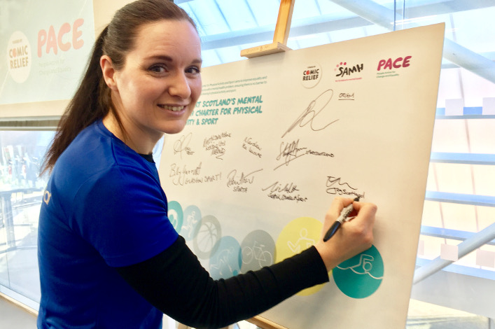

Slide 5
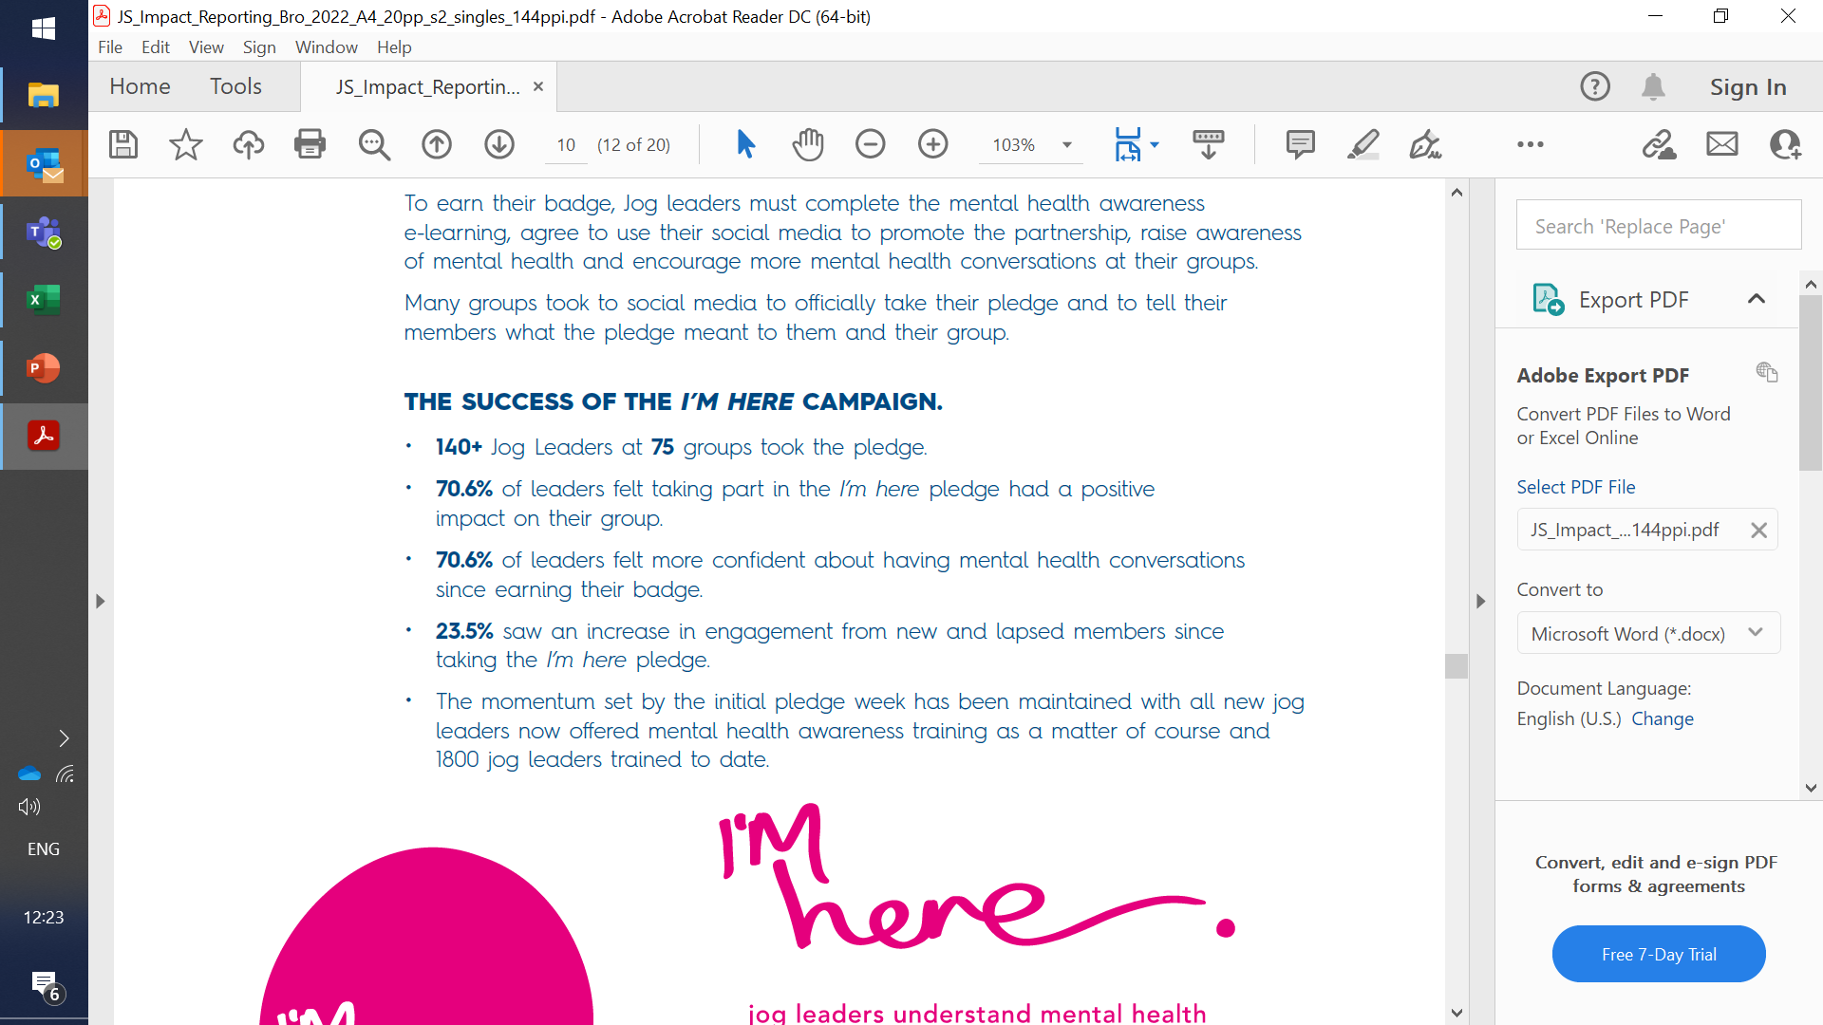


‘I had 3 separate conversations on mental health during pledge week and someone messaged me privately in the spirit of I’m Here to say she was struggling to it's certainly allowed people that space to talk more about mental health.’ Jog Leader

Slide 6
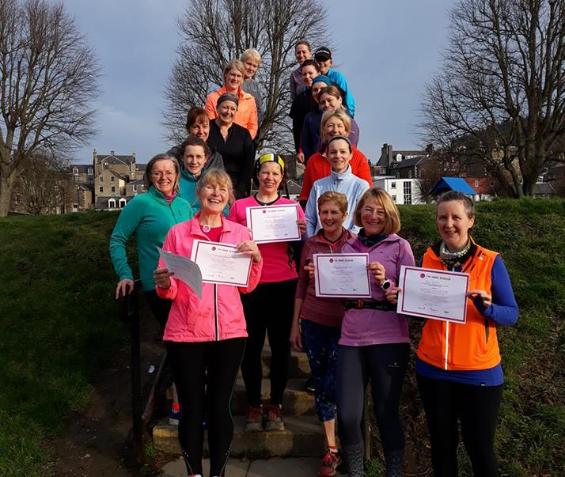
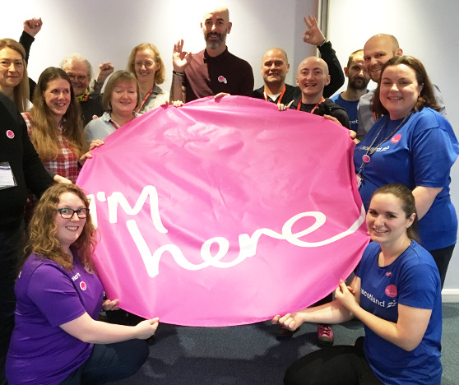
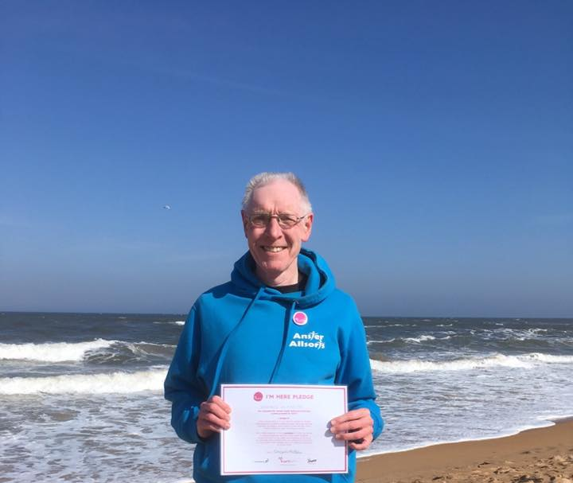
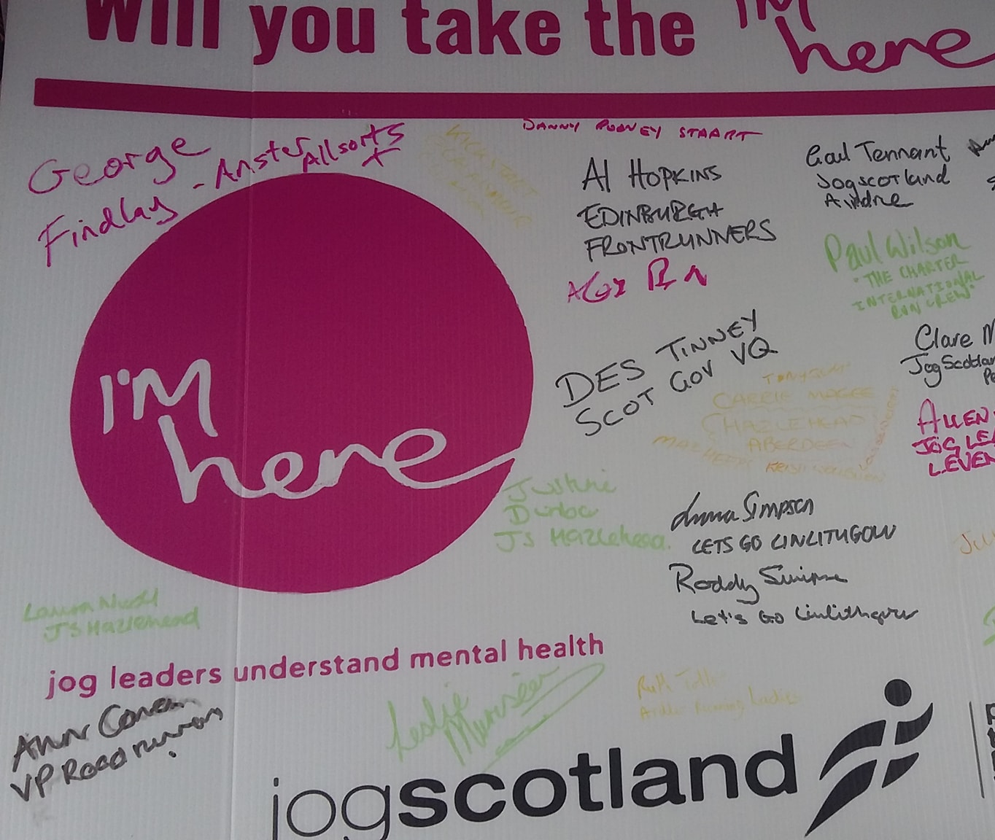

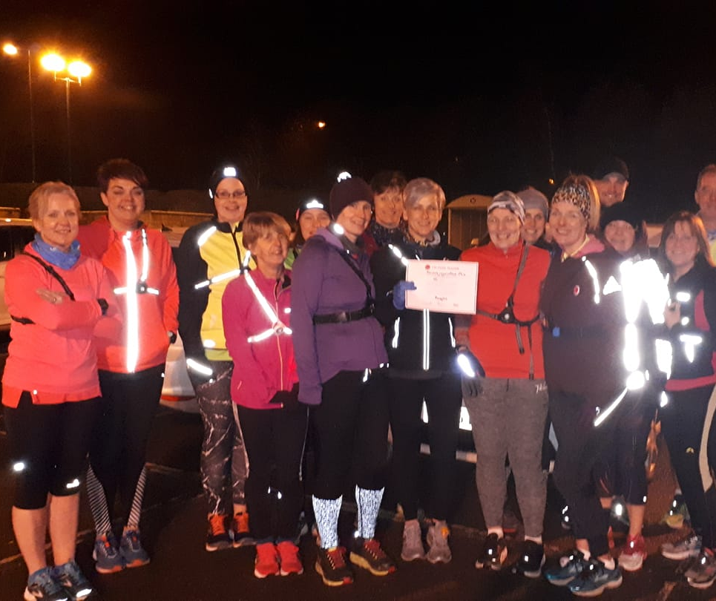

Slide 7
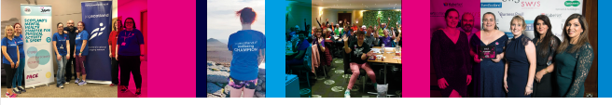
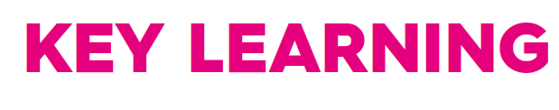
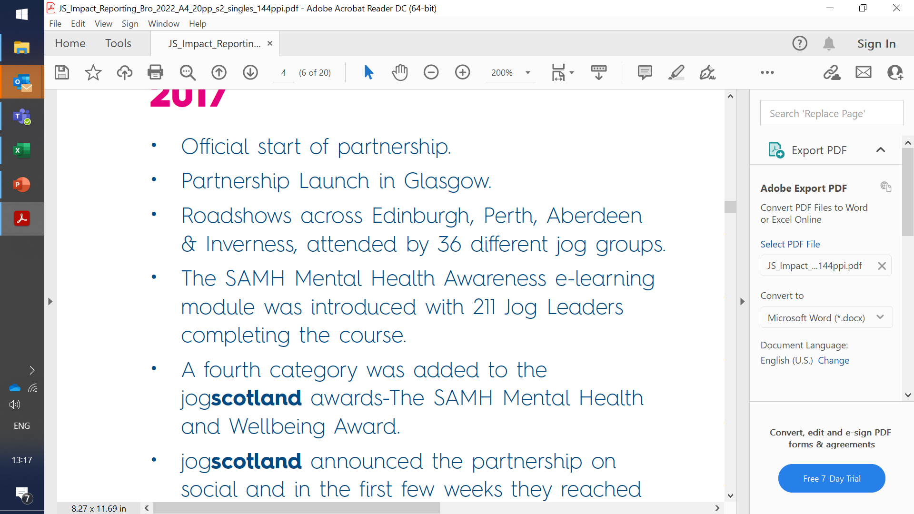
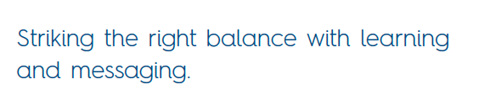
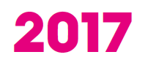
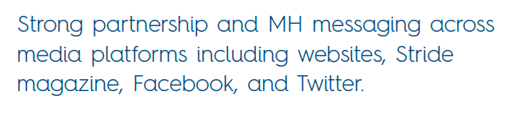
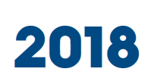
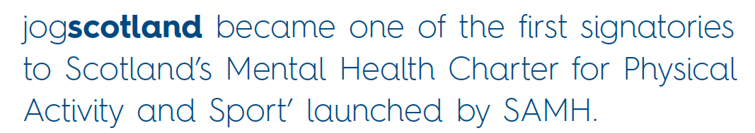
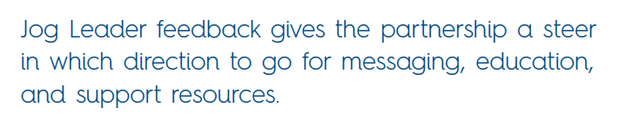
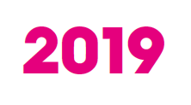
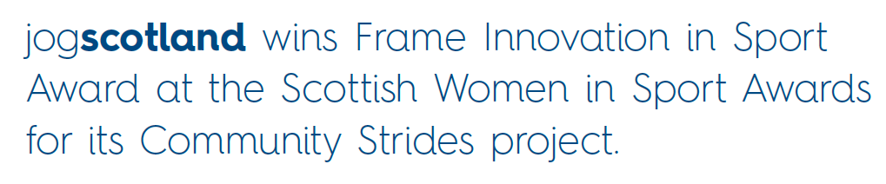
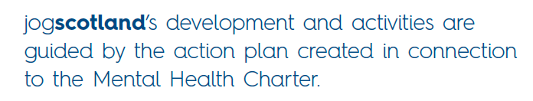
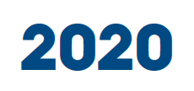
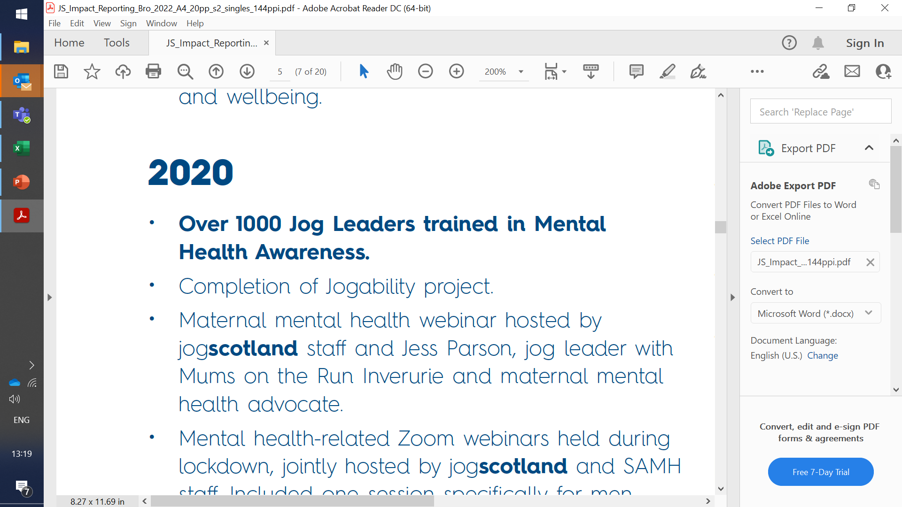
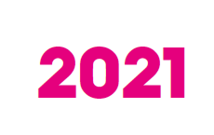
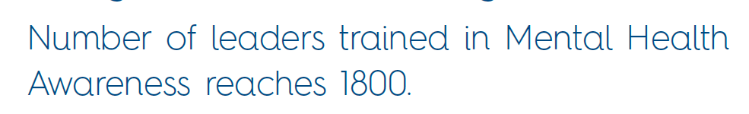

Notes:
We began with a series of roadshows across the country to introduce the leaders to SAMH and to run MHA workshops and to find out what they wanted/needed from the partnership. This really helped to shape the resources and activities that followed.
Next big milestone was signing the mental health charter and creating our action plan. We didn’t just create and action plan, we actually delivered on it
Raising awareness was one of our actions and we did that with Sammies Road Trip – huge buzz, reached local communities through press coverage, increased membership and saw lapsed members re-engaging with the groups once again

Slide 8

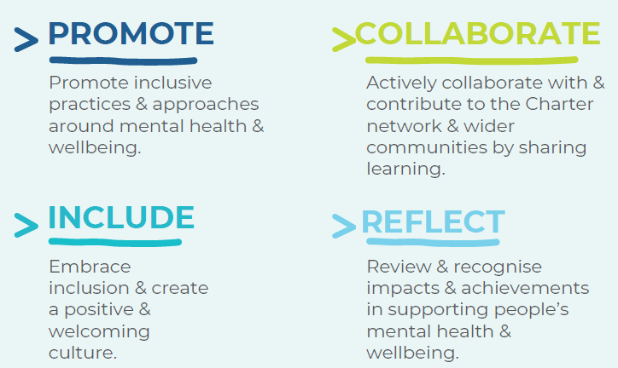




2021 Get Into Summer
  - Dedicated tools and resources to embed
  mental health and wellbeing into clubs
Feel Your Personal Best campaign
  - sportscotland
  Young People’s Forum (14-23)
  2022 Scotland’s Mental Health Charter for Sport
- Design, development & testing of resource
- Supported launch the charter
Menopause Friendly Jogging Groups
      - Moving Through Menopause research
2023 Ahead of the Game
- Movember
  - Athletes, Coaches, Parents
  Moving Through Menopause research
  Menopause Friendly Clubs
  YPF & National Club Conferences

Slide 9

Charity partner
Social impact group
First major sporting event to sign up to Scotland’s Mental Health Charter
Building Capacity across staff and volunteers
2 expert panel sessions, focussed on Mental Health (workplace & athletes)
City activation

Slide 10
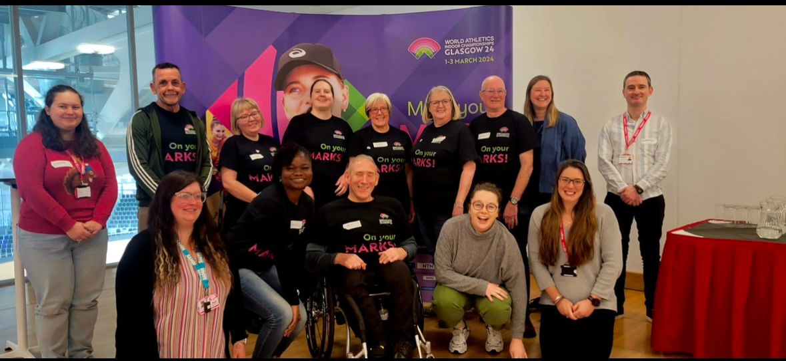
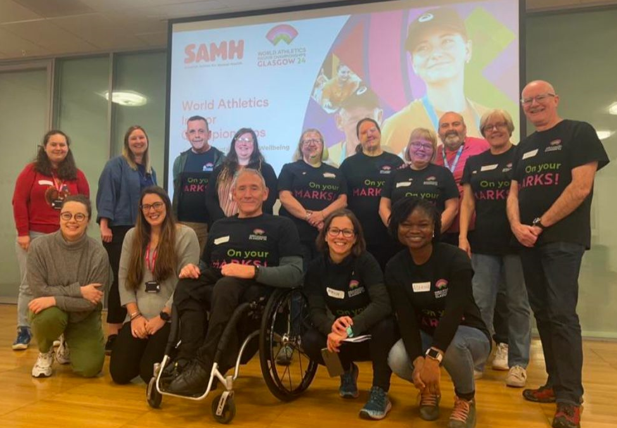
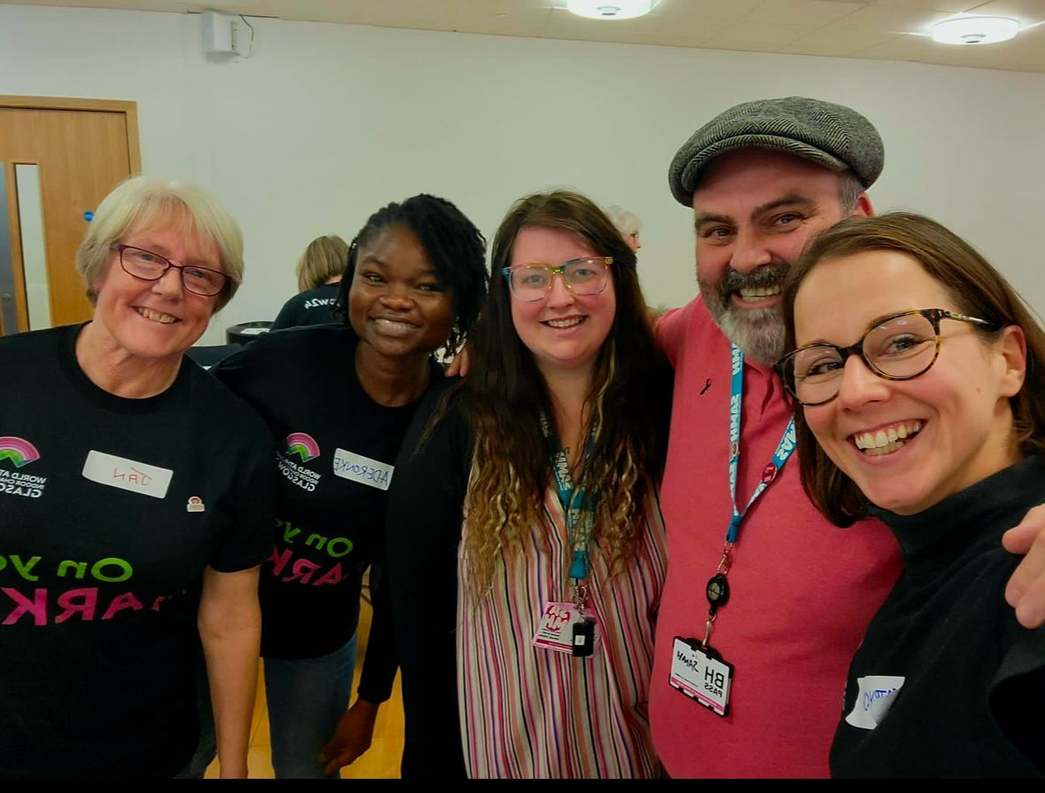

Slide 11

WAIC Legacy & Impact…
  Mental Health and Wellbeing for scottishathletics officials
    Establishing the Working Group
    For Officials, by officials
    I’m Here for officials
    Mentally healthy national championship events & event wellbeing champions
      Complete the online e-learning module
      Take the I’m here pledge
      Receive your badge
  Develop new mental health resources, through the lens of athletics officials
    Resources and education
    Communications

Slide 12
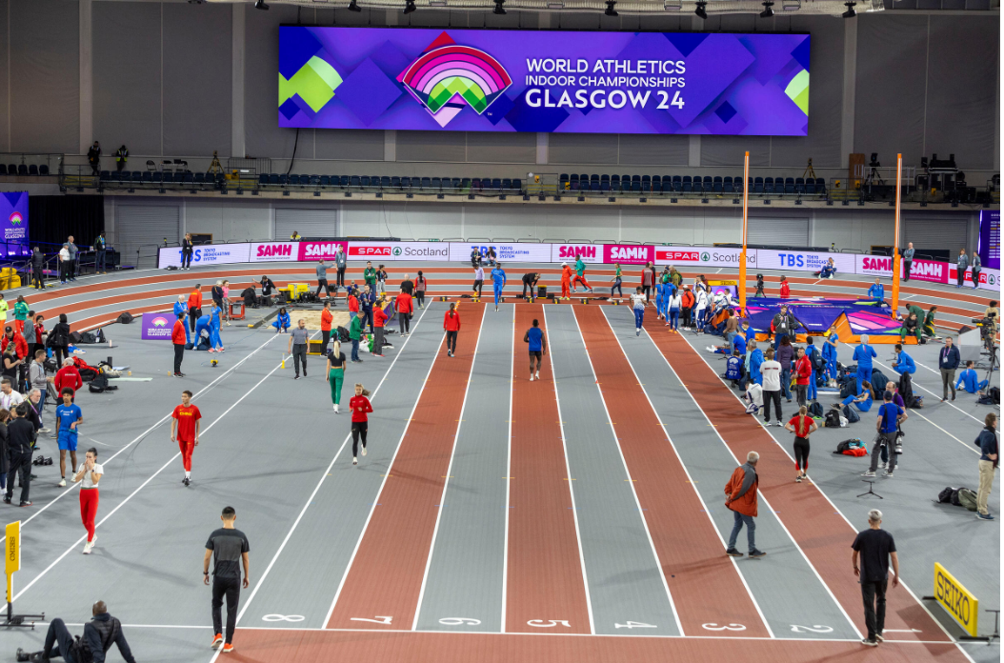
THANK YOU
Q&A

