Slide 2
The Call Room
Call Room Manager
Call Room Referee
Call Room Admin
Five Teams of three or four each with a team leader

Slide 3
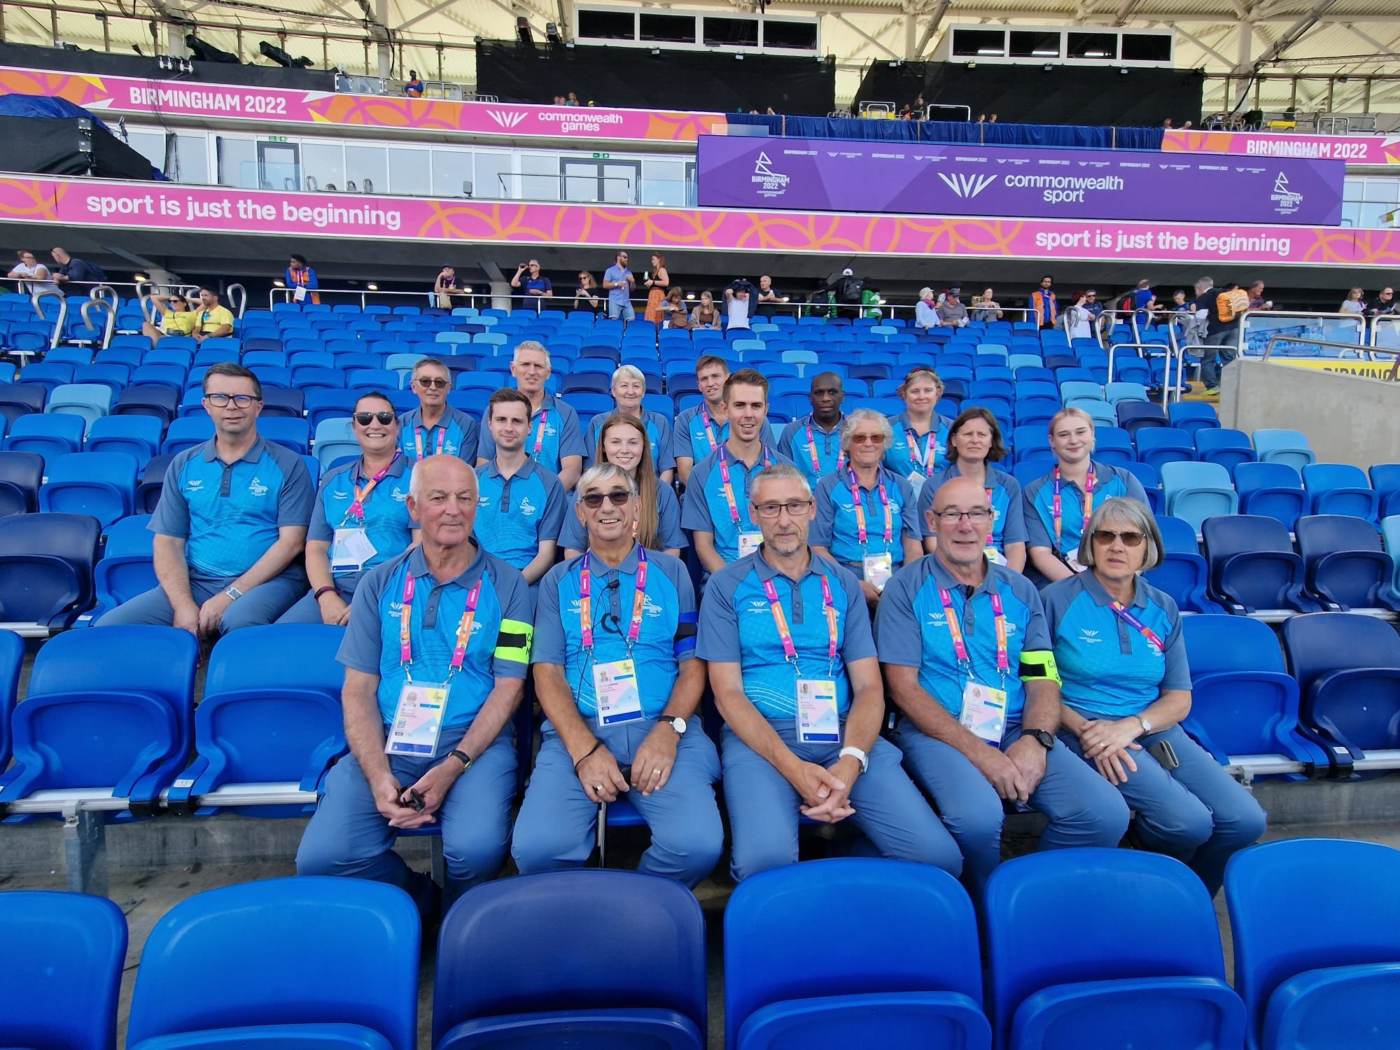

Slide 4
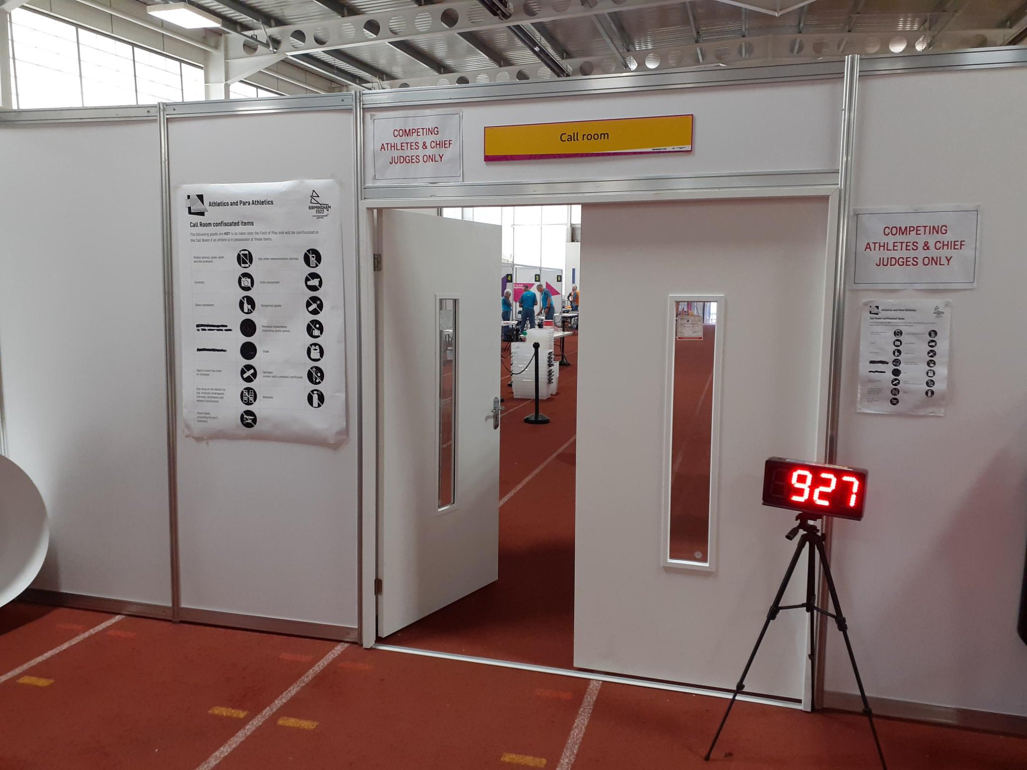

Slide 5
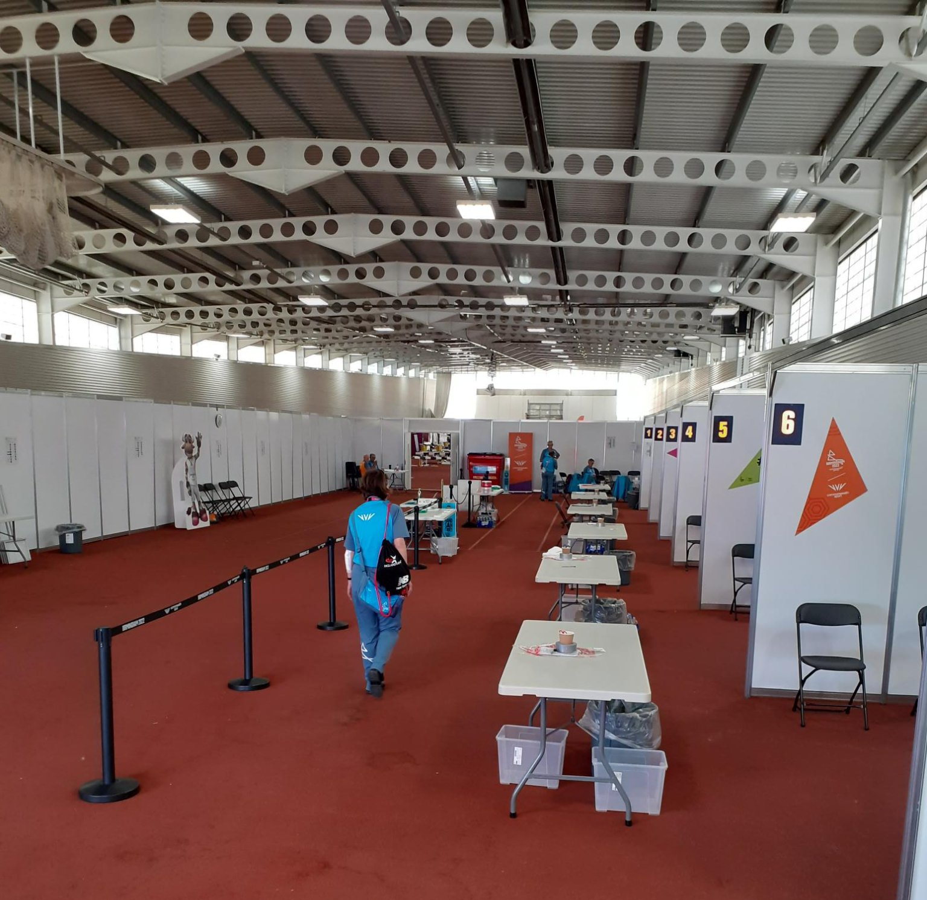

Slide 6
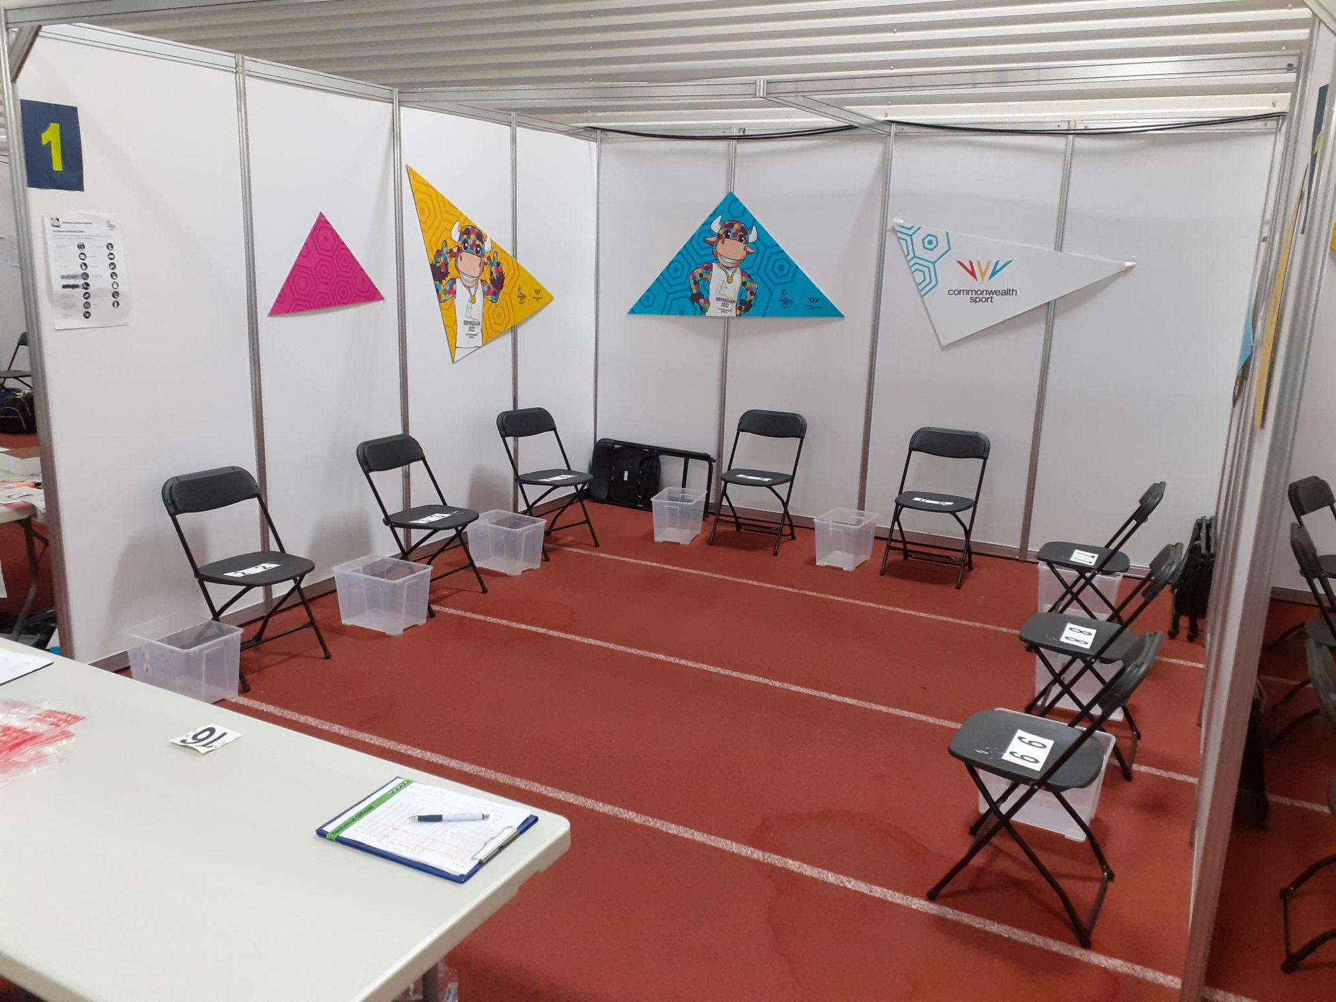

Slide 7
Track
Plan A – good weather, ready on track to race
Plan B – going out with outer wear
Field
Athletes go out with their kit and kit bags
Para
Wheel chairs / frames / aids

Slide 8
Track – Plan A
Race Ready
Check correct kit + transponder
Check correct name against paperwork
Tick each athlete present on EACH sheet
DNS for absent athletes on each sheet
DNS names to OMEGA team
One copy of paperwork to stay in call room
4 pins on bibs
Spikes – check length & number
Leg numbers + pinned – East / West

Slide 9
Track – Plan B
Check correct kit + transponder
Check correct name against paperwork
Tick each athlete present on EACH sheet
DNS for absent athletes on each sheet
DNS names to OMEGA team
One copy of paperwork to stay in call room
4 pins on bibs
Spikes – check length & number
Leg numbers + pinned – East / West
Check bags for anything undeclared
Confiscate any communication devices e.g., mobile phones
Bag and receipt confiscations

Slide 10
Checklist for Field Events
Checking correct name against paperwork
Tick each athlete present on each sheet
DNS for absent athletes on each sheet
DNS names to OMEGA team
One copy of paperwork to stay in call room
4 pins on bibs
Check with judge regarding vests on / off
Check bags – inspect for anything undeclared
Confiscate any communication devices e.g., mobile phones
Bag & receipt confiscations

Slide 11
Checklist for Para Athletic Events
Wheelchairs – height of front & rear wheels
Wheelchairs – frame rear
Numbers on helmets in racing position
4 pins on bibs
Height of frames
Check for confiscations

Slide 12
Together, we WILL make it work !

