Slide 1
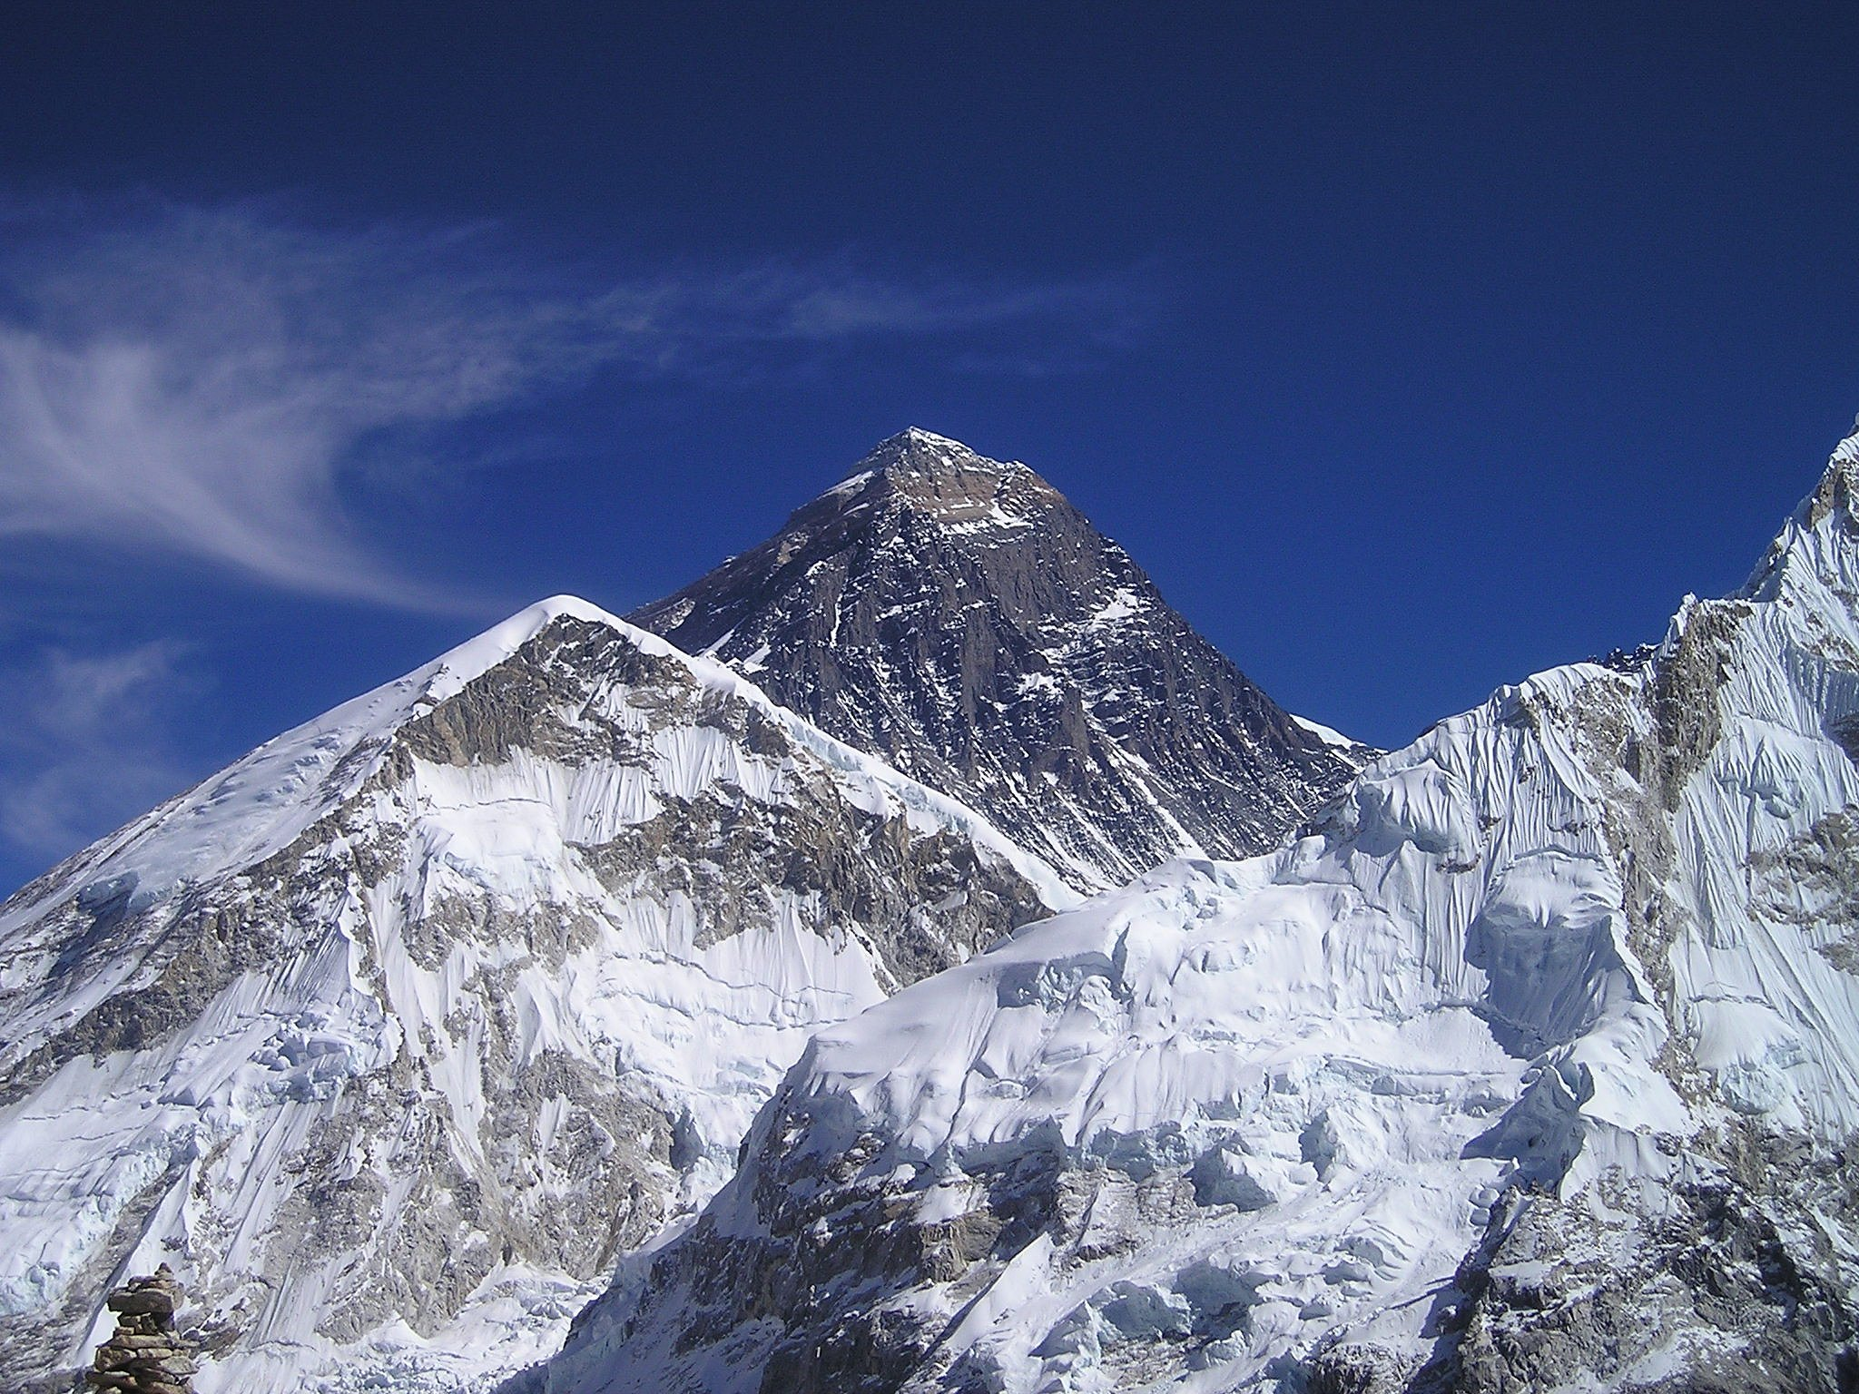
The Big Picture

Slide 2
Let’s start with the OBVIOUS.
We’re all on the same team!

Slide 3
Every official should feel supported and appreciated
Everyone has to work together to make a successful meeting
Everyone is valued as a member of the team
Every discipline is vital
We know these are true
but how do we achieve
them in practice

Slide 4
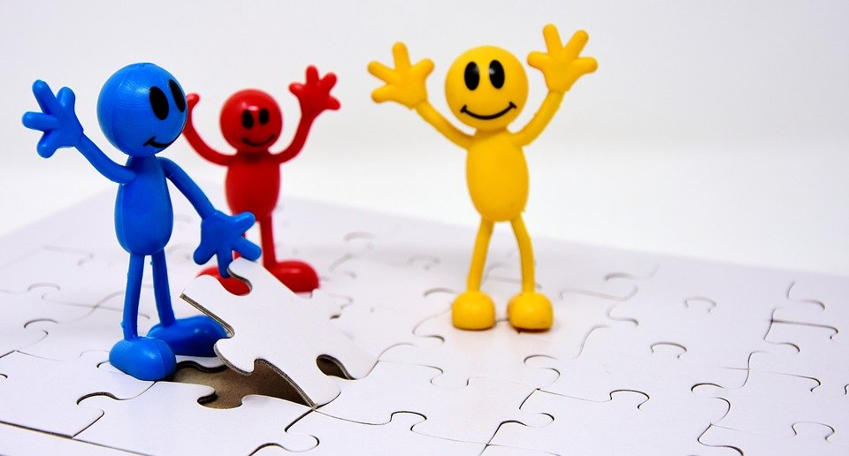
For every official there
Are times when things
Go wrong
Hands up if you have never made a mistake

Slide 5
How we support each other should be based On an understanding of the Complexities of every role

Slide 6
Difficult
Decisions
What happens when an athlete arrives 15 minutes after their declaration time?

Slide 7
Our band of willing
volunteers are going to act this out
Scene 1 – Throwing your fellow officials under the bus. A purely fictional account
Scene 2 – Working together

Slide 8
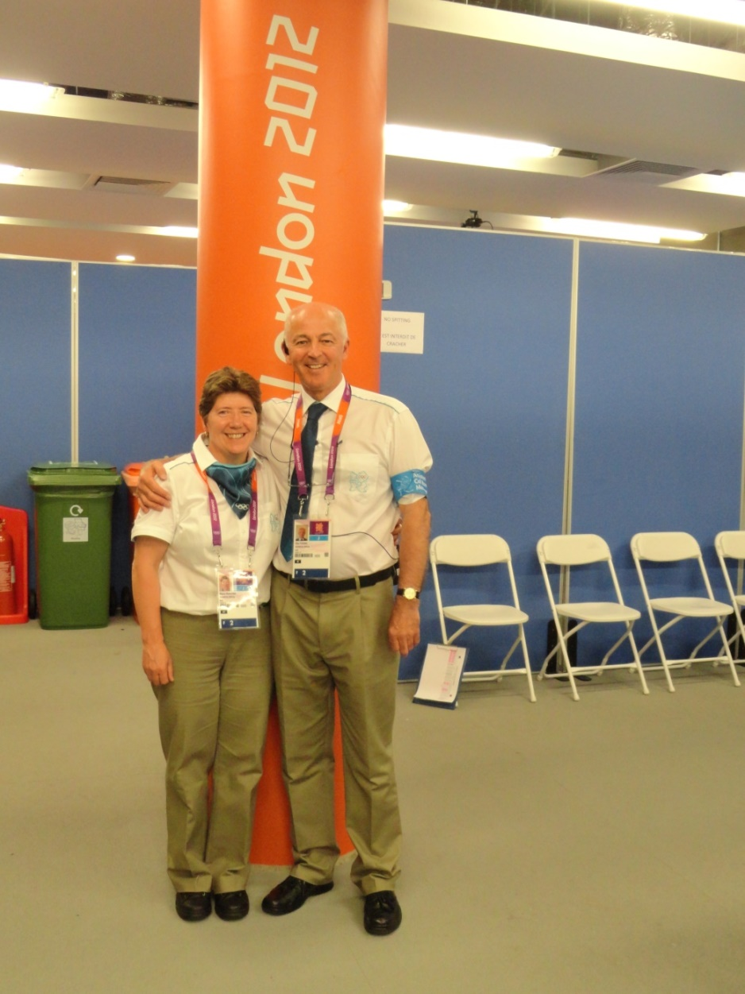
How does the Call Room
work with these
Disciplines?
Field Officials
Start Team
Photo Finish
Seeding

Slide 9
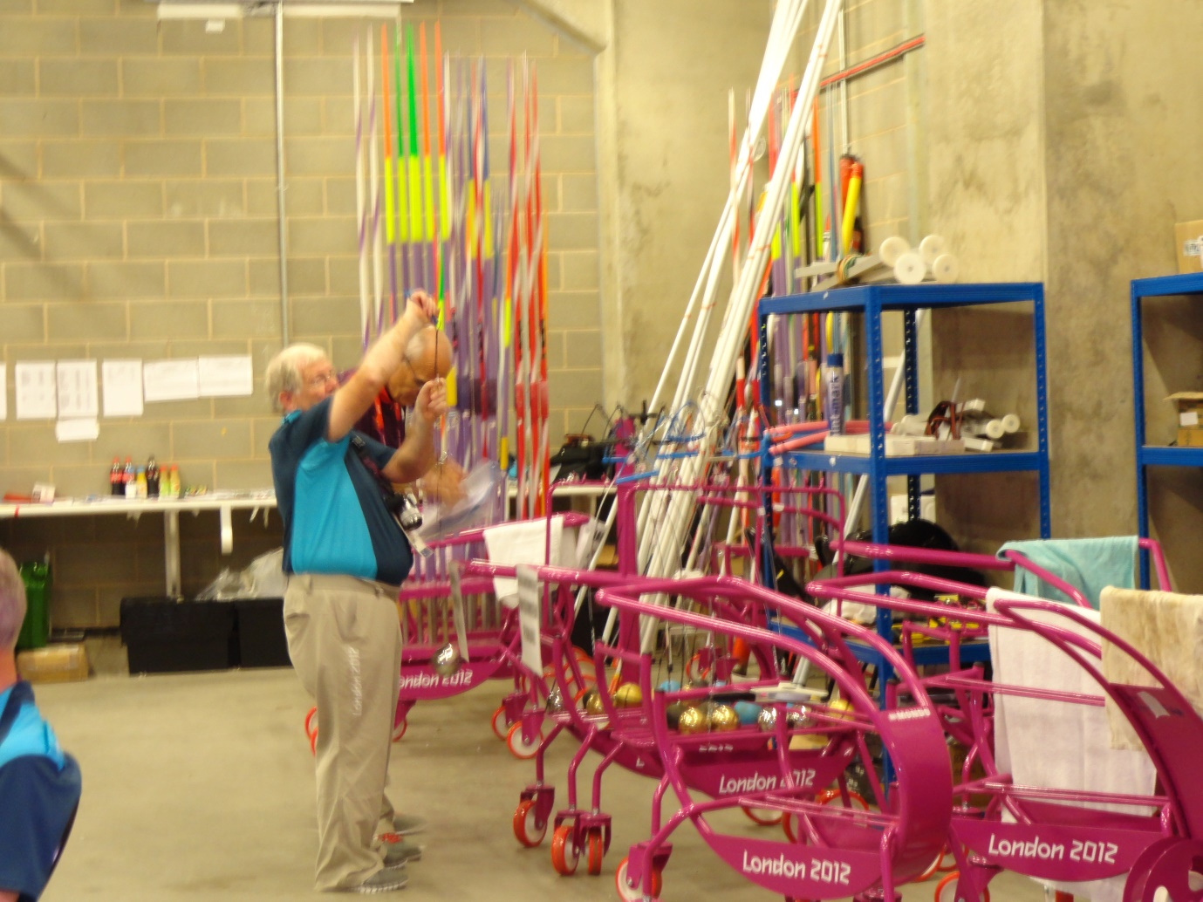
The
Tech
team
What do they do?

Slide 10
Challenge
First team to list 10 tasks
carried out by Tech Team
Extra Rule – you can only use each verb once

Slide 11
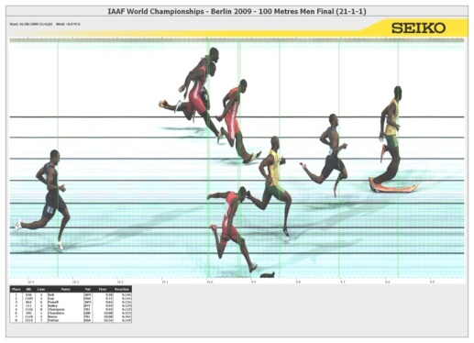
photo finish,Track, field, start and admin
COMMUNICATION,COMMUNICATION,
COMMUNICATION- Which vital Radio Messages should be getting through?

Slide 12
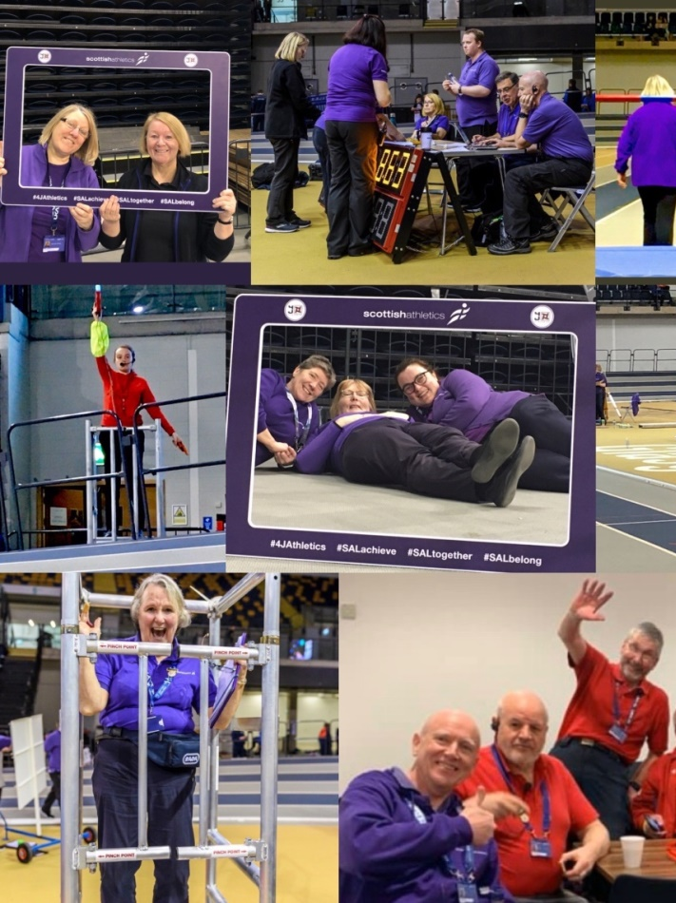
Obviously officiating is a serious business!!!!
In Scotland we are proud of our professional performance.
But, it should be fun for everyone.
If there are times when clashes happen between officials, that can really affect moral.

Slide 13
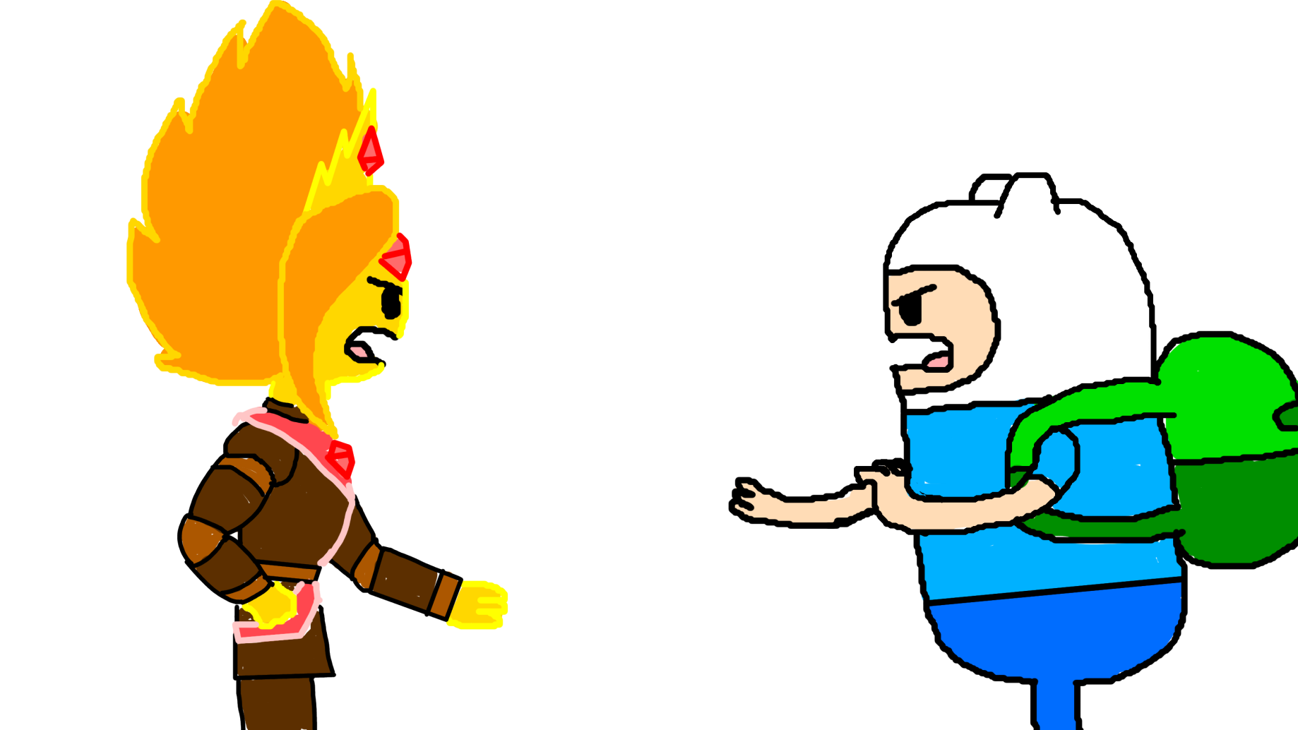
Let’s look at a few
Possible
Flash points

Slide 14
Start and Long Jump
Use of the space
Leading Out Athletes

Slide 15
Things to tell new officials to avoid
Tripping over the Track Edge
Stepping out in front of a moving athlete
Being hit by a flying implement
Being hit by a falling bar or pole at the Pole Vault
Standing too close to the cage
Crossing the finish line while race is in progress
Knocking over the PF camera
Failing to appreciate and help each other
If we look out for each other and work together we should have………

Slide 16
A WINNING TEAM!!

Slide 17
One More Challenge
Unscramble these to get words to describe a good official
SUOITNEICSNOC
DIESRNAOTCE
OMCILNEGW
FUHEPLL
ENDRFIYL
NIKD
DEGLEWAOBNLKE
PRTPOUSIEV

Slide 18
One More Challenge
So how many did you get….
CONSCIENTIOUS
CONSIDERATE
WELCOMING
HELPFUL
FRIENDLY
KIND
KNOWLEDGEABLE
SUPPORTIVE

