Slide 1
Road Race Course Measurement
Mike Burns
Course Measurement Coordinator, Scottish Athletics
Secretary, Association of UK Course Measurers (AUKCM)
Area Course Measurement Secretary, AUKCM, Scotland

Slide 2
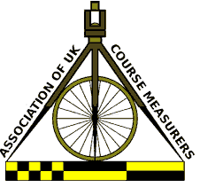

Slide 3
The Association of UK Course Measurers (AUKCM) maintains a system for the measurement and certification of road running courses in the UK. The Association was formed in January 2010. Reconstituted in February 2017 as a company limited by guarantee. AUKCM will certify courses on behalf of bodies which have rules regarding the measurement and certification of their courses (Scottish Athletics, Athletics England, Athletics Wales and the Association of Running Clubs). The activities of the Association are funded by a modest Measurement Registration Fee paid by governing bodies to AUKCM for each measurement.

Slide 4
Course Measurers
AUKCM Grade 2: qualified to measure any race other than national championships;
AUKCM Grade1: qualified to measure any race, including national championships;
World Athletics/AIMS Grade A & B: qualified to measure AIMS registered international races.

Slide 5
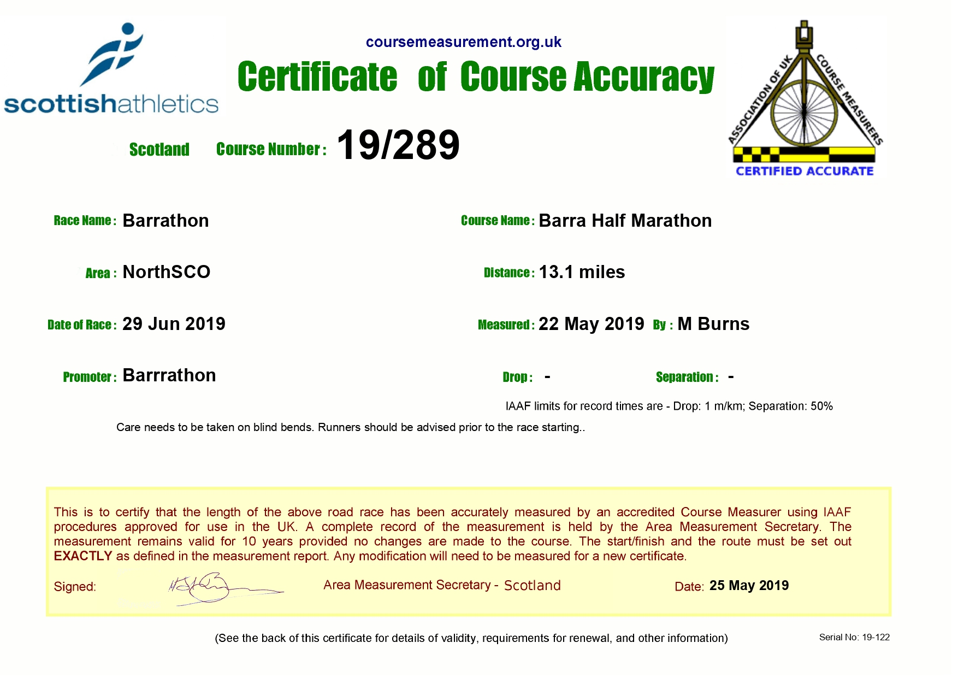
As with track races, road runners
want to know that the race distance is accurate; Any race advertising a specific distance must have a Certificate of Course Accuracy to receive a Scottish Athletics licence.

Slide 6
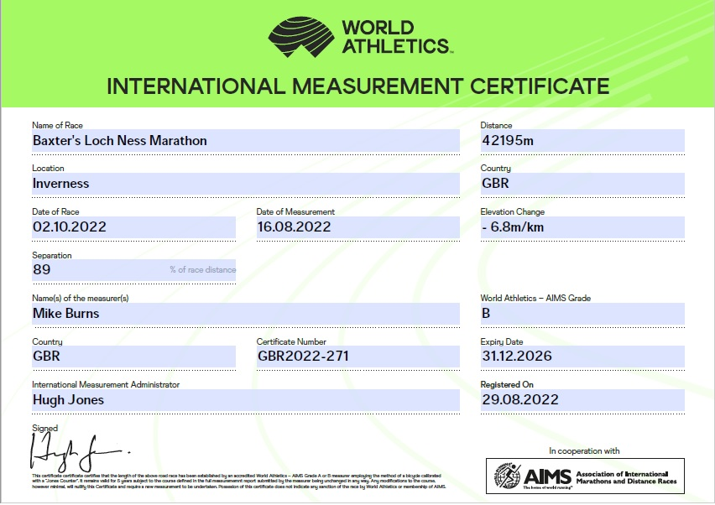
World Athletics and AIMS
only recognise races that have
been measured to WA standards using approved measurement practices.

Slide 7
Certificates of Course Accuracy
2015 | 16
2016 | 5
2017 | 15
2018 | 133
2019 | 232
2020 | 123
2021 | 191
2022 (to date) | 214

Slide 8
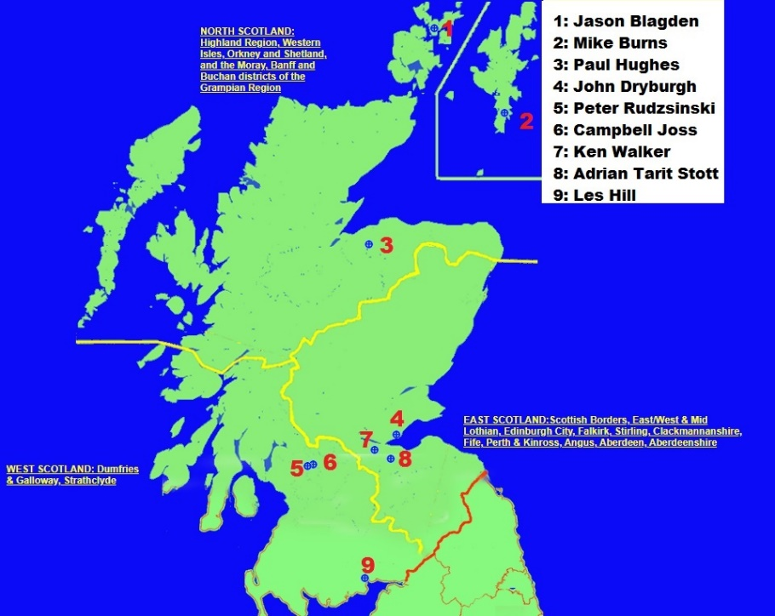

Slide 9
