Slide 1
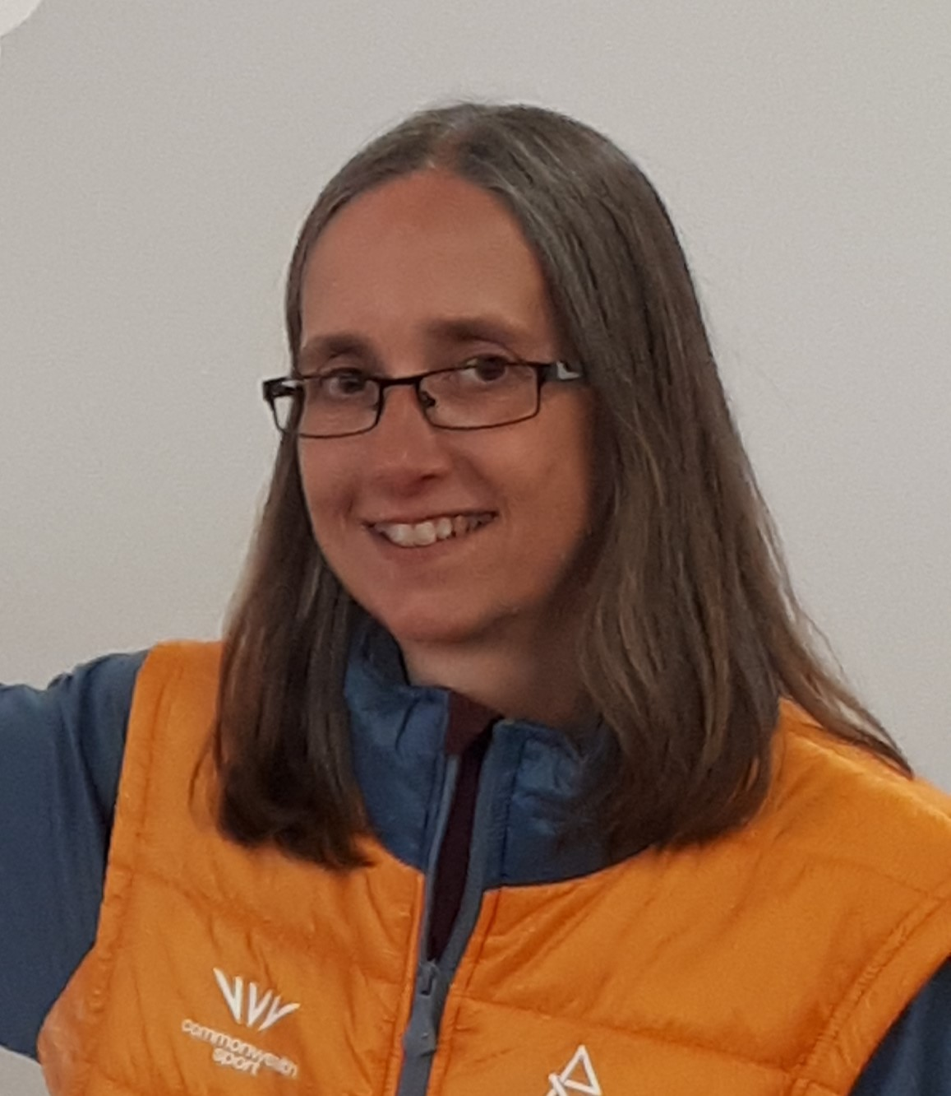
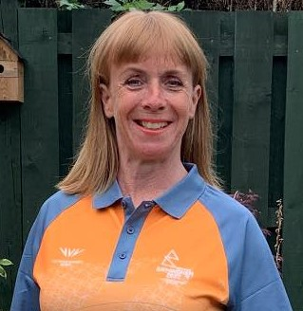
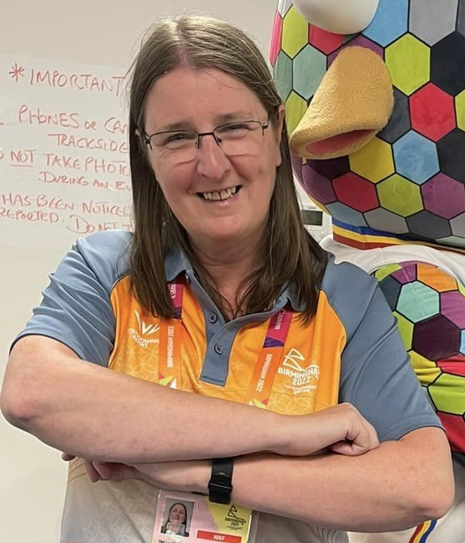
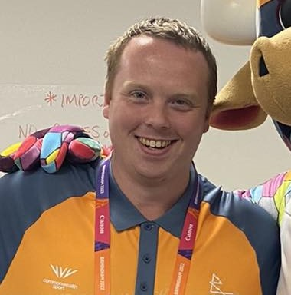
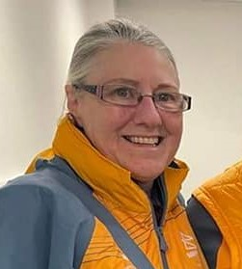
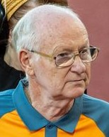
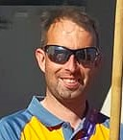
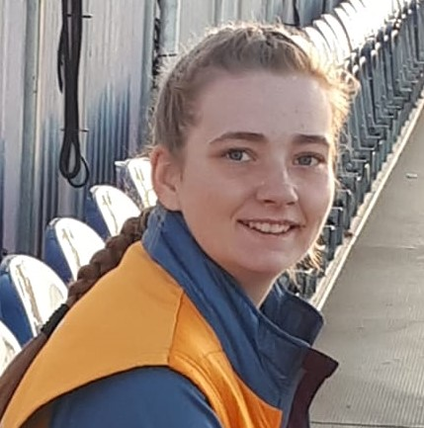
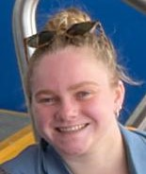
‘The Scottish Collective’
(Volunteers!)
Pauline Pearson
Gillian Lindsay

Slide 2
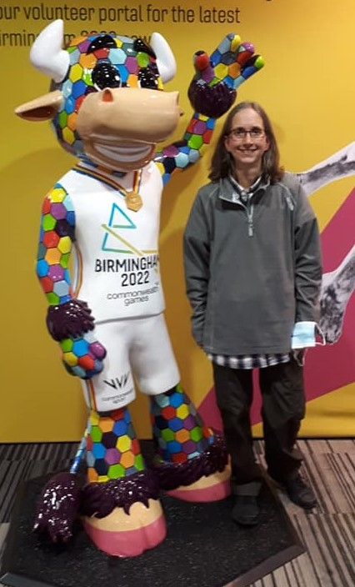
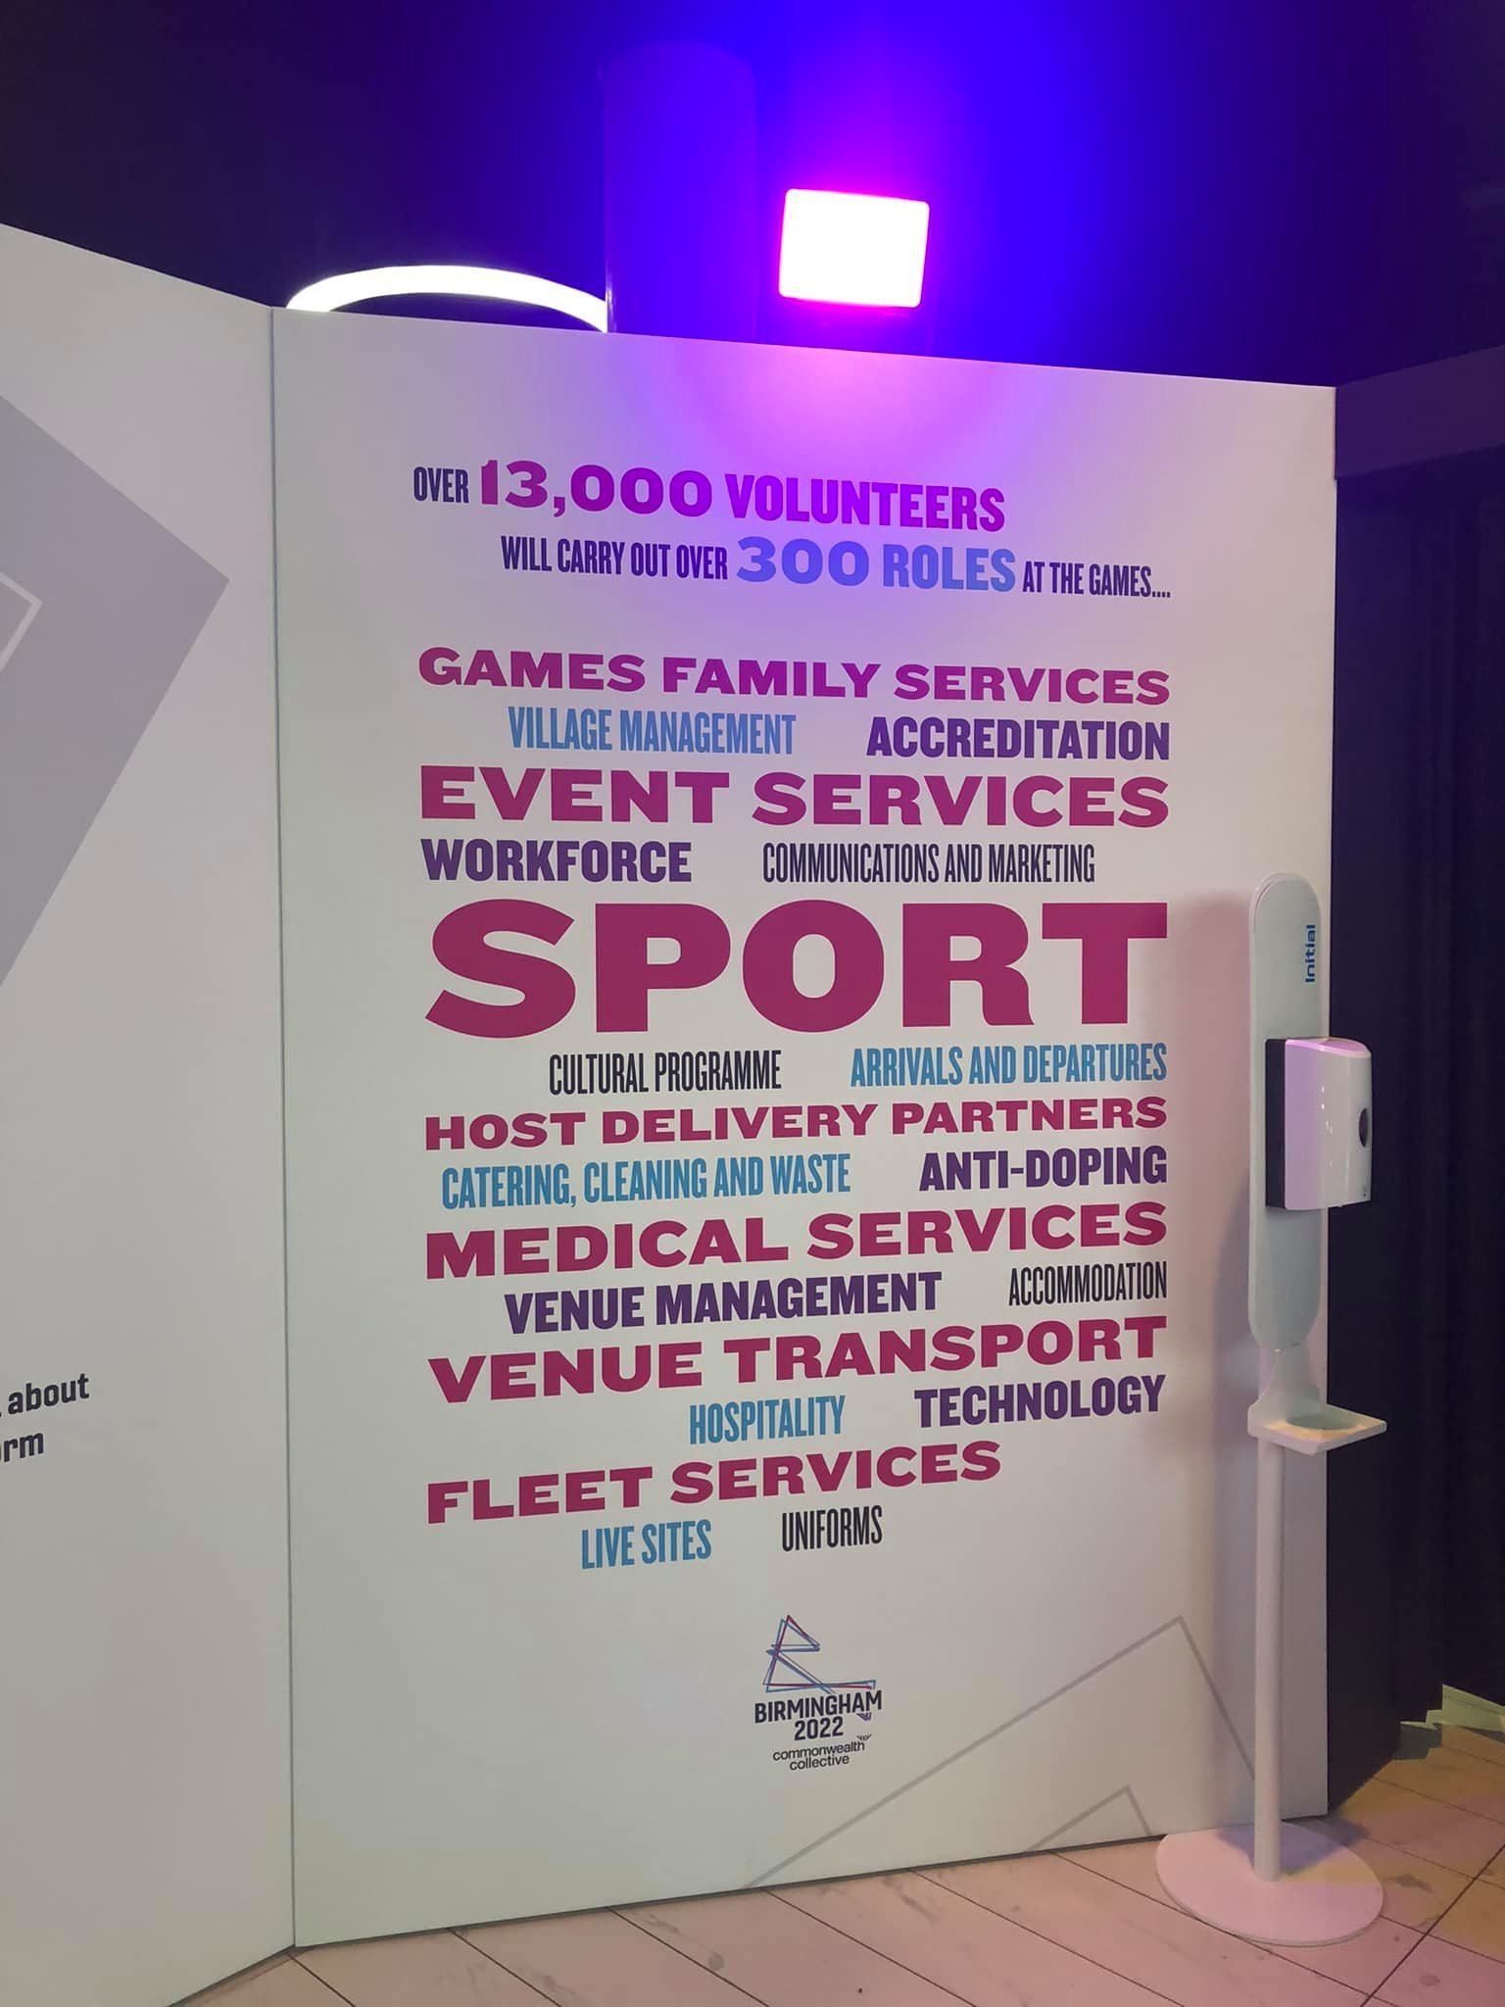
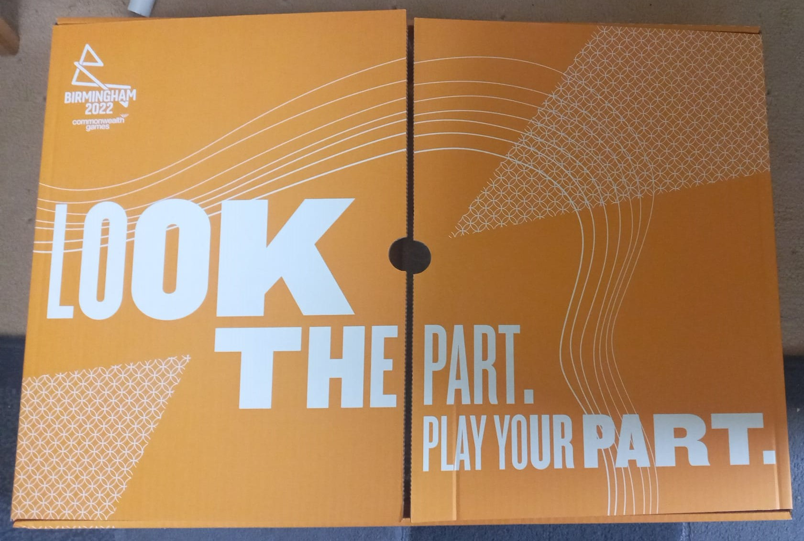
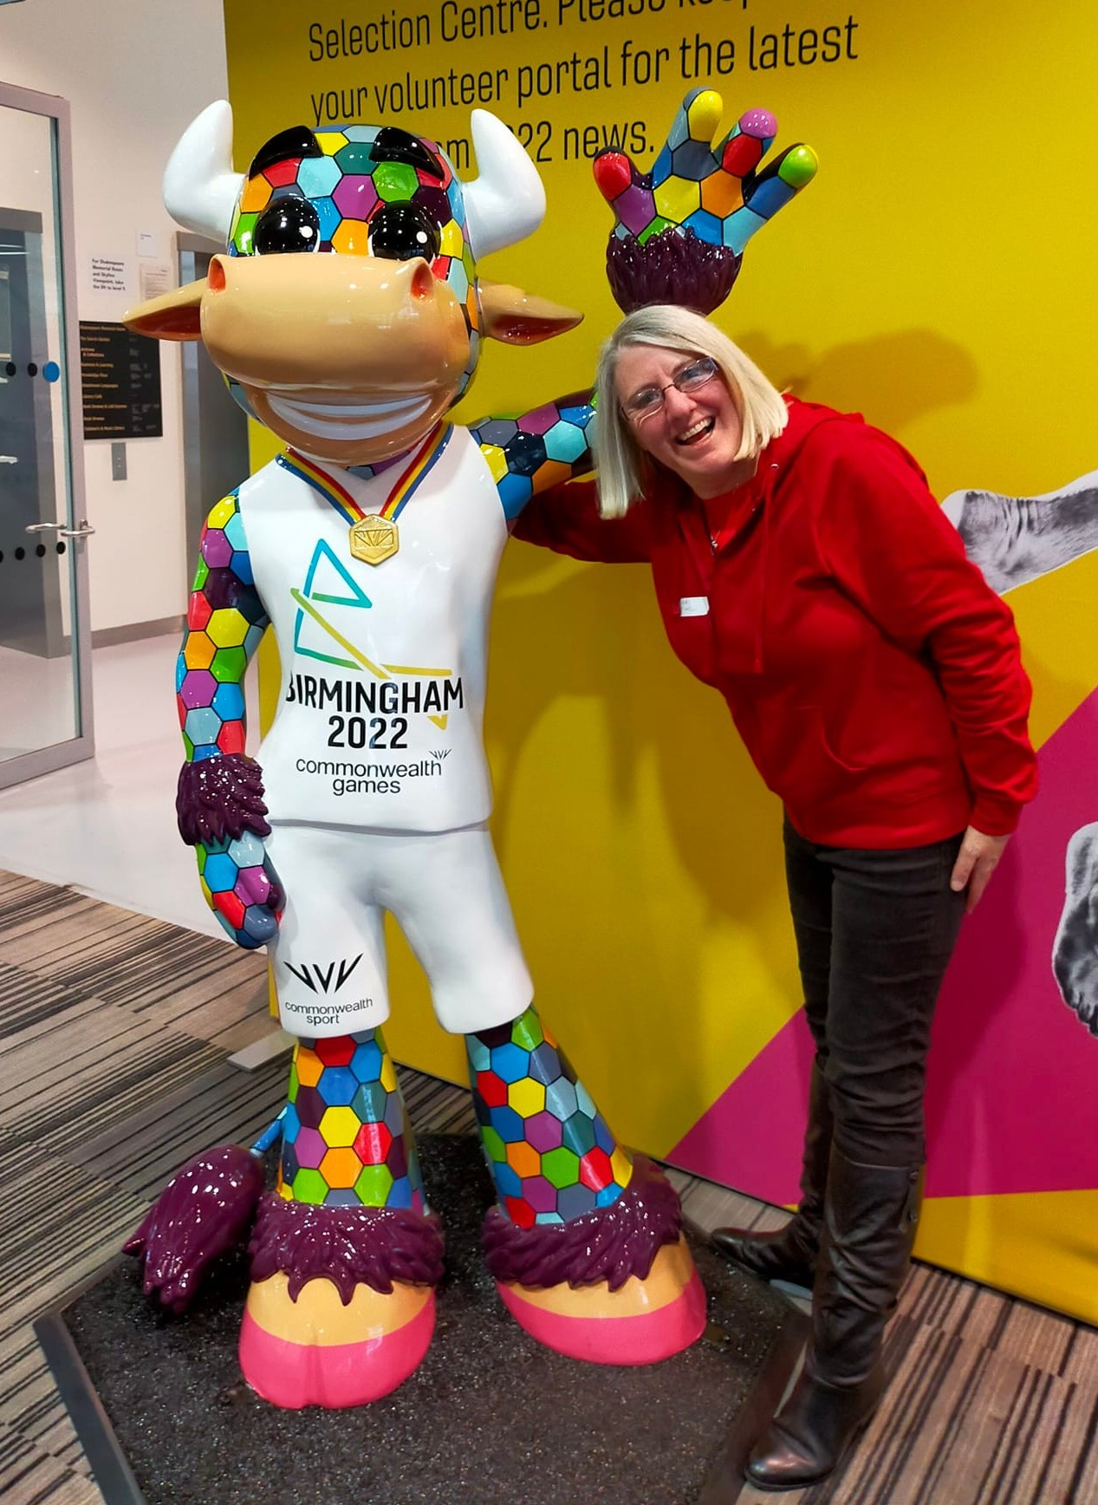
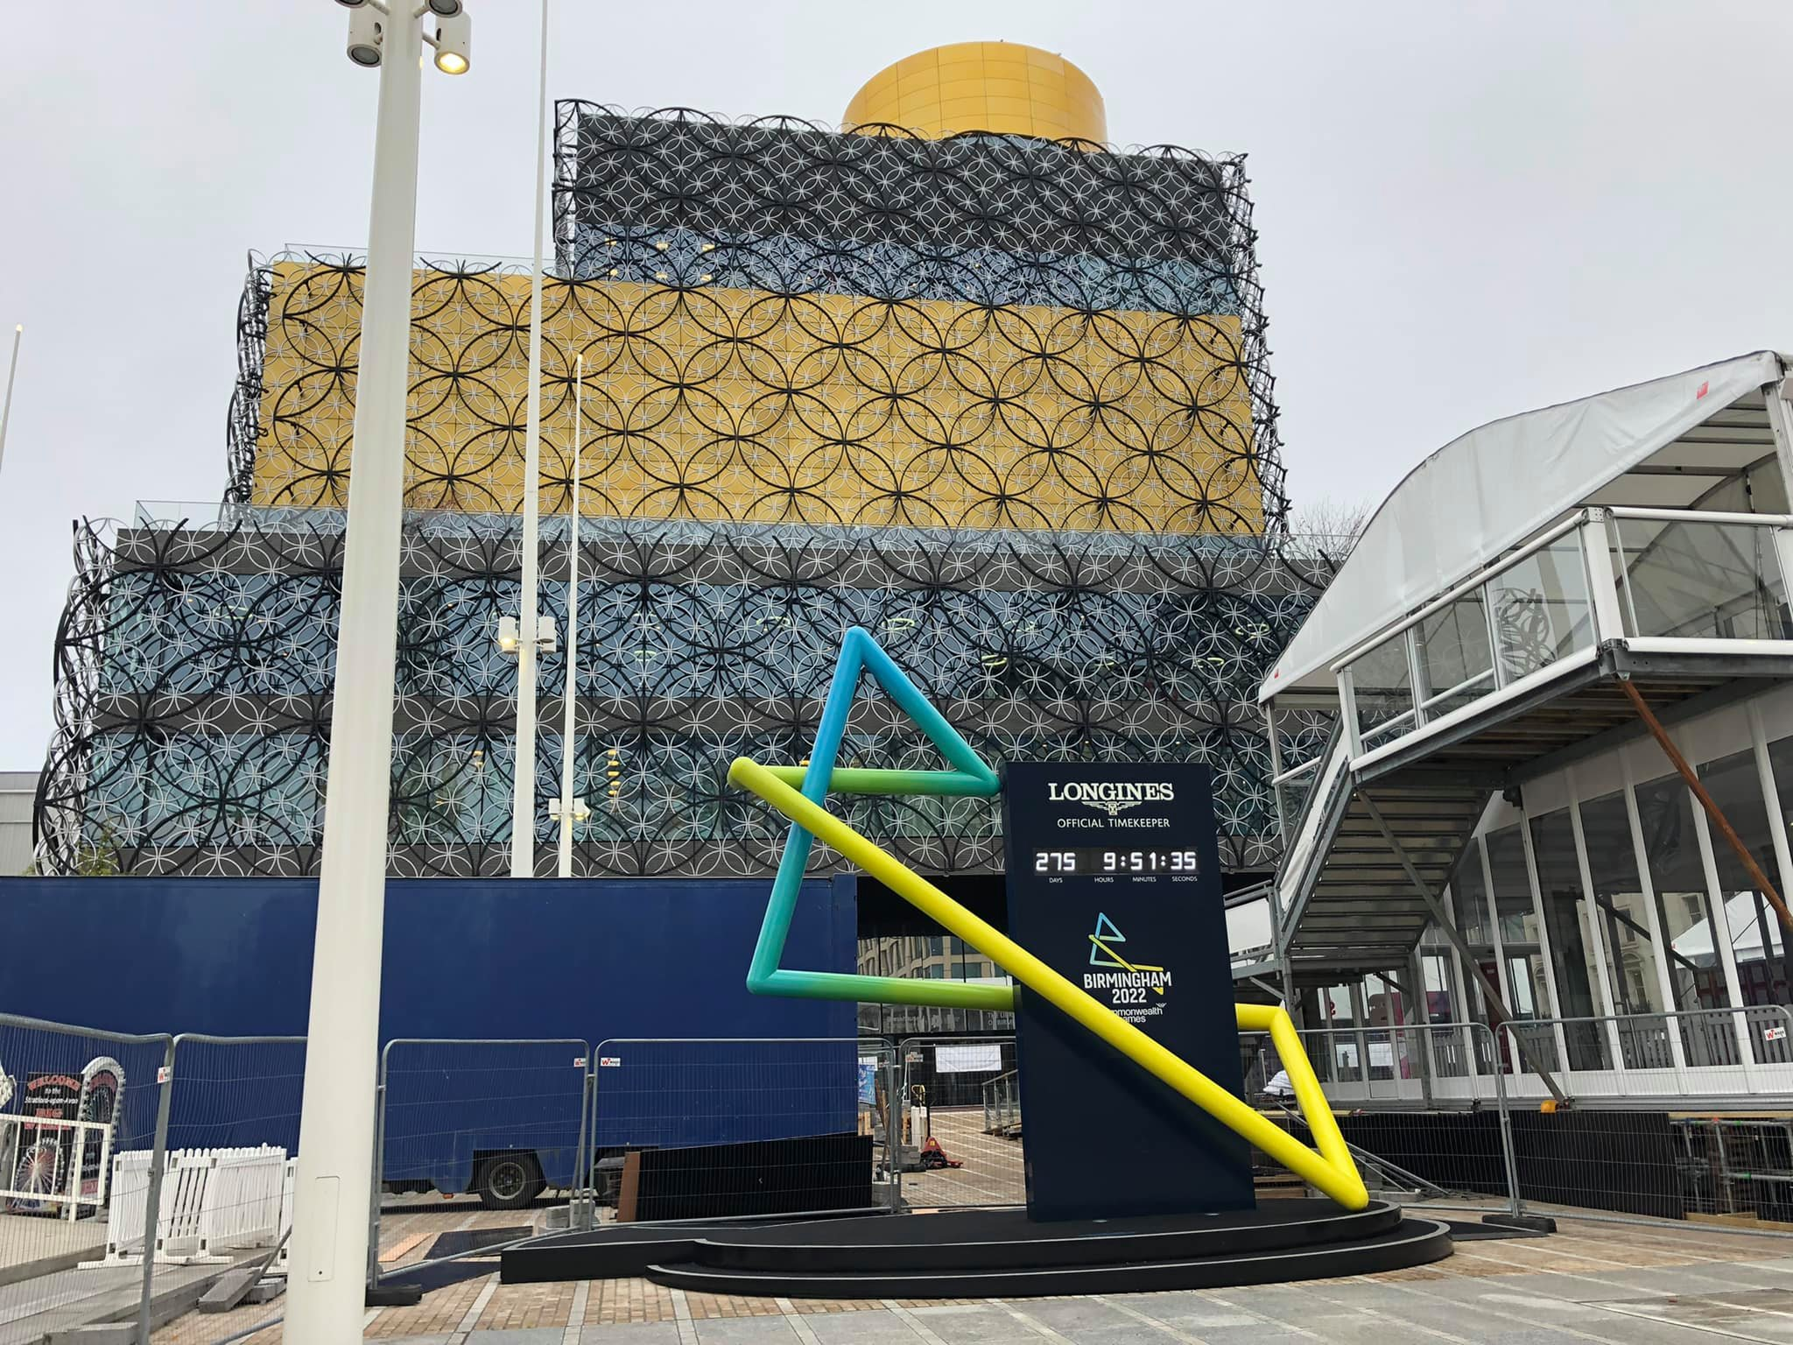
The Volunteer Journey
Summer 2021 – Submit Application
October 2021 – Interview at Birmingham Library
Our first opportunity to find out more about the volunteer roles, meet other prospective volunteers and meet Perry!
March 2021 – Receive volunteer role offers
April 2021 – Orientation Event – online
May 2021 – Role Specific Training in Birmingham
An introduction to our volunteer roles and an opportunity to meet others selected for similar roles.
June/July 2021 – Uniform delivered to homes
July 2021 – Venue Specific Training
July/August 2021 – Attend the Games!
Arrange and book accommodation
Arrange travel to/from Birmingham
Arrange travel to/from venue for shifts

Slide 3
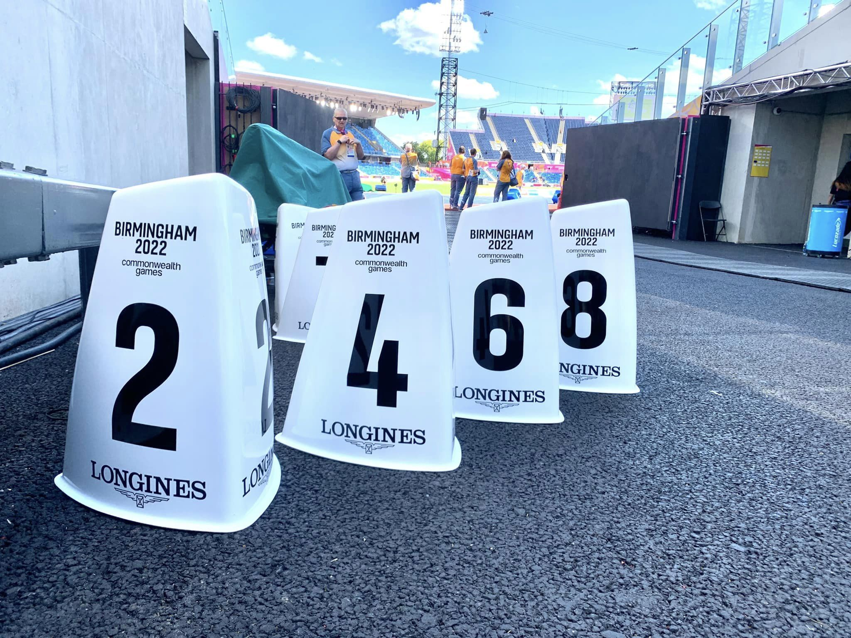
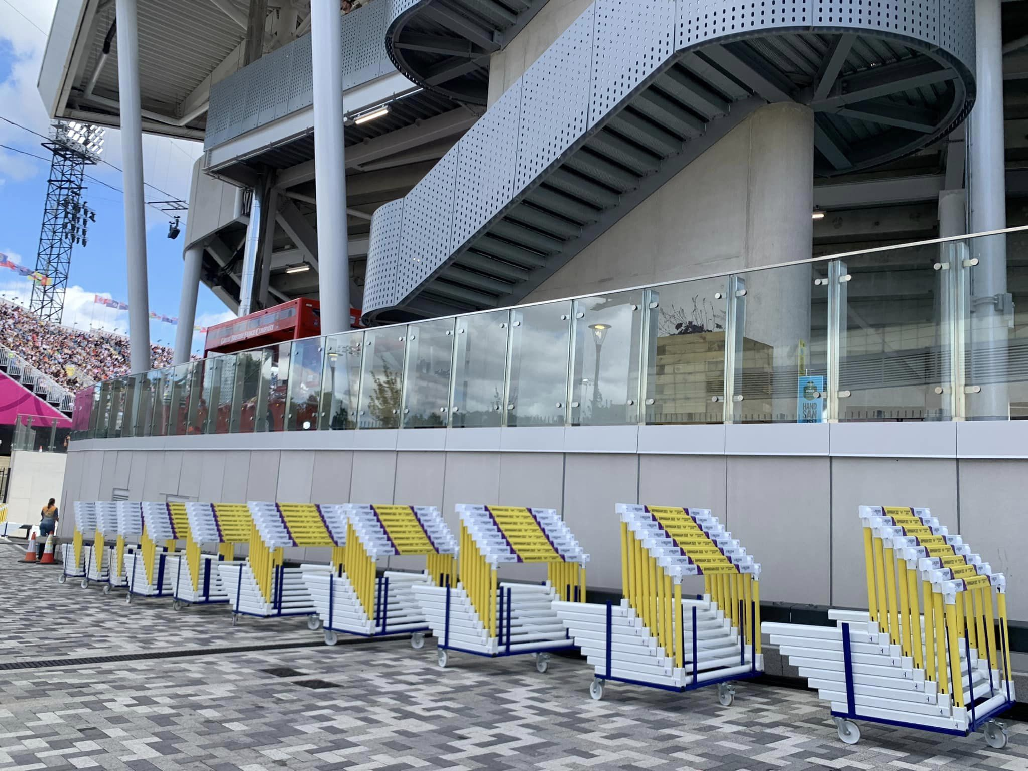
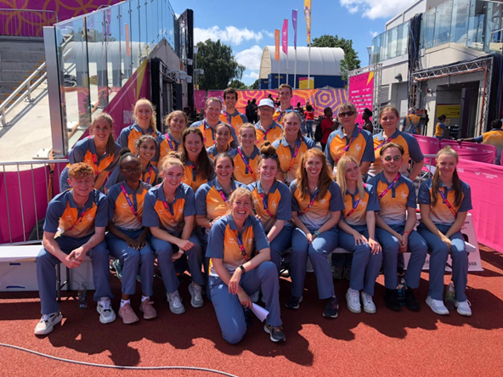
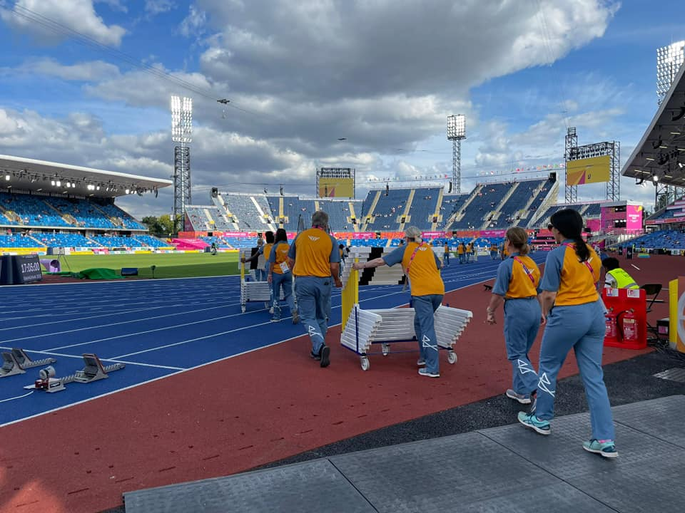
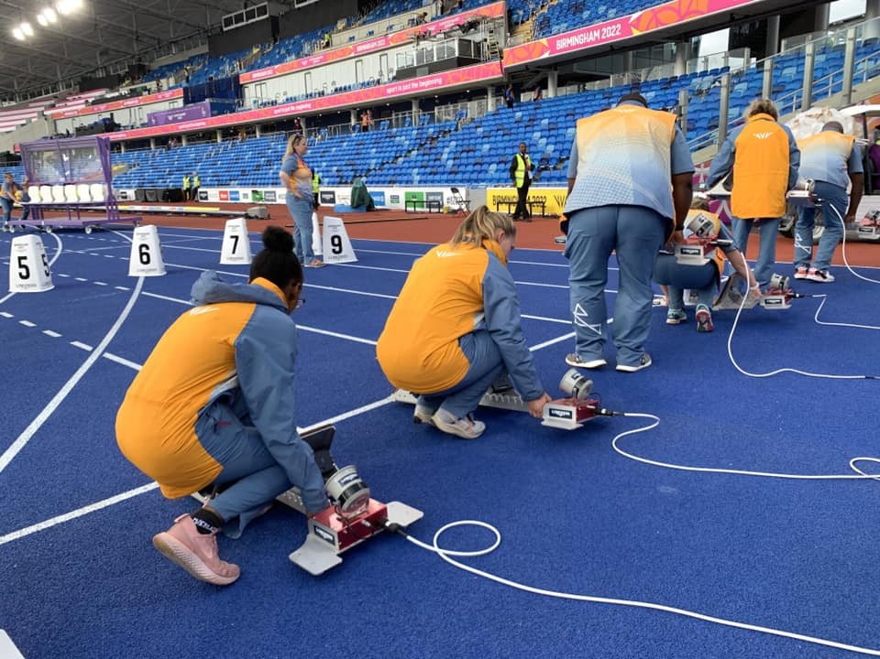
FOP (Field of Play)
Carolyn, Gary, Isobel, Jan, John, Kevin, Moira, Rebekah, Stewart
Marathon
Blocks and Lane Markers
Hurdles and Steeplechase
Tie Downs (Seated Shot Put)
Sandpit

Slide 4
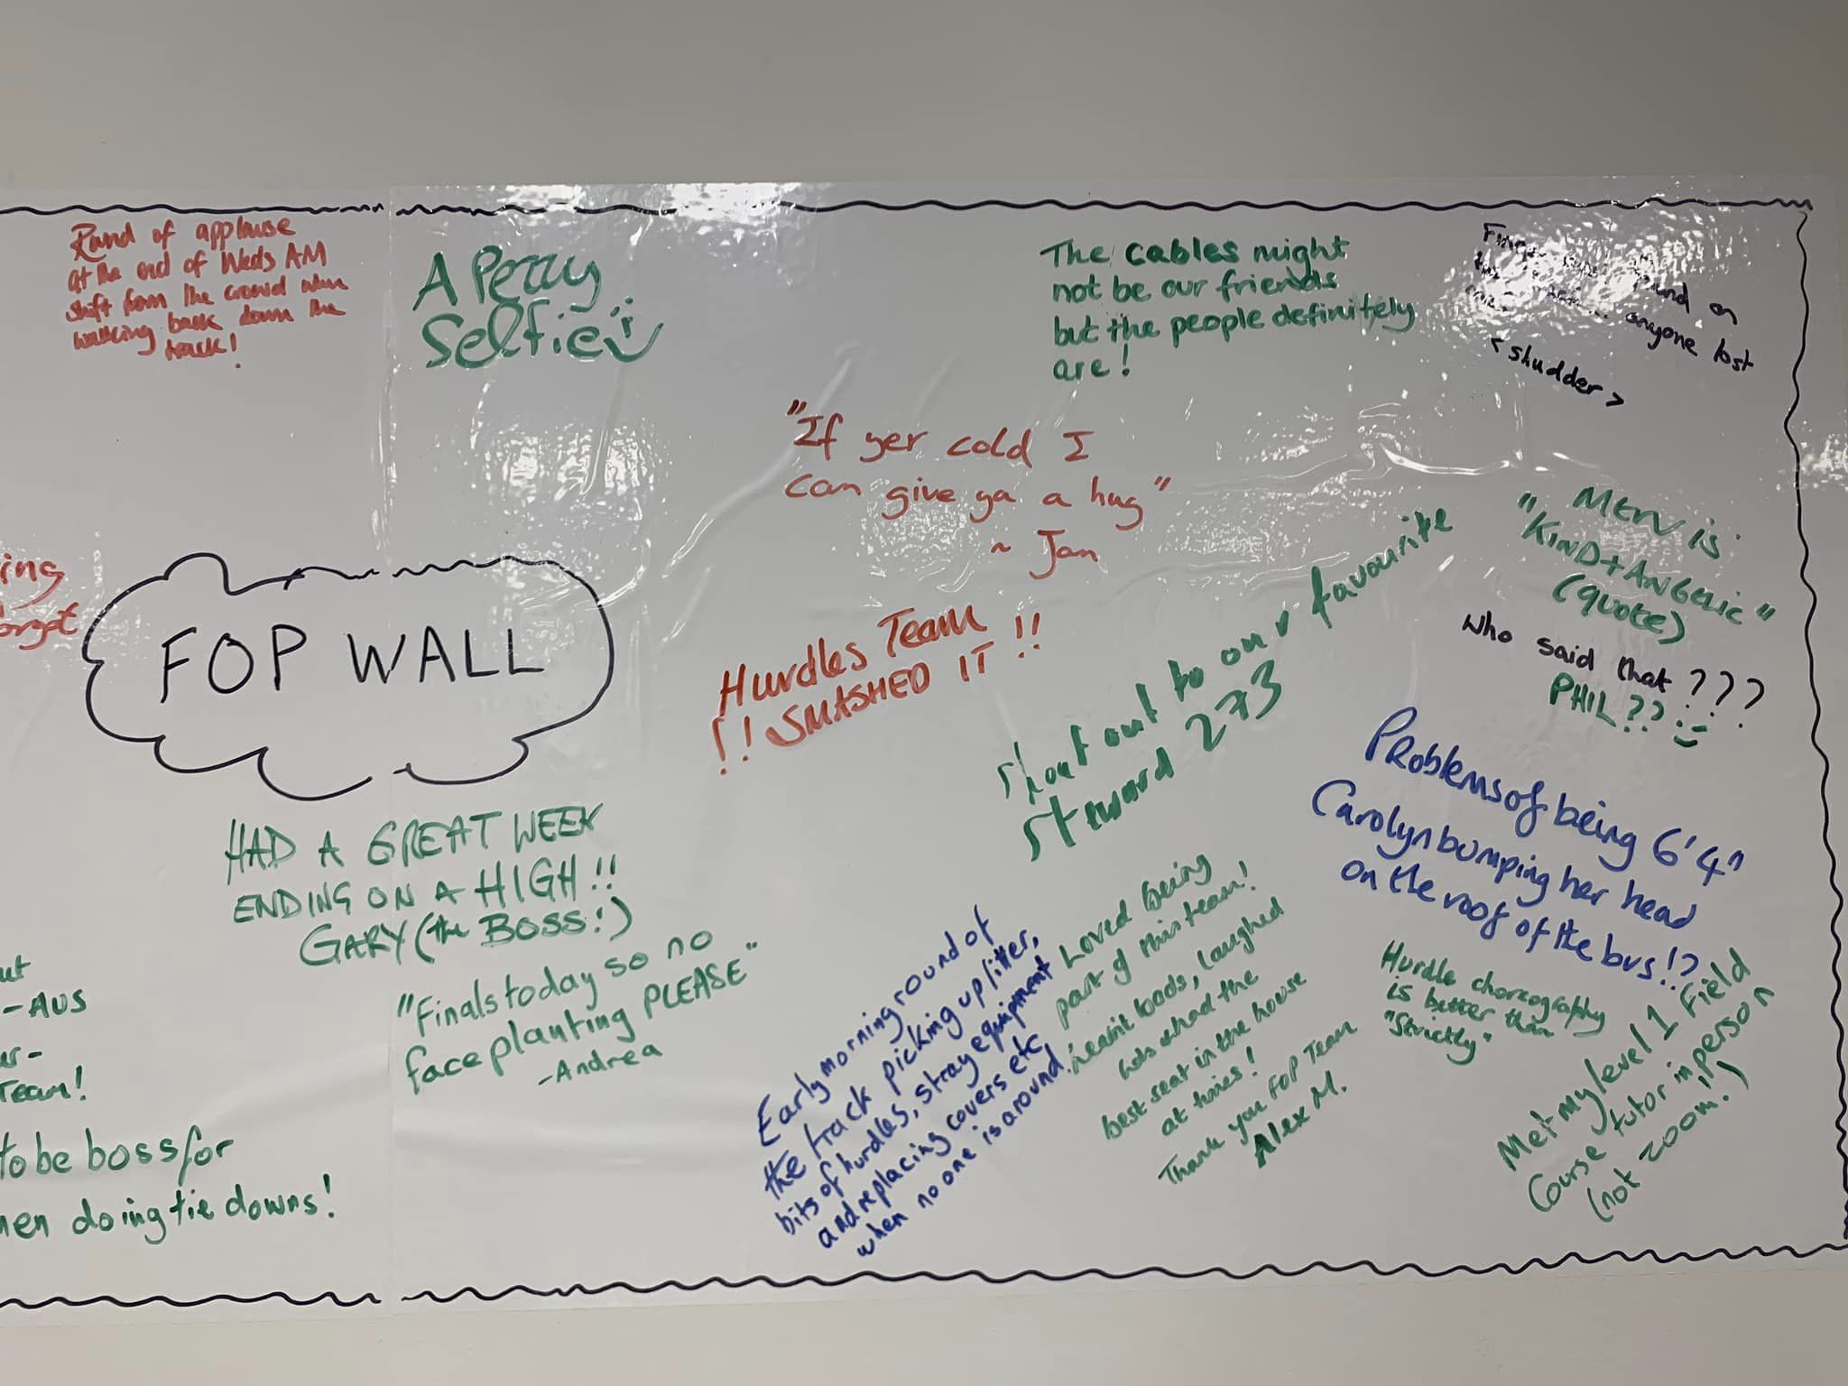
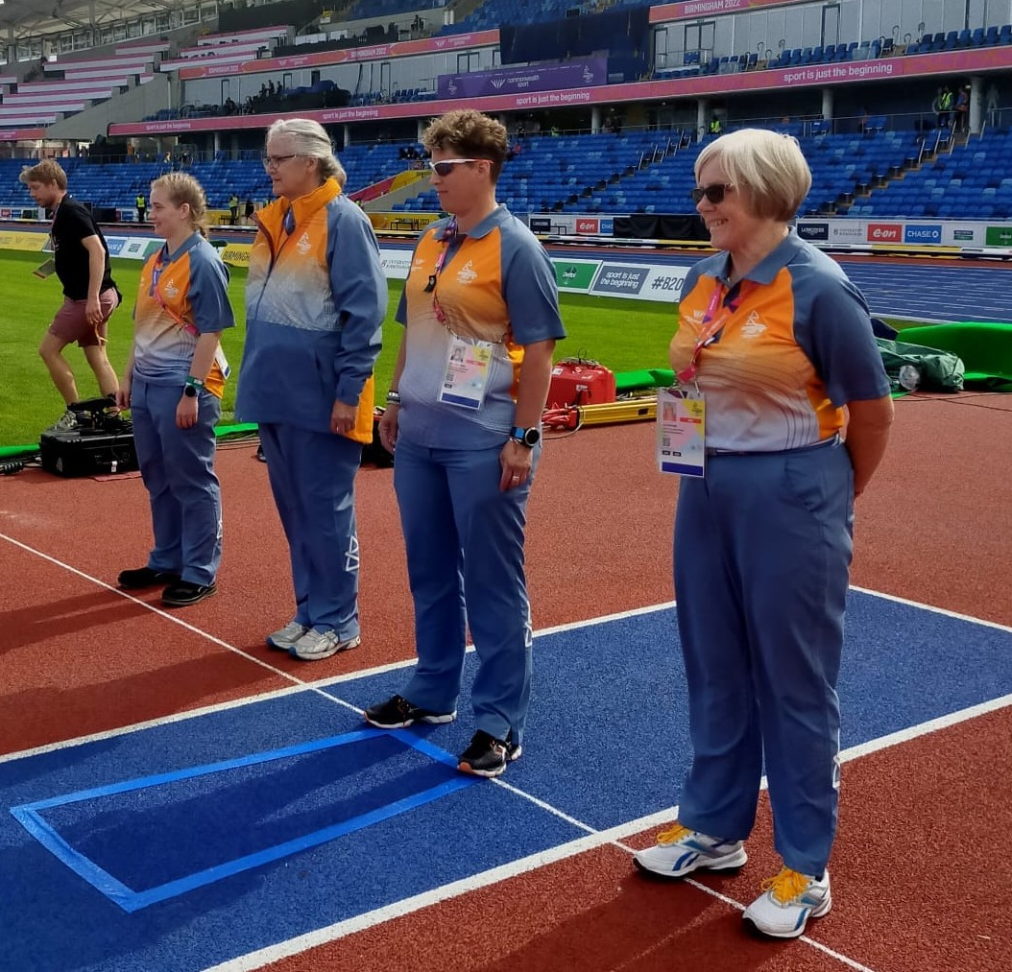
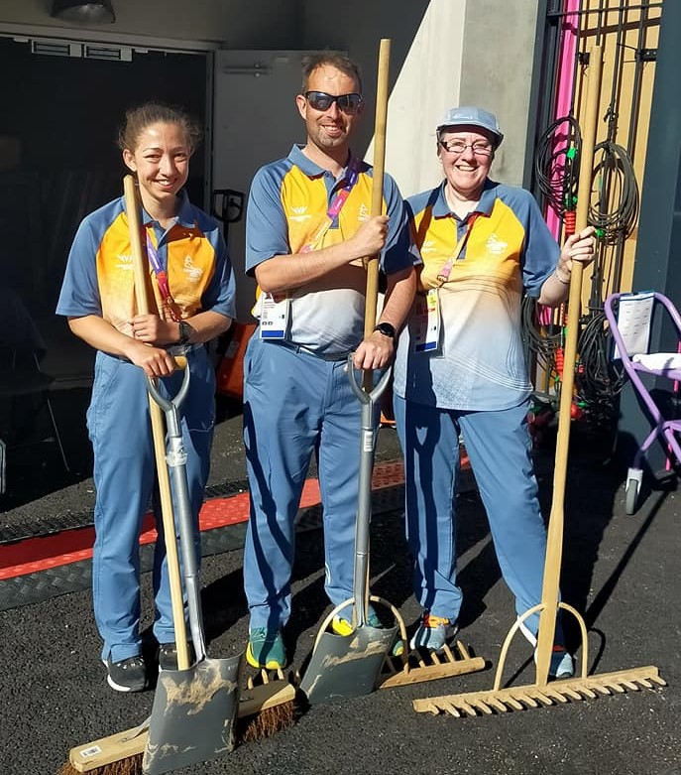
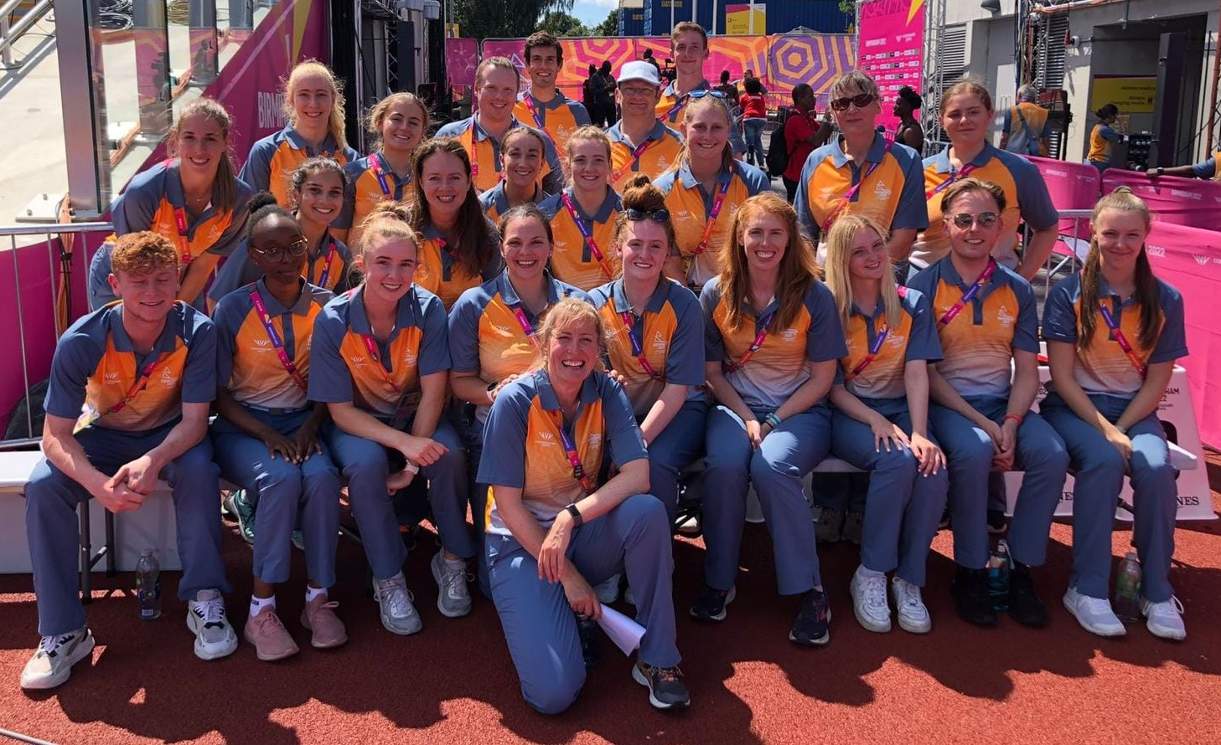
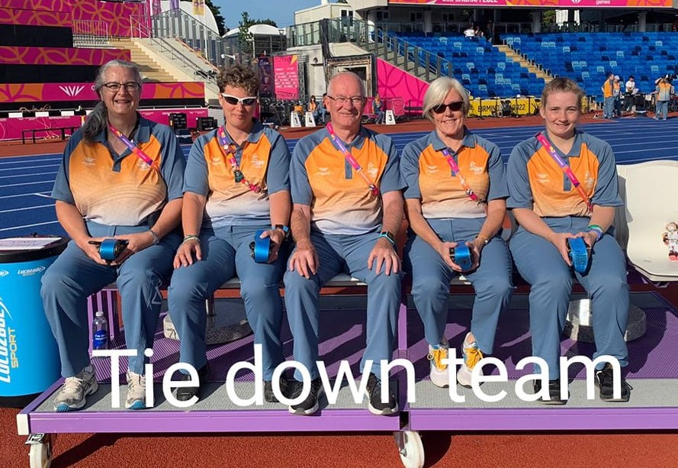
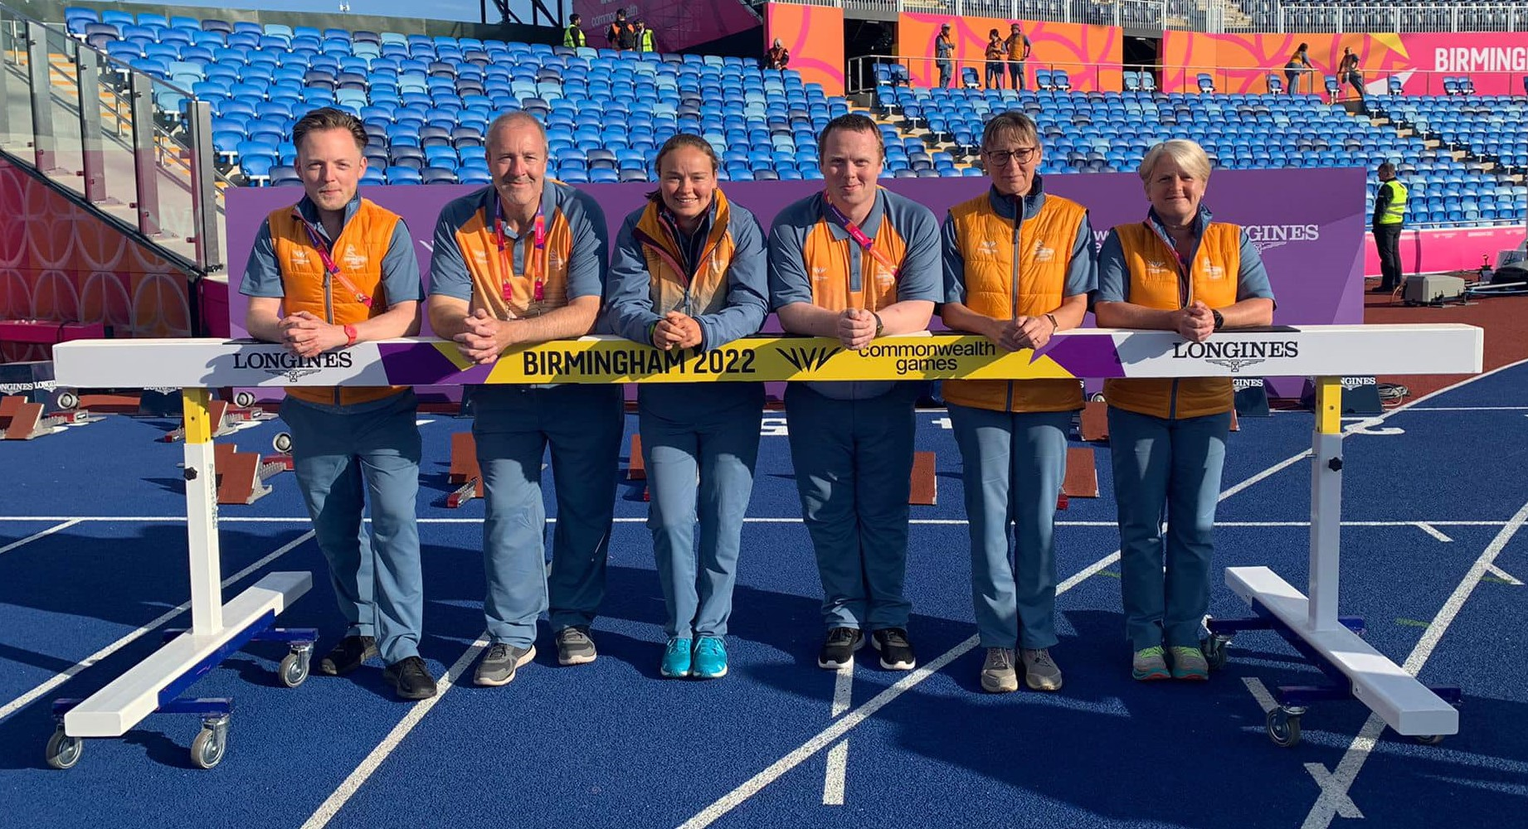
FOP
Field of Play Team

Slide 5
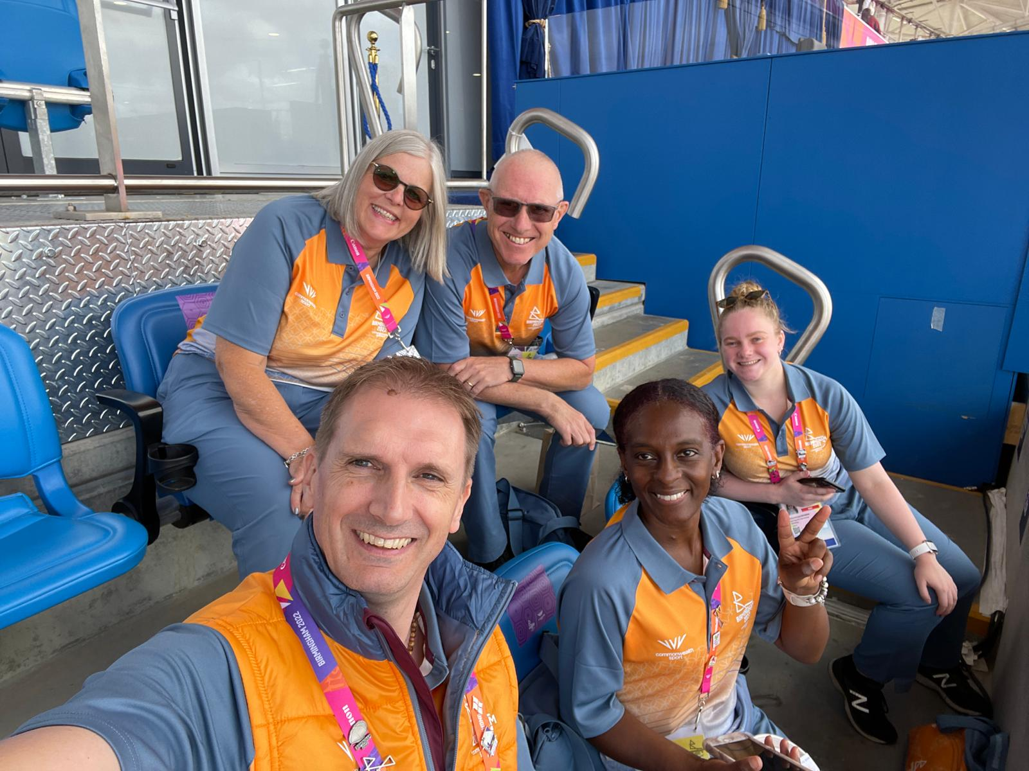
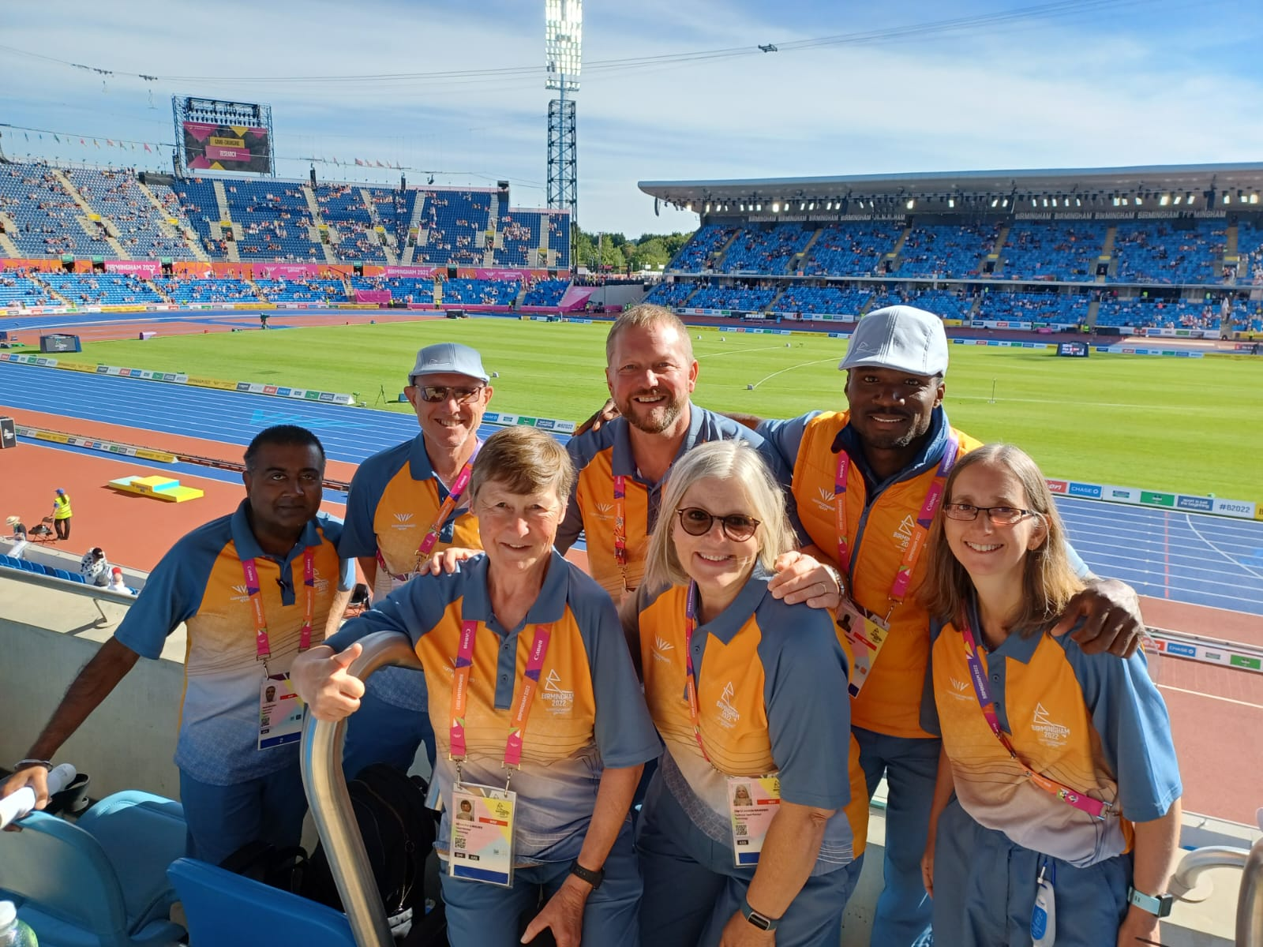
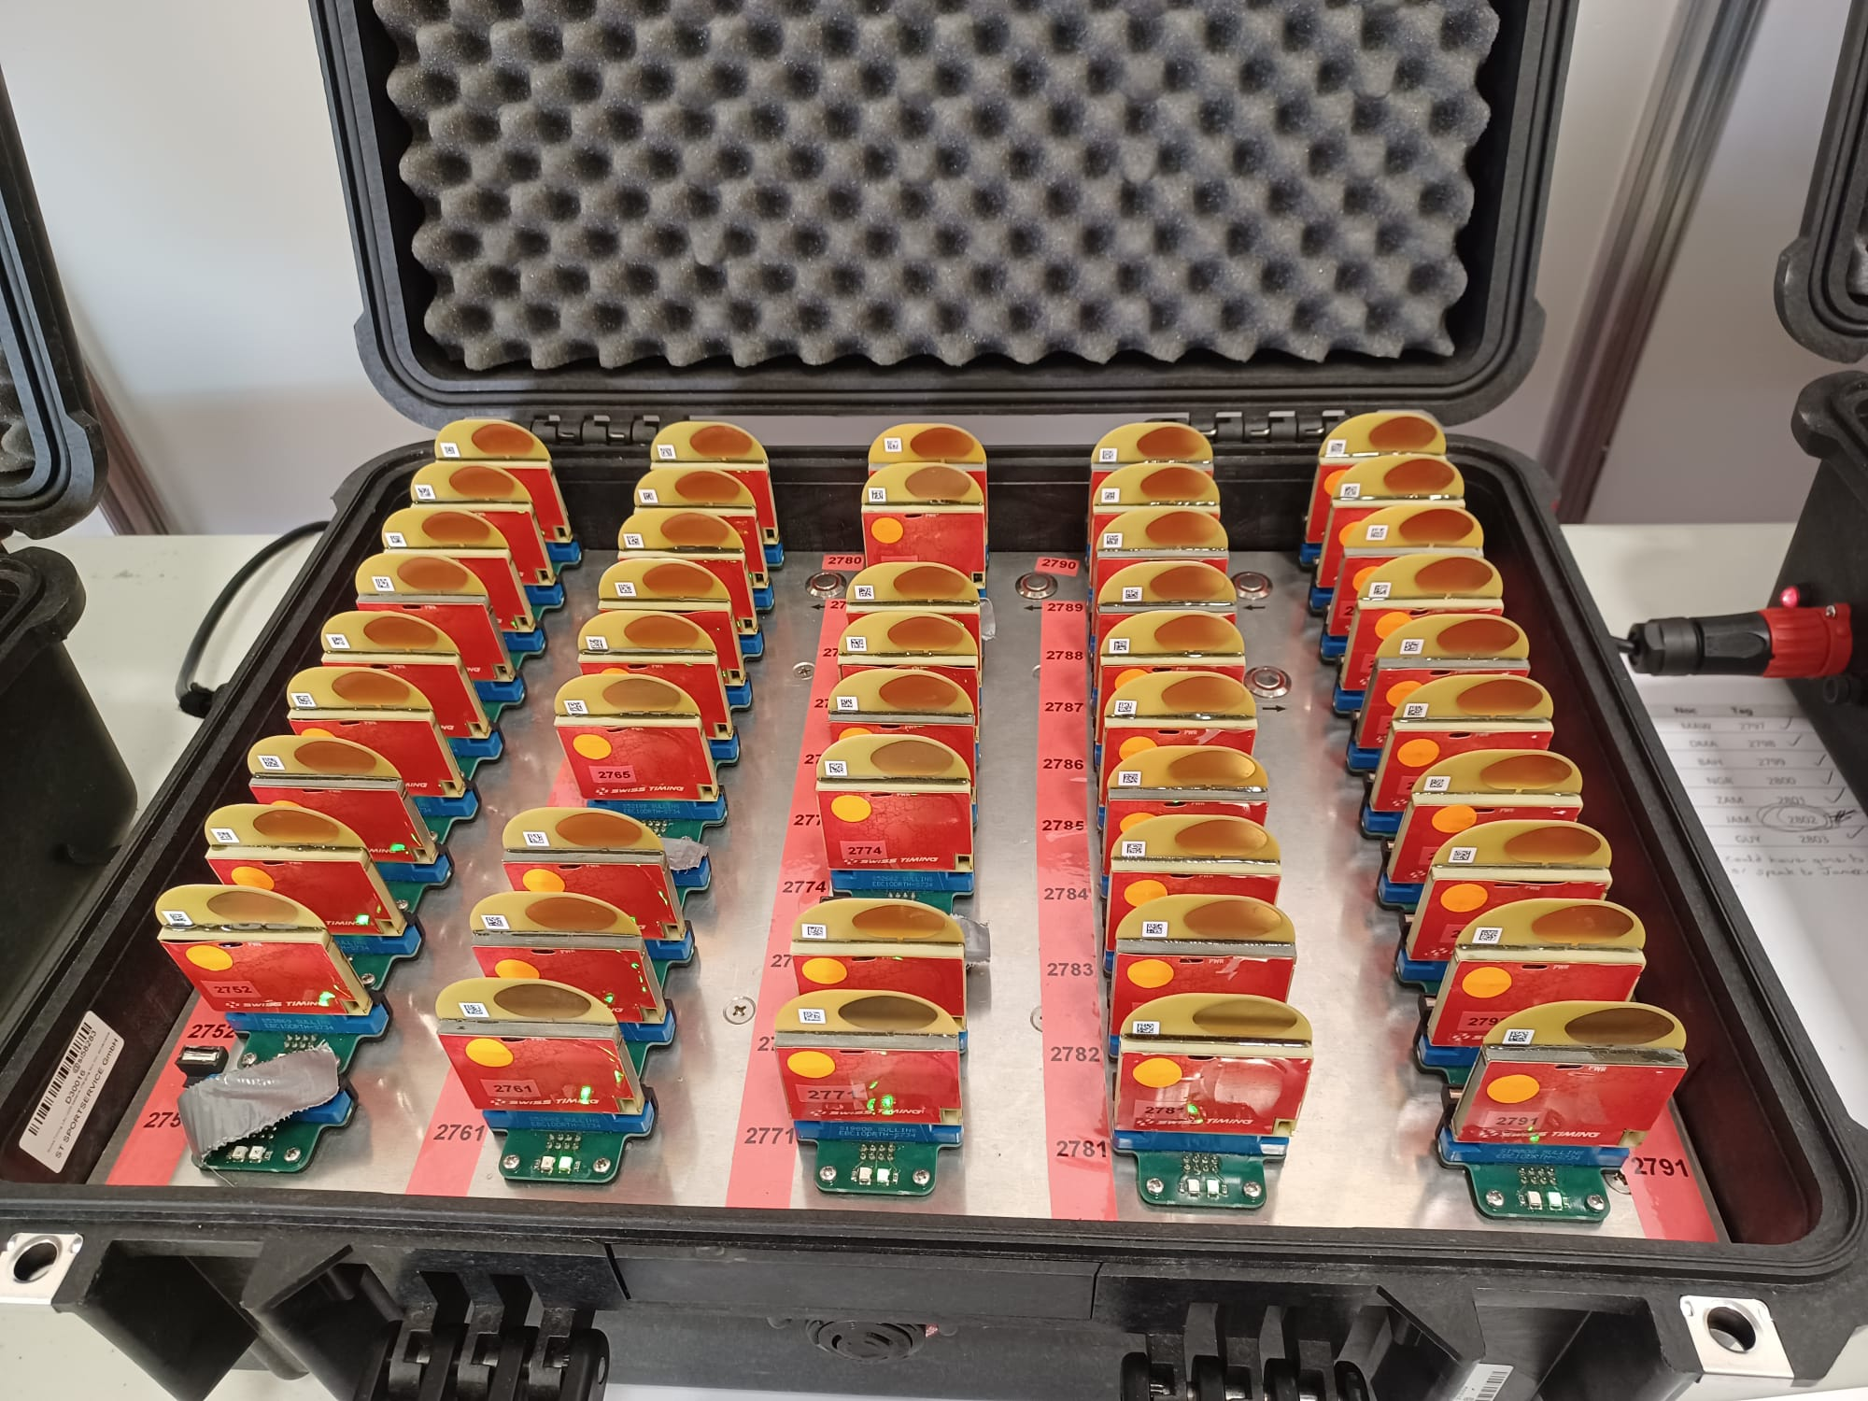
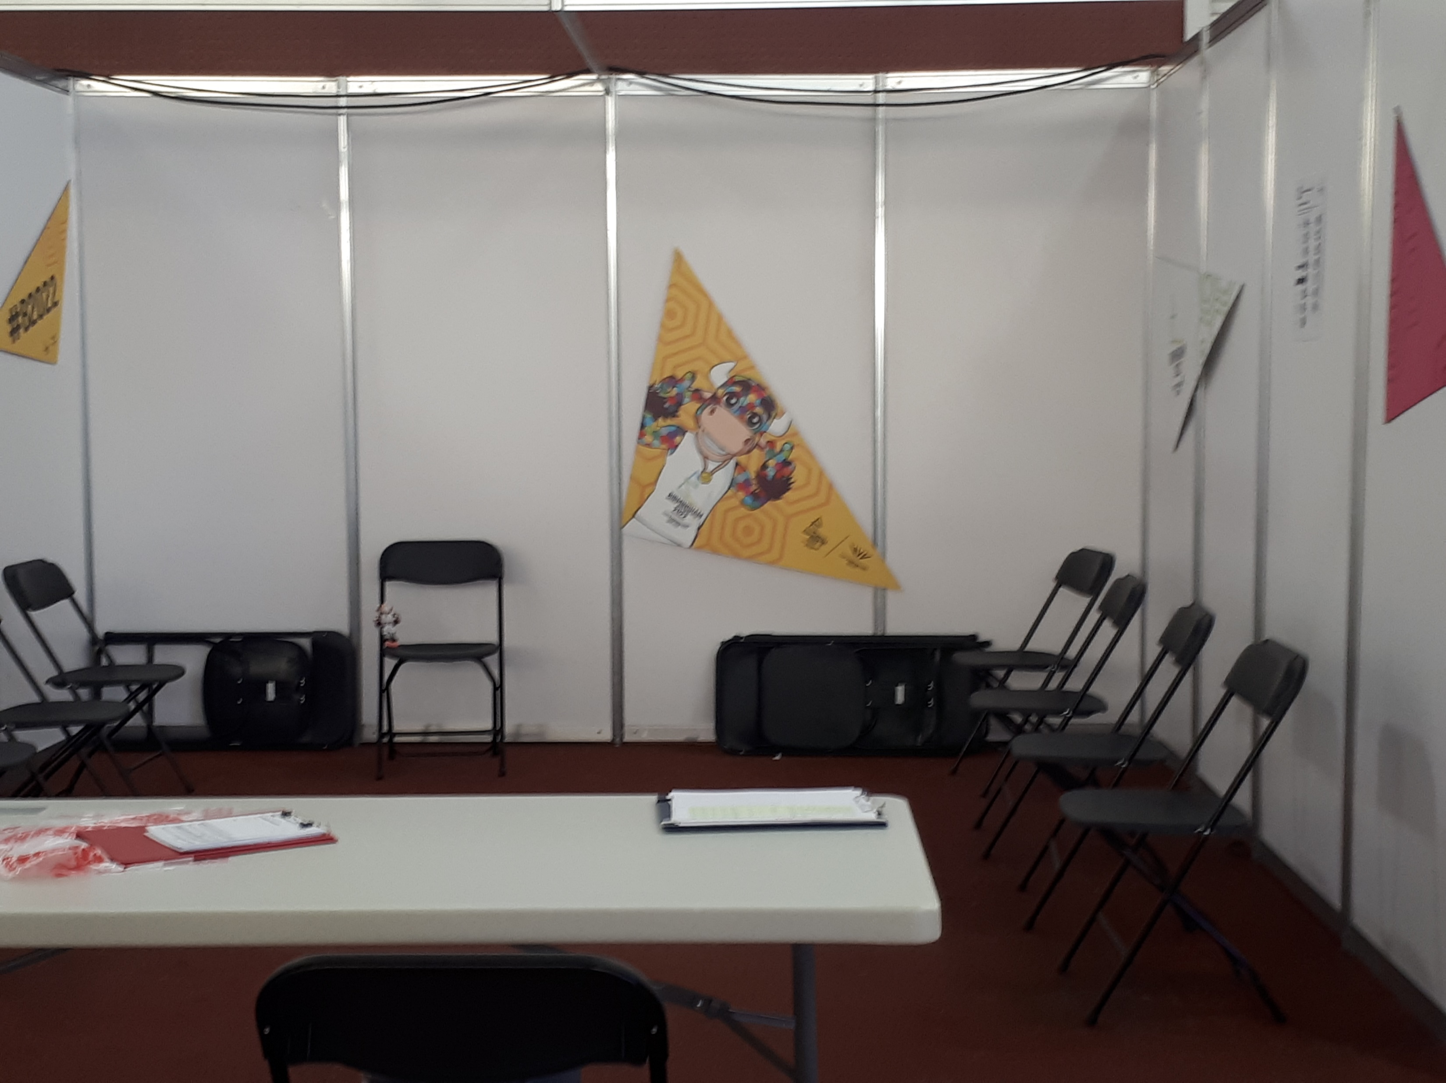
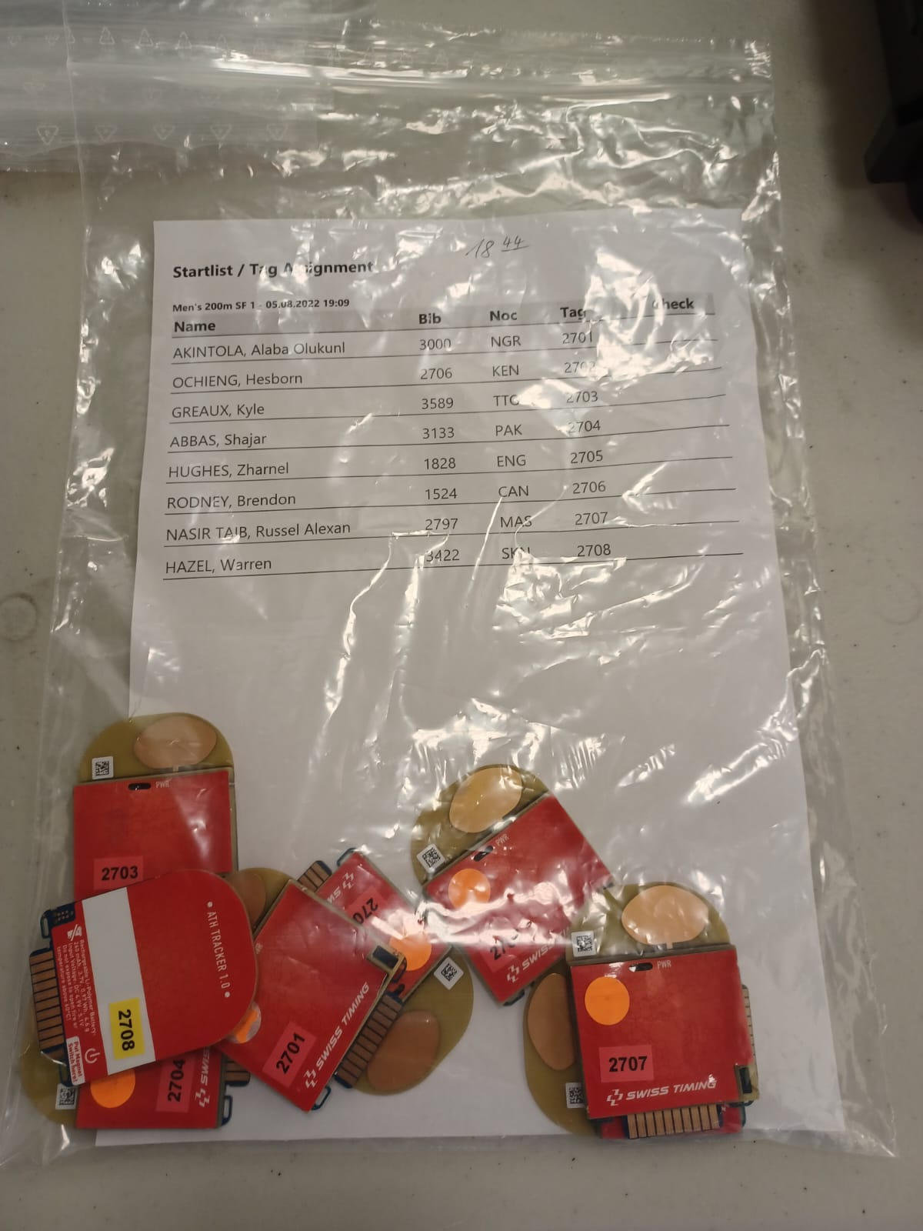
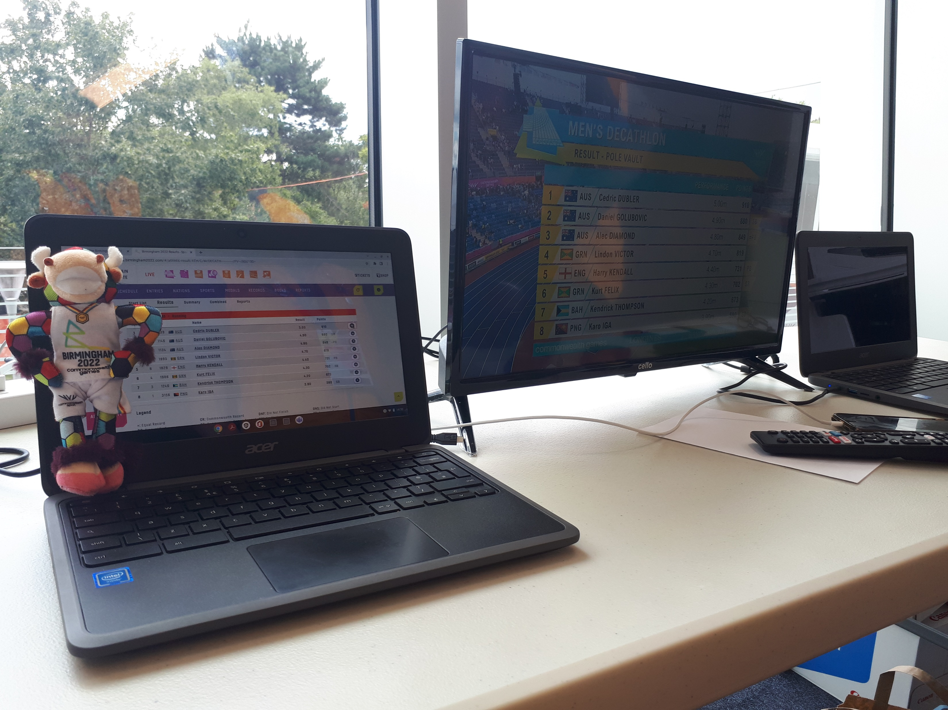
RTS (Results & Technology Services) – Carol and Emily
Supporting On Venue Results at Marathon and Alexander Stadium
Transponders, Scoreboards, QA of Website Results
Working with Longines staff, Call Room and Post Event Control

Slide 6
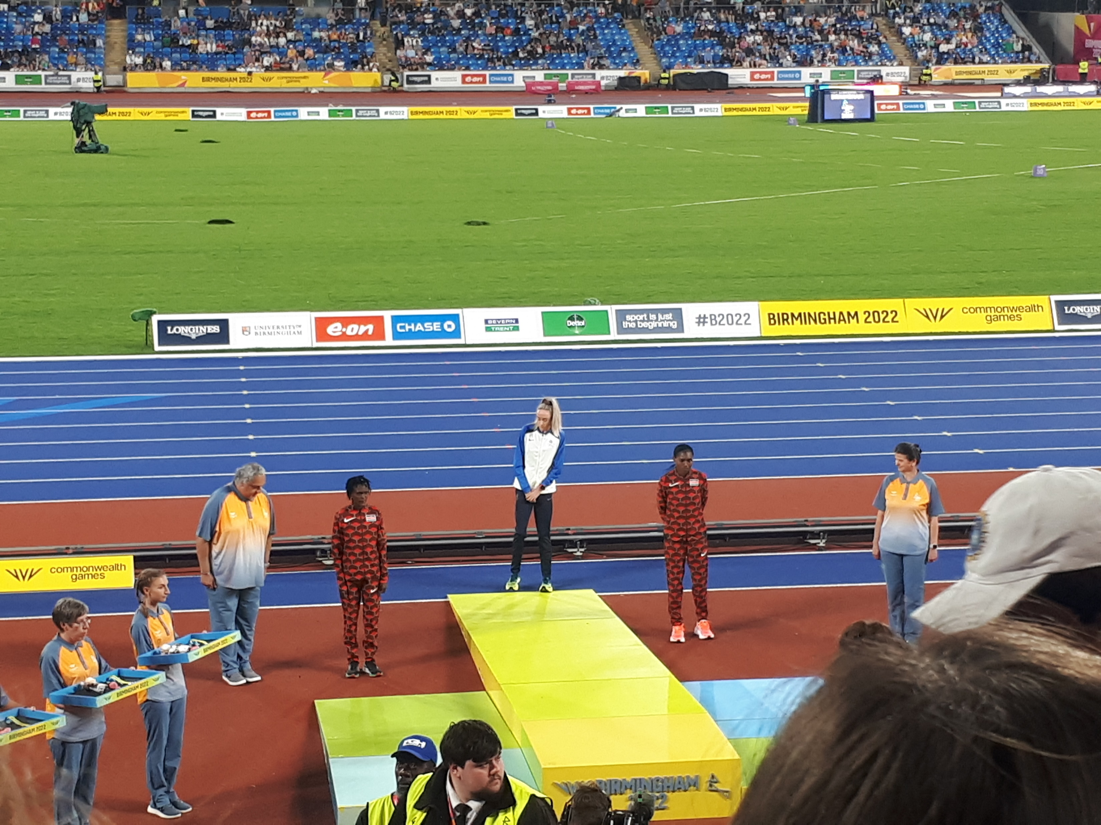
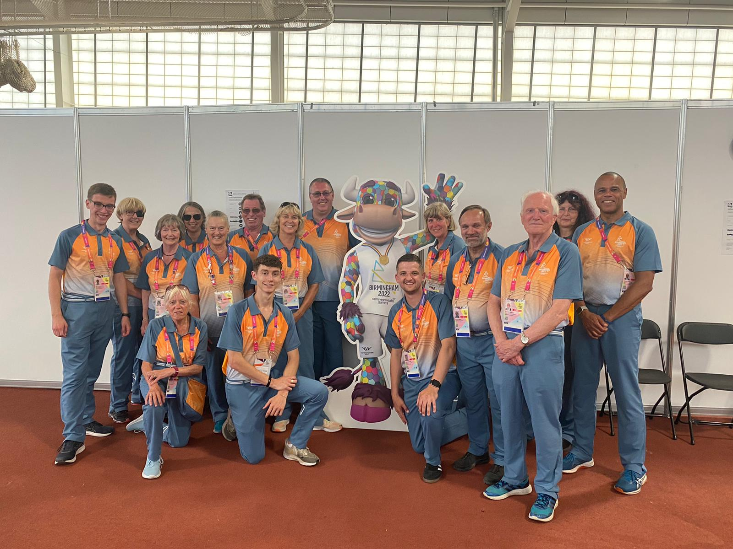
Athlete Services – Pauline
Assisting the athletes and the officials.
Making sure they had all they needed in the stadium and warm up areas
Supporting athletes and their coaches in the call room and mixed zone
Medal Ceremony Team – Alex
Athlete Steward – Gillian
Supporting athletes and officials in the call room
Leading athletes out to their events

Slide 7
Pauline: on the last day when an athlete came looking for me specifically to thank me and all the athlete services volunteers for making their games. He wanted to give me a pin badge as a thank you.
Gary, Jan, Rebekah: being part of the tie down team for the Seated Shot Put.
Highlights
Alex: the night Eilish McColgan won the 10,000 metres when I was on shift. When Eilish came back into the tunnel after 10,000 metres medal ceremony and sat down I said to her I don't know who was more emotional on Flower of Scotland me or you
Gary: being team leader (The Boss) for the tie-downs. In charge of 4 women who followed my instructions. Priceless!!!
Being close to the action and the top athletes
Emily: the last night, where we scrambled to get the women’s 4x400 relays out, and then went and watched the very exciting race unfold - the crowd was incredible!
The amazing atmosphere in the stadium

Slide 8
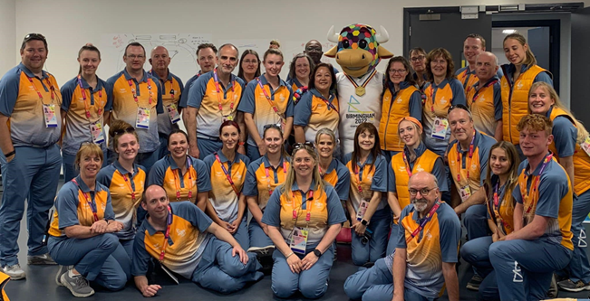
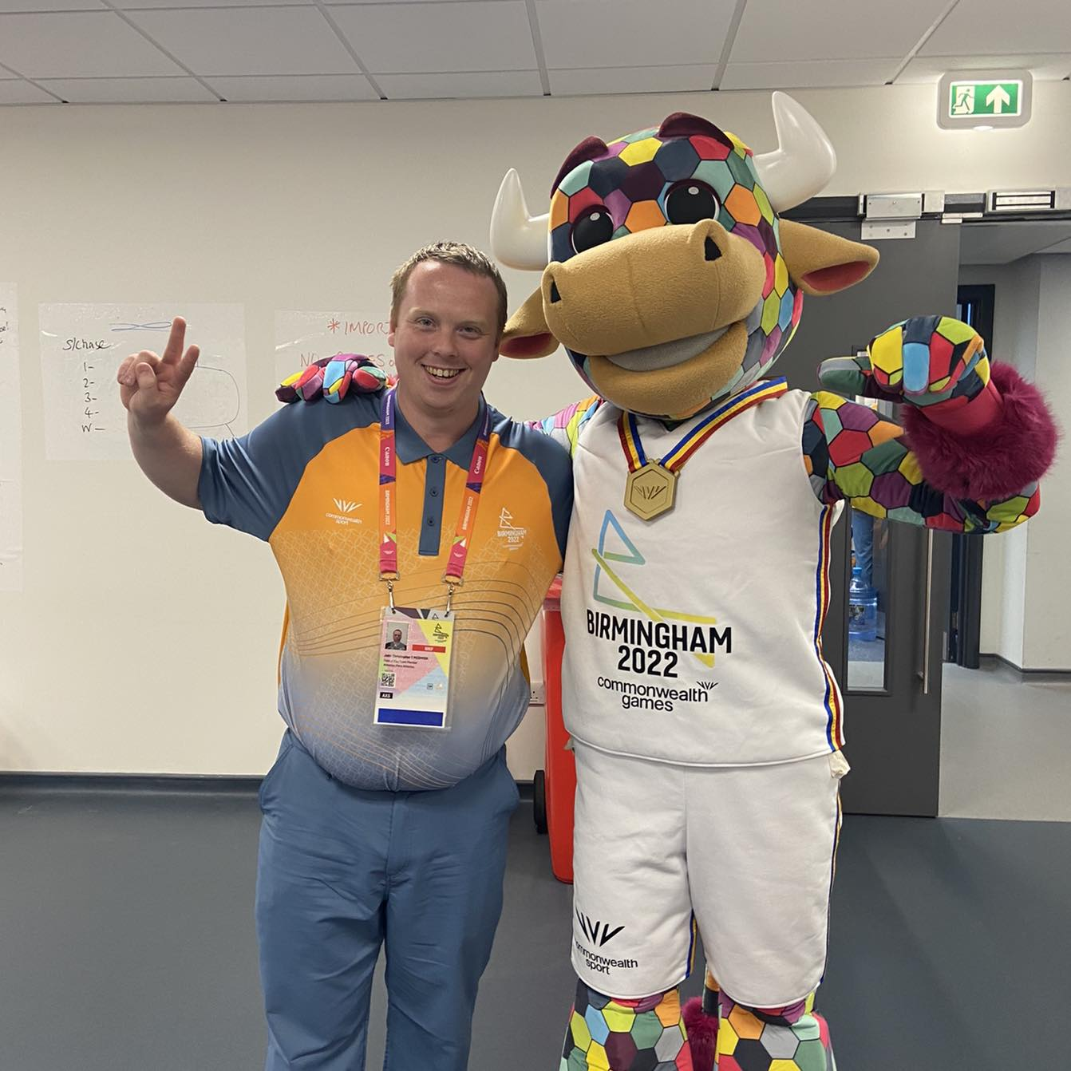
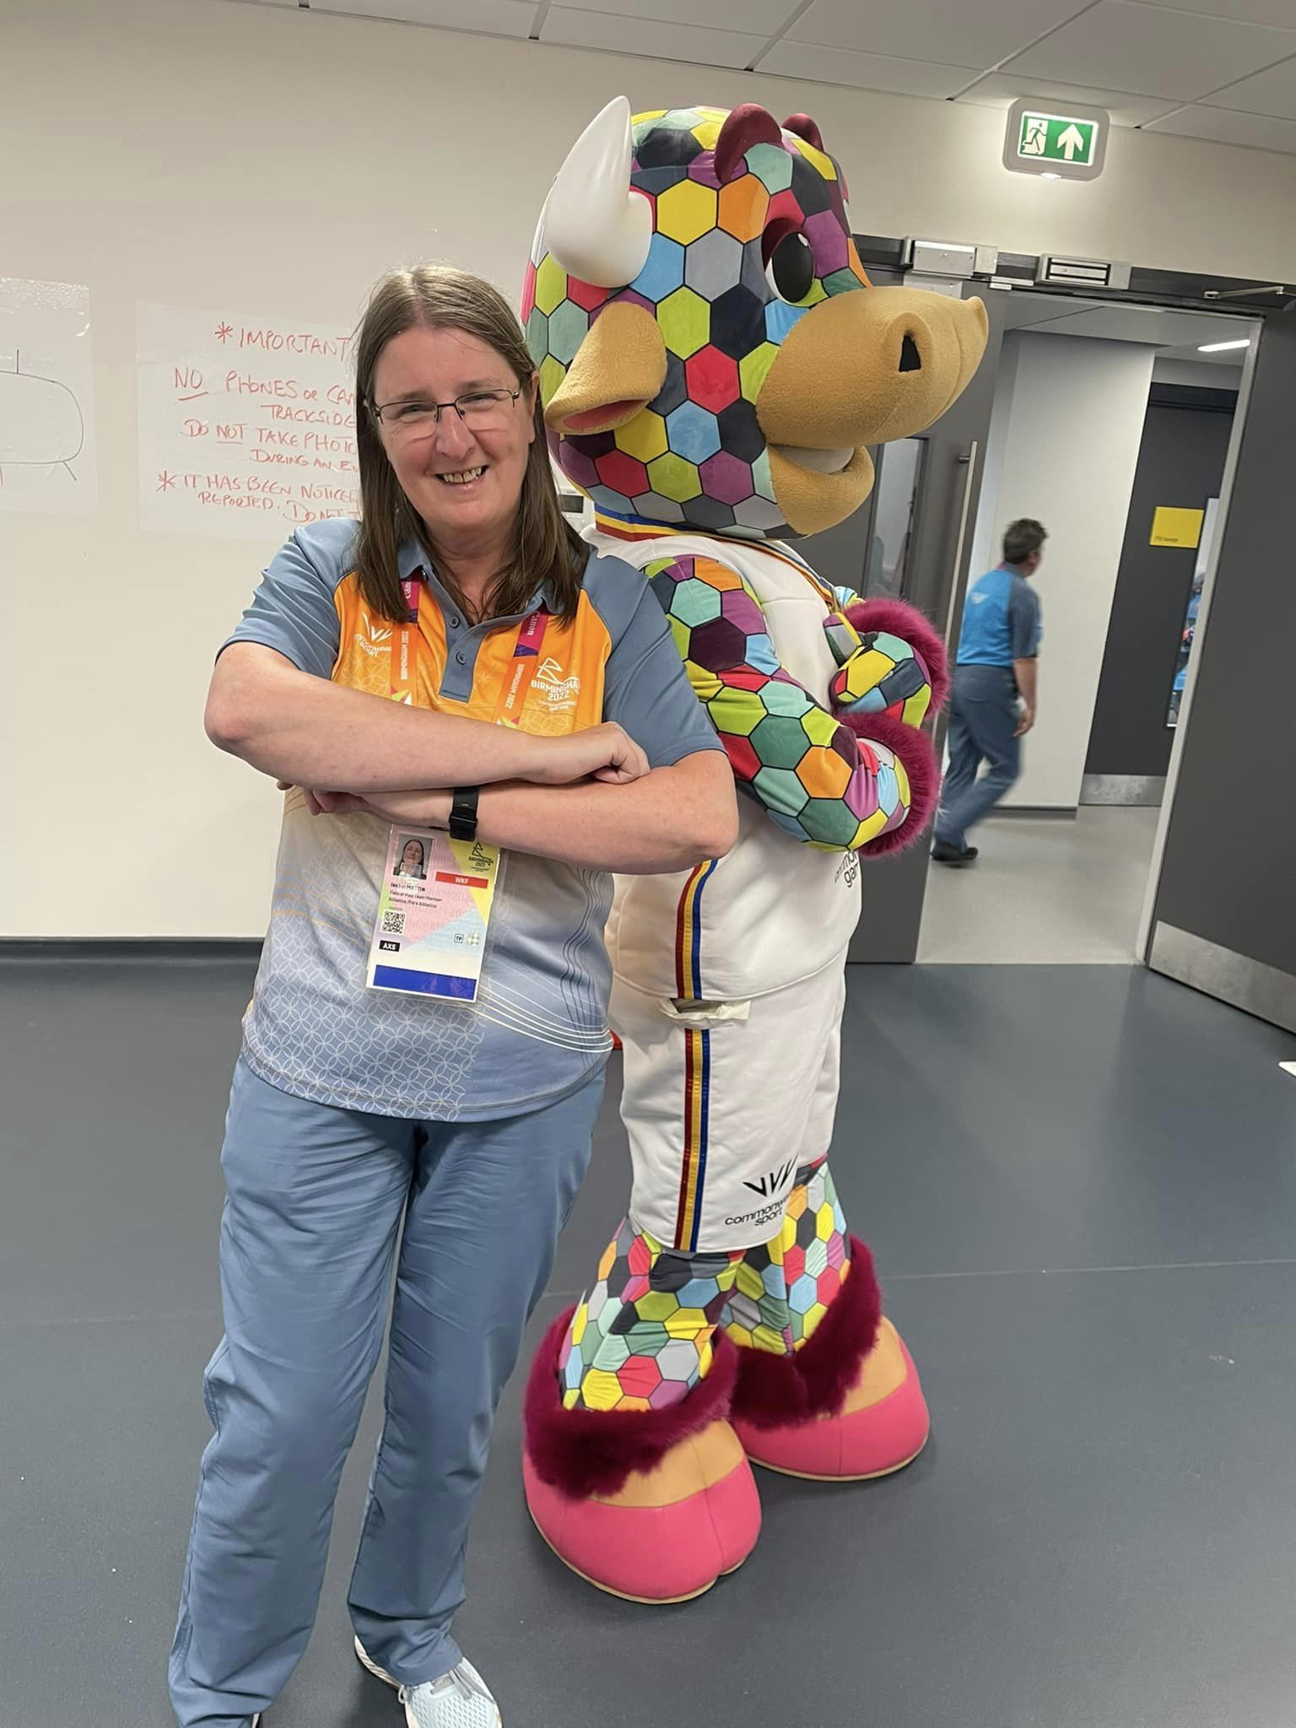
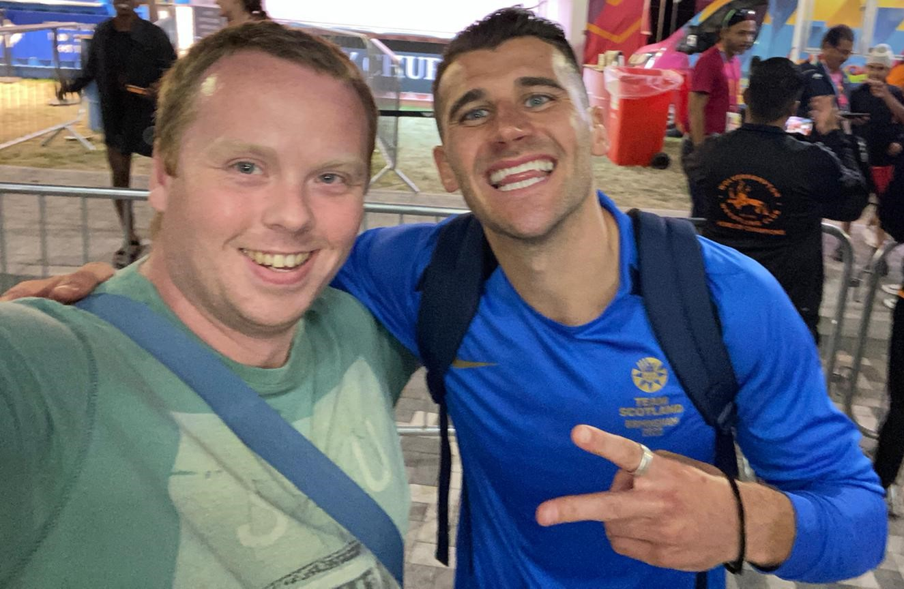
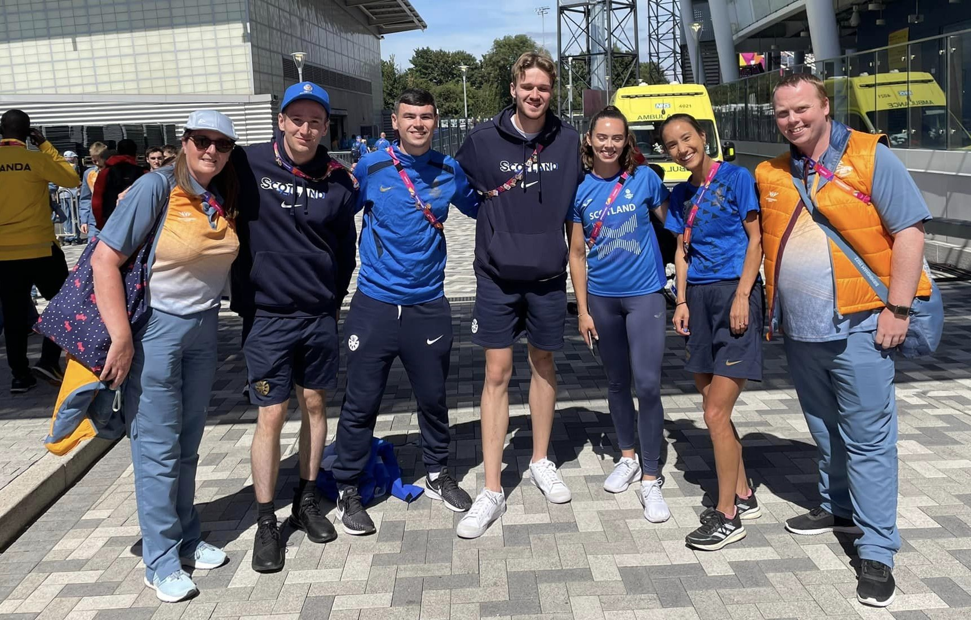
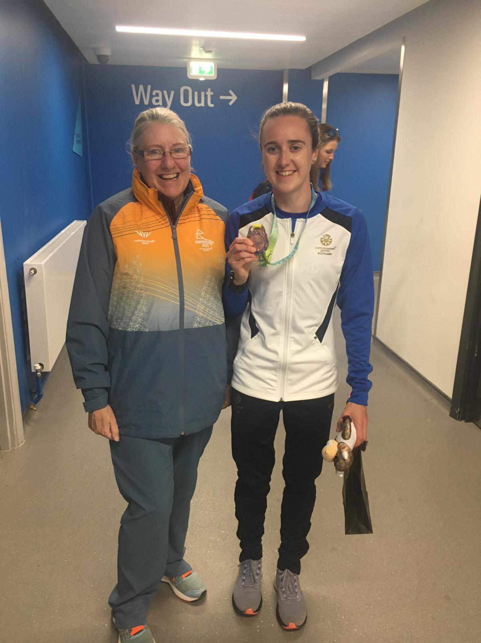
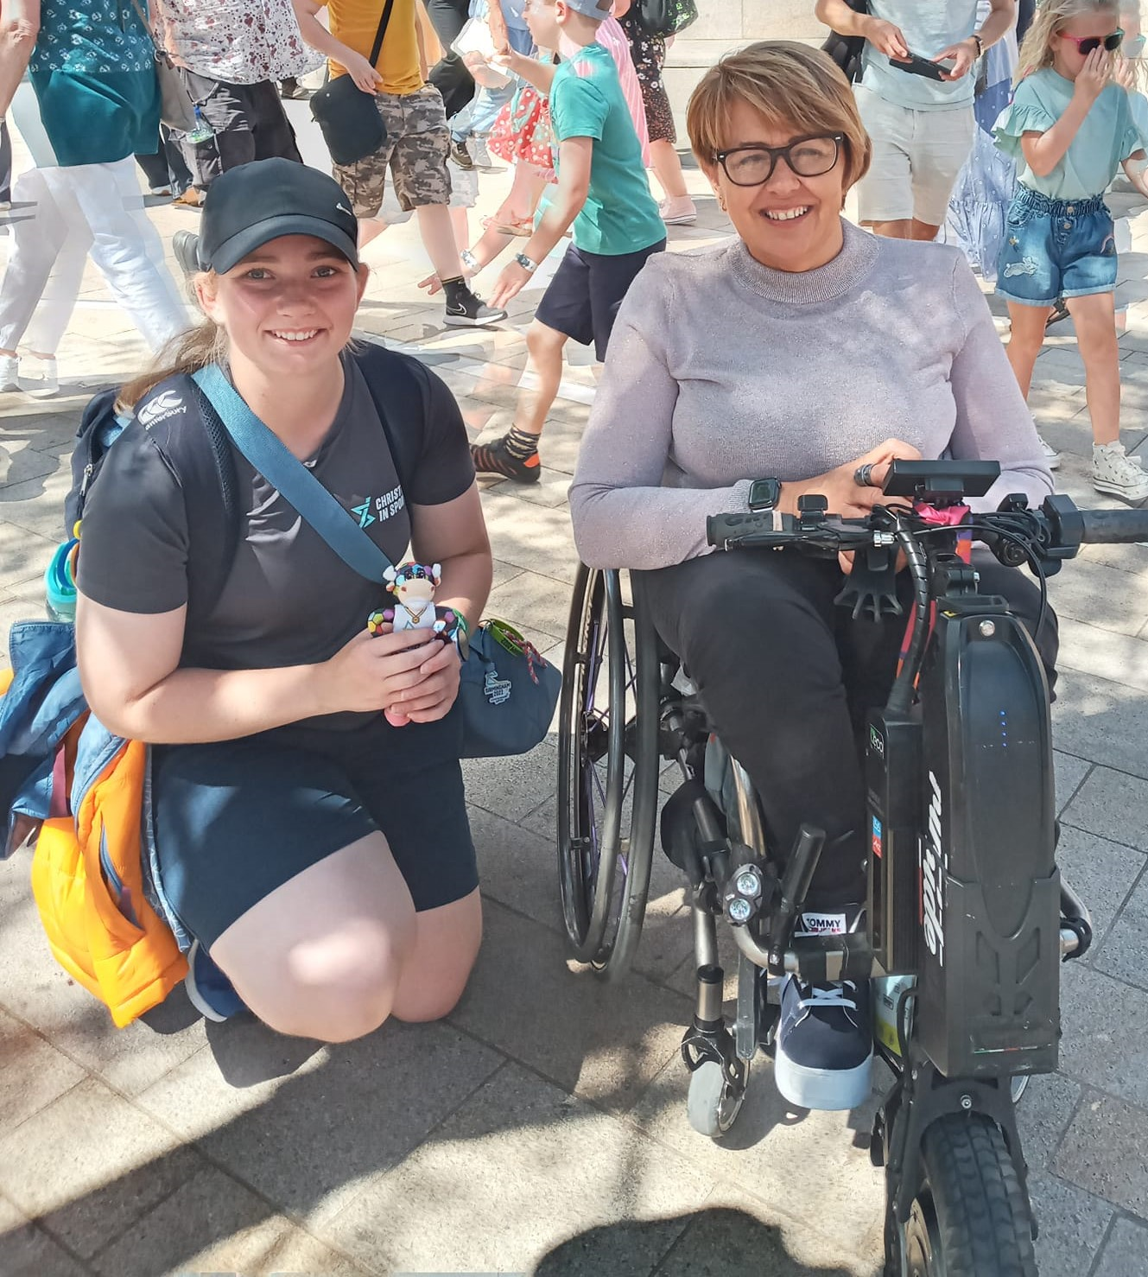

Slide 10
