Slide 1
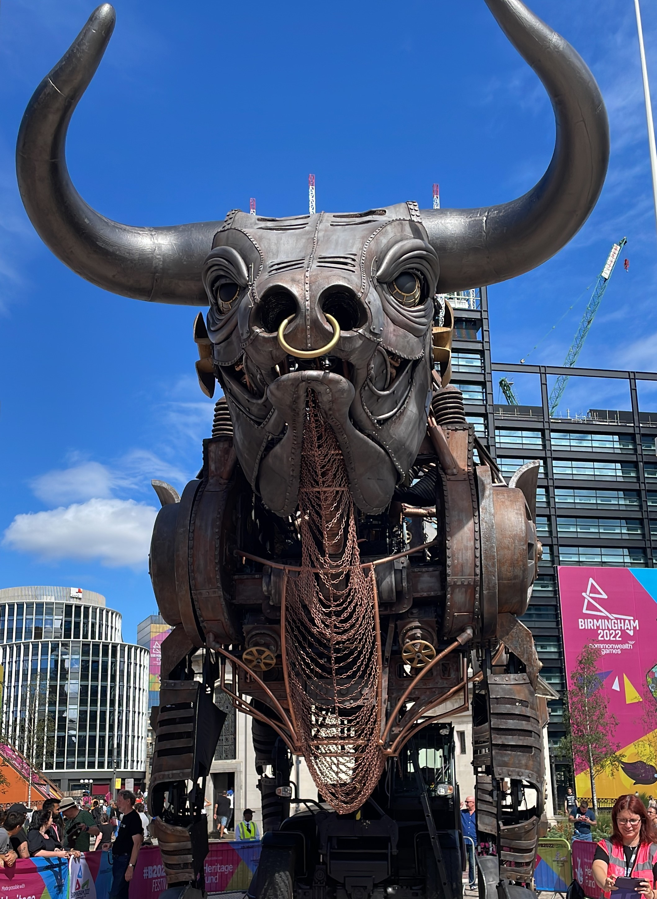
Commonwealth Games 2022
Birmingham
Norma Bruce, Field Judge
The Good
The New
The Resourcing

Slide 2
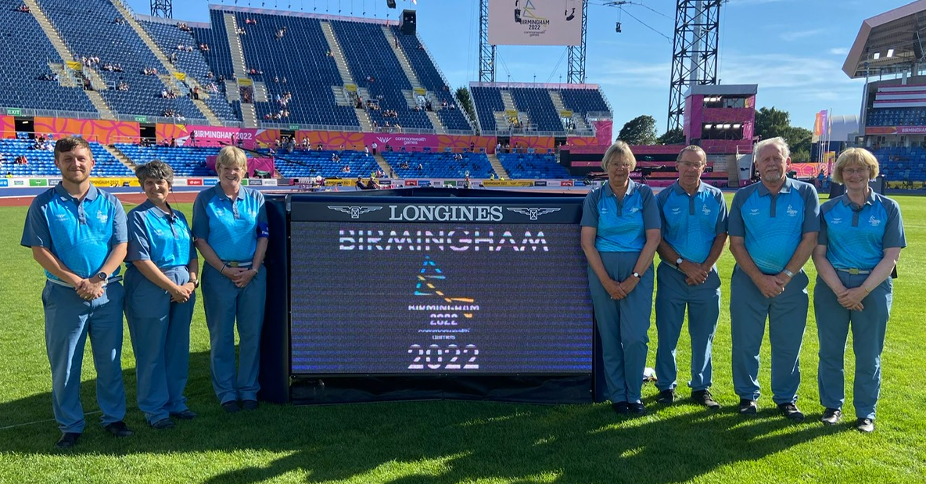
Long Jump Team
Mixture of ages and experience
Olympics, World Champs
New 4p
Endurance
Mary
Elaine
John
Brian
Craig
Sian
Norma

Slide 3
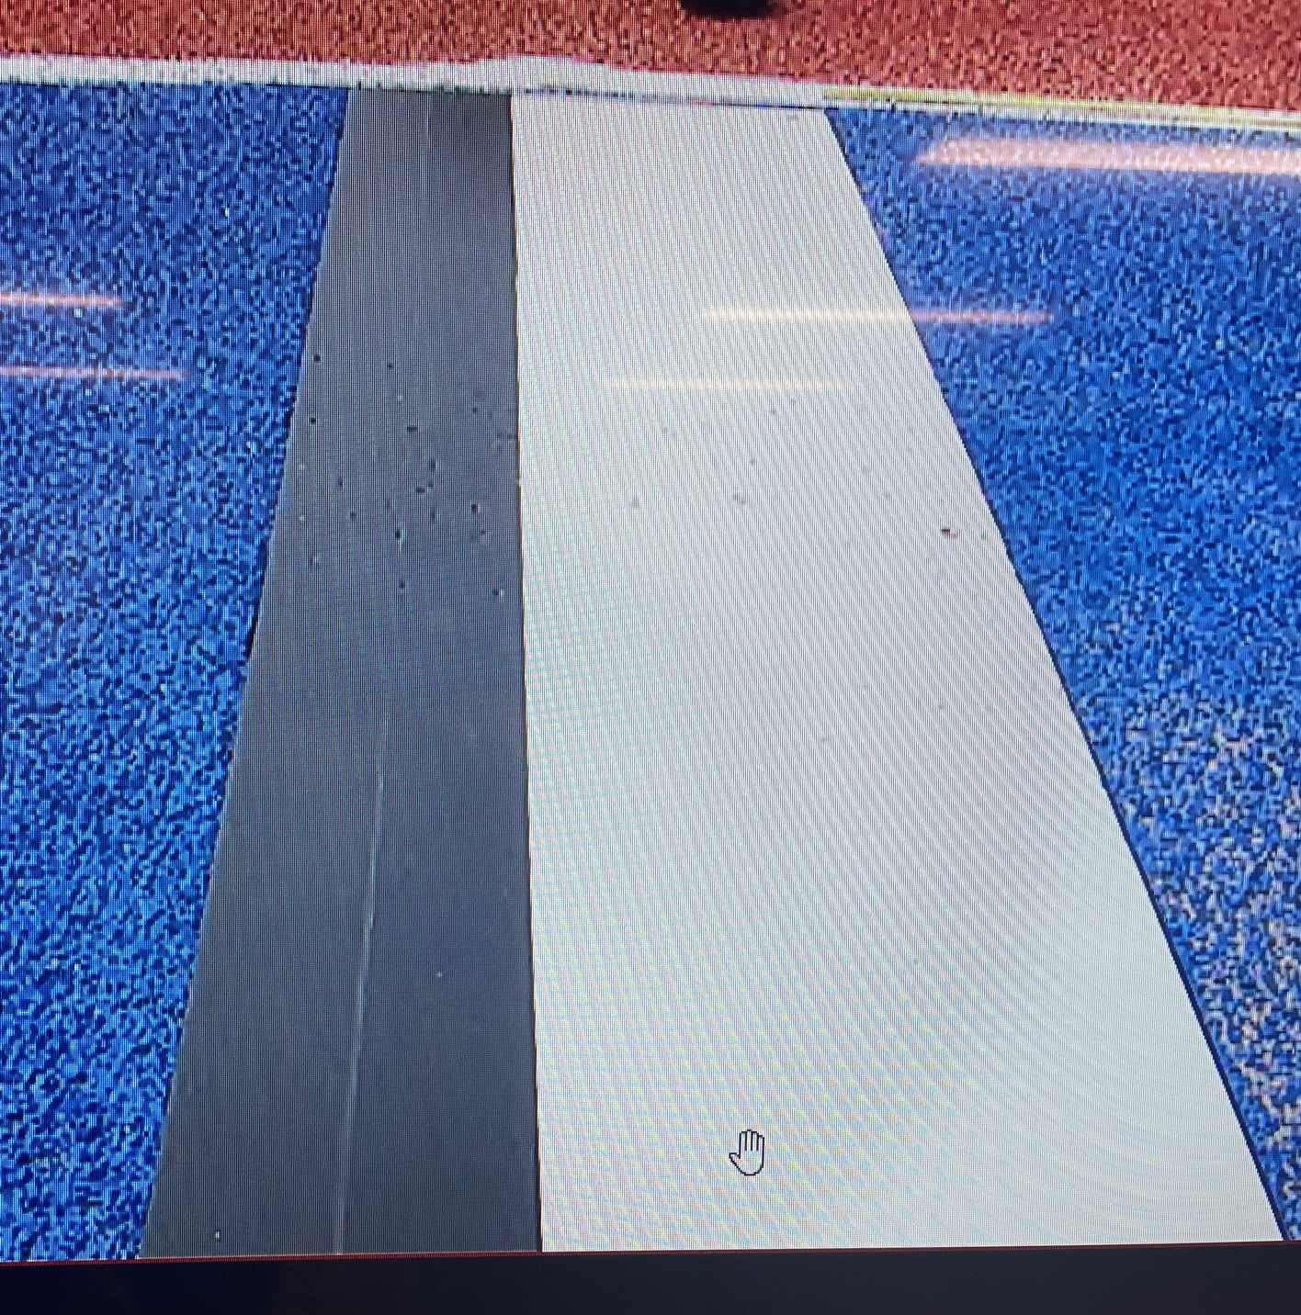
New Technology
Video Take Off
No judge at the board
Judged remotely in video room
Can’t see if athlete has taken off before or after the board
Comms!

Slide 4
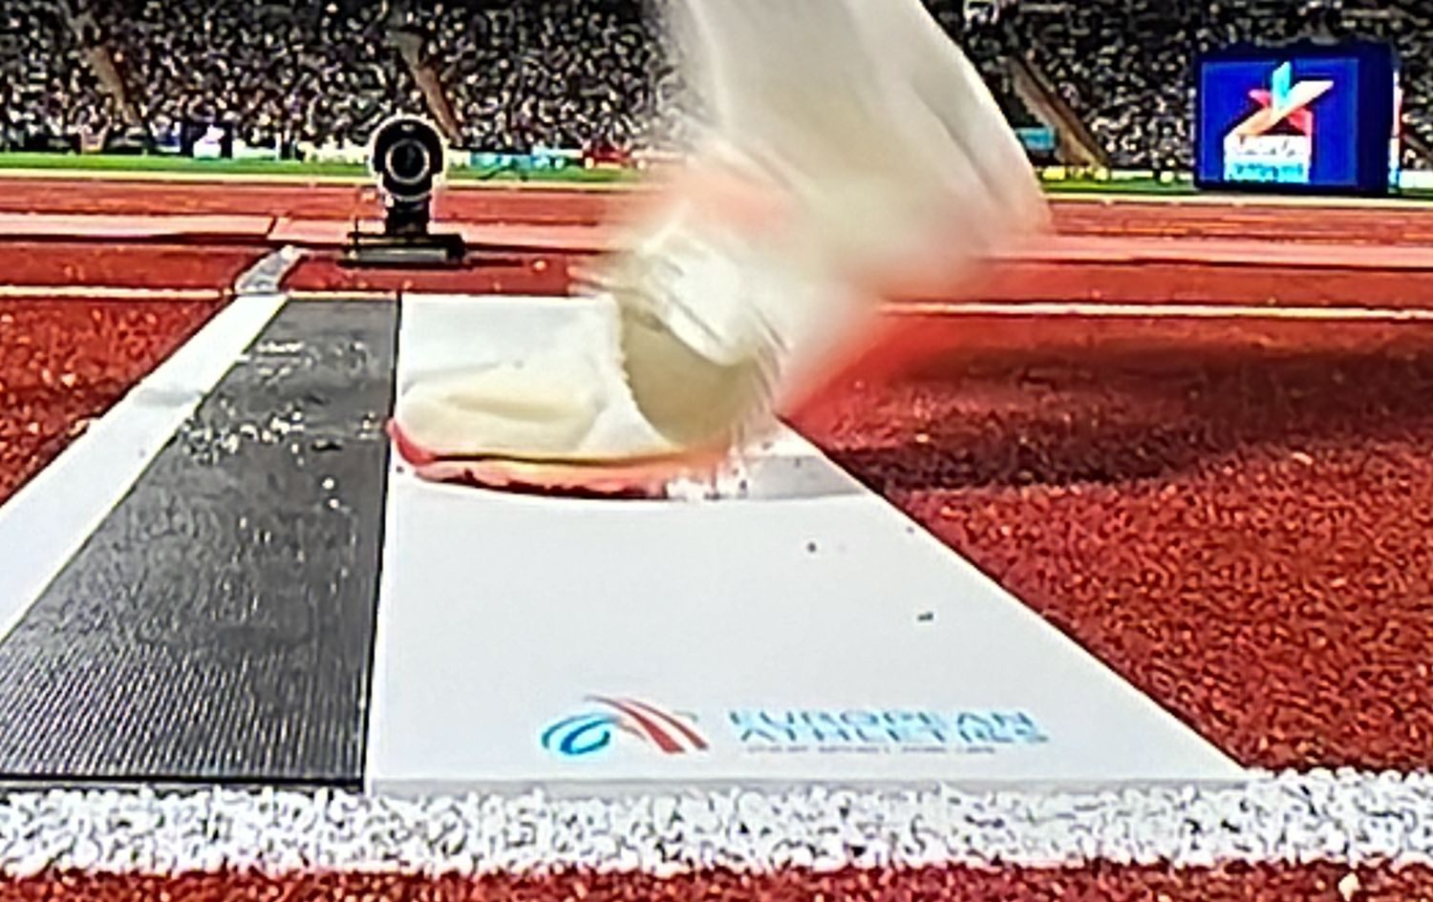
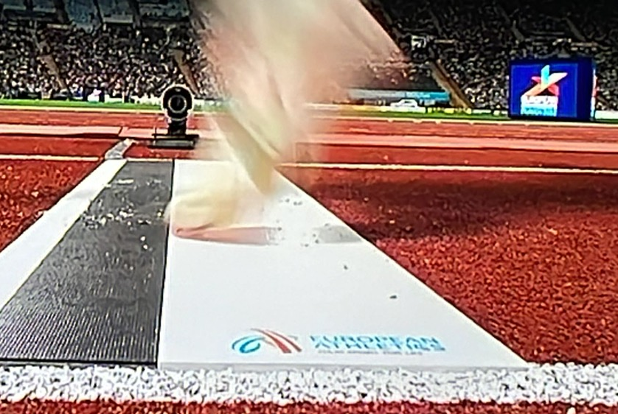
Can you tell?

Slide 5
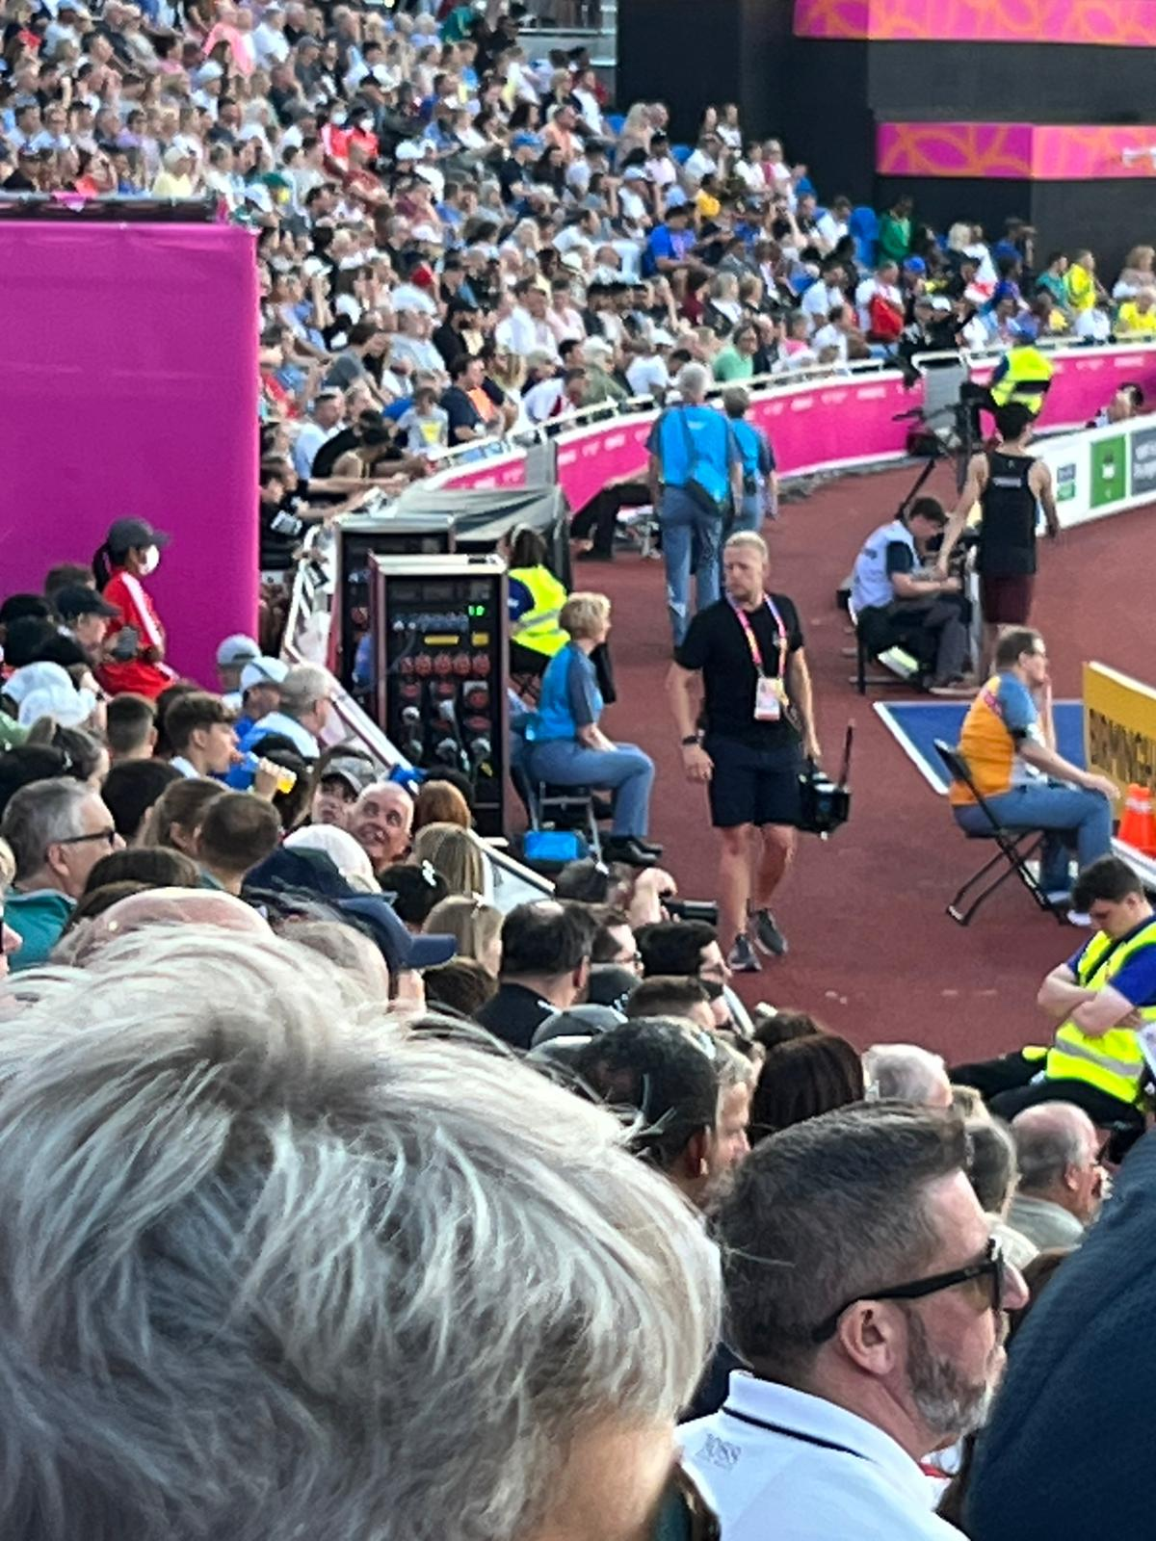
Resourcing
Not as many Technical Officials as previous games
Event Teams smaller
Less perimeter judges (1 for Men’s HJ Final)
Travel times to and from stadium
Was TO welfare a priority?

Slide 6
Sand & a good thing
Sand gets everywhere!
Can you spot the improvement between these 2 sessions?
Stools
Chairs
WHY???

Slide 7
Always Being Watched!

Slide 8
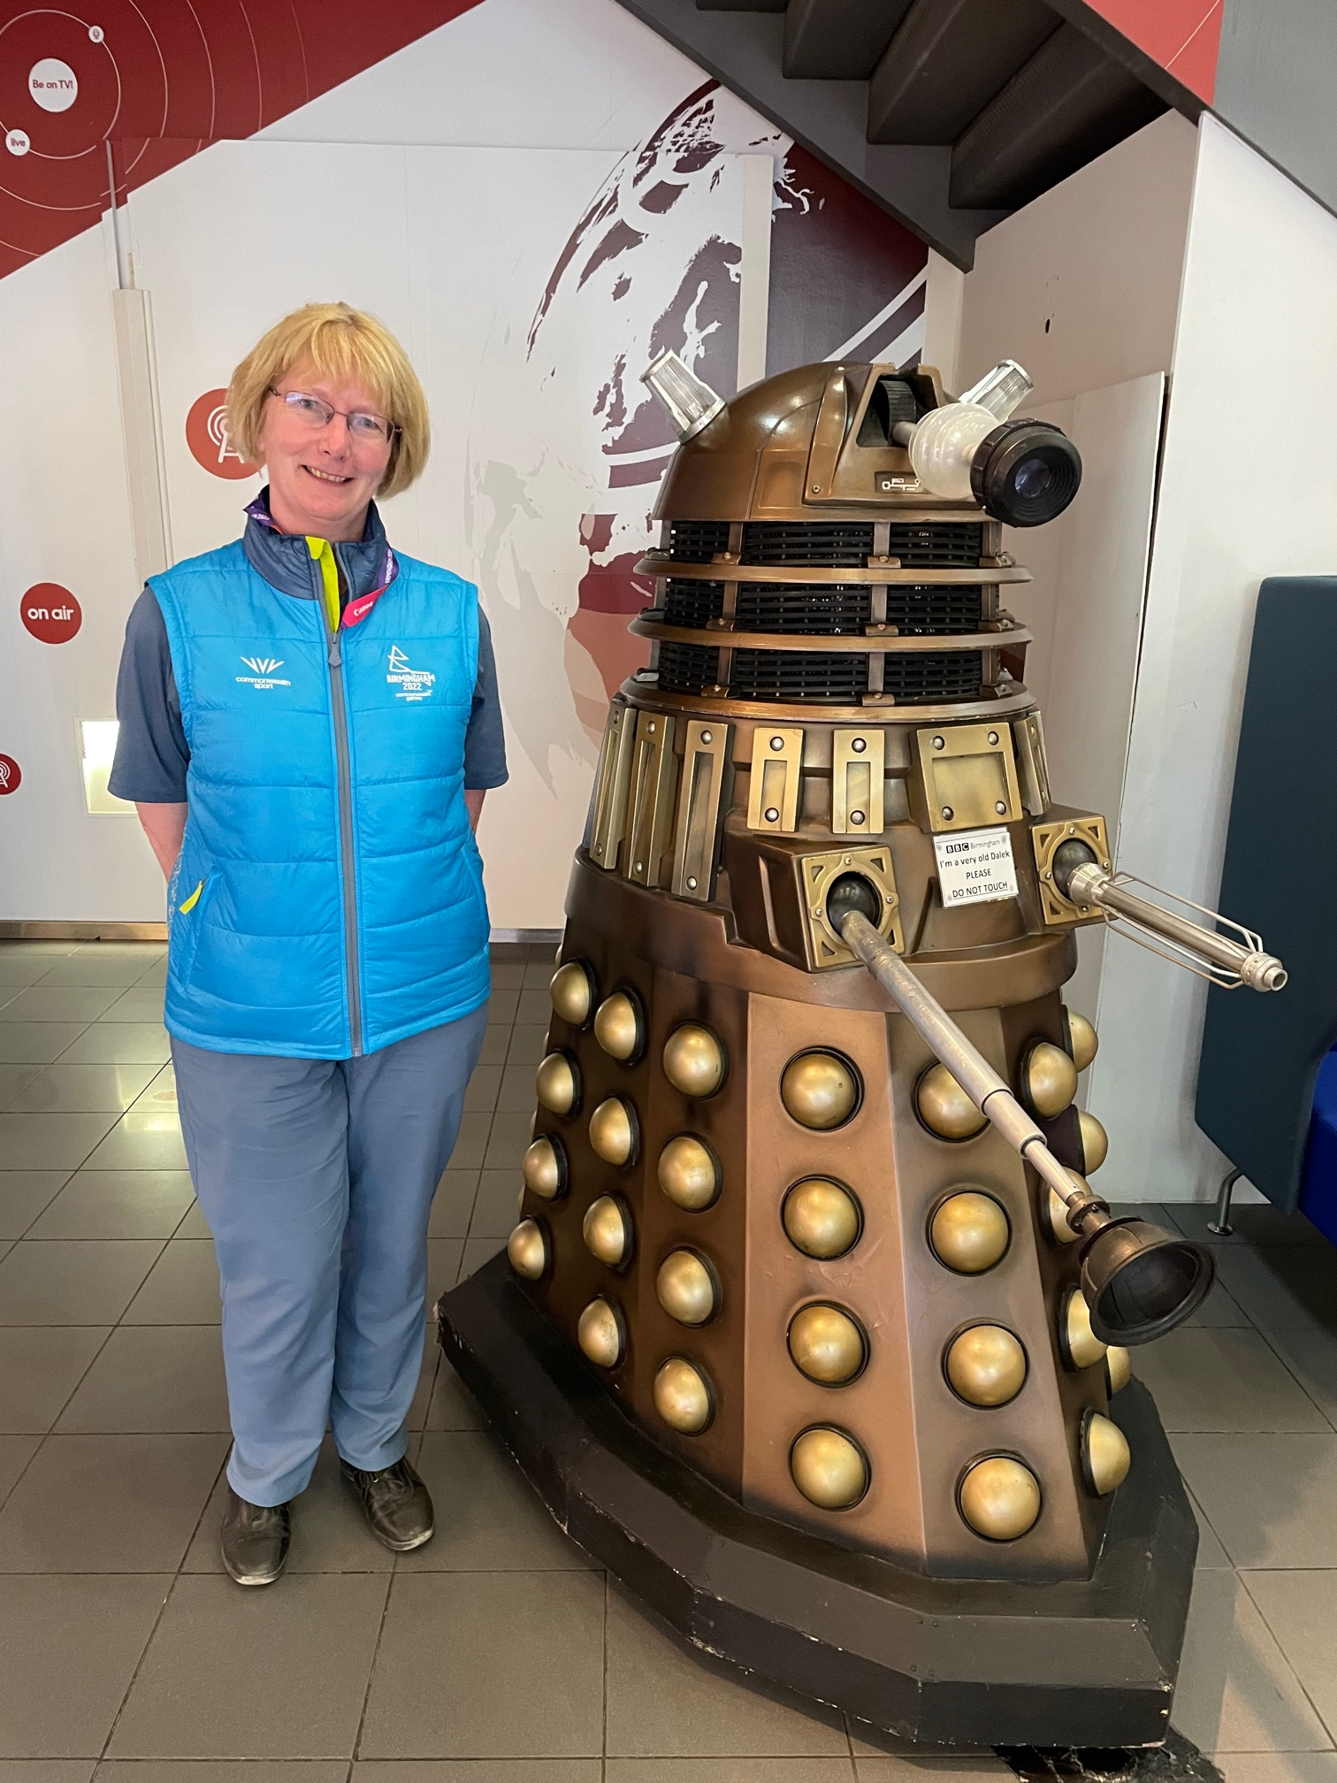
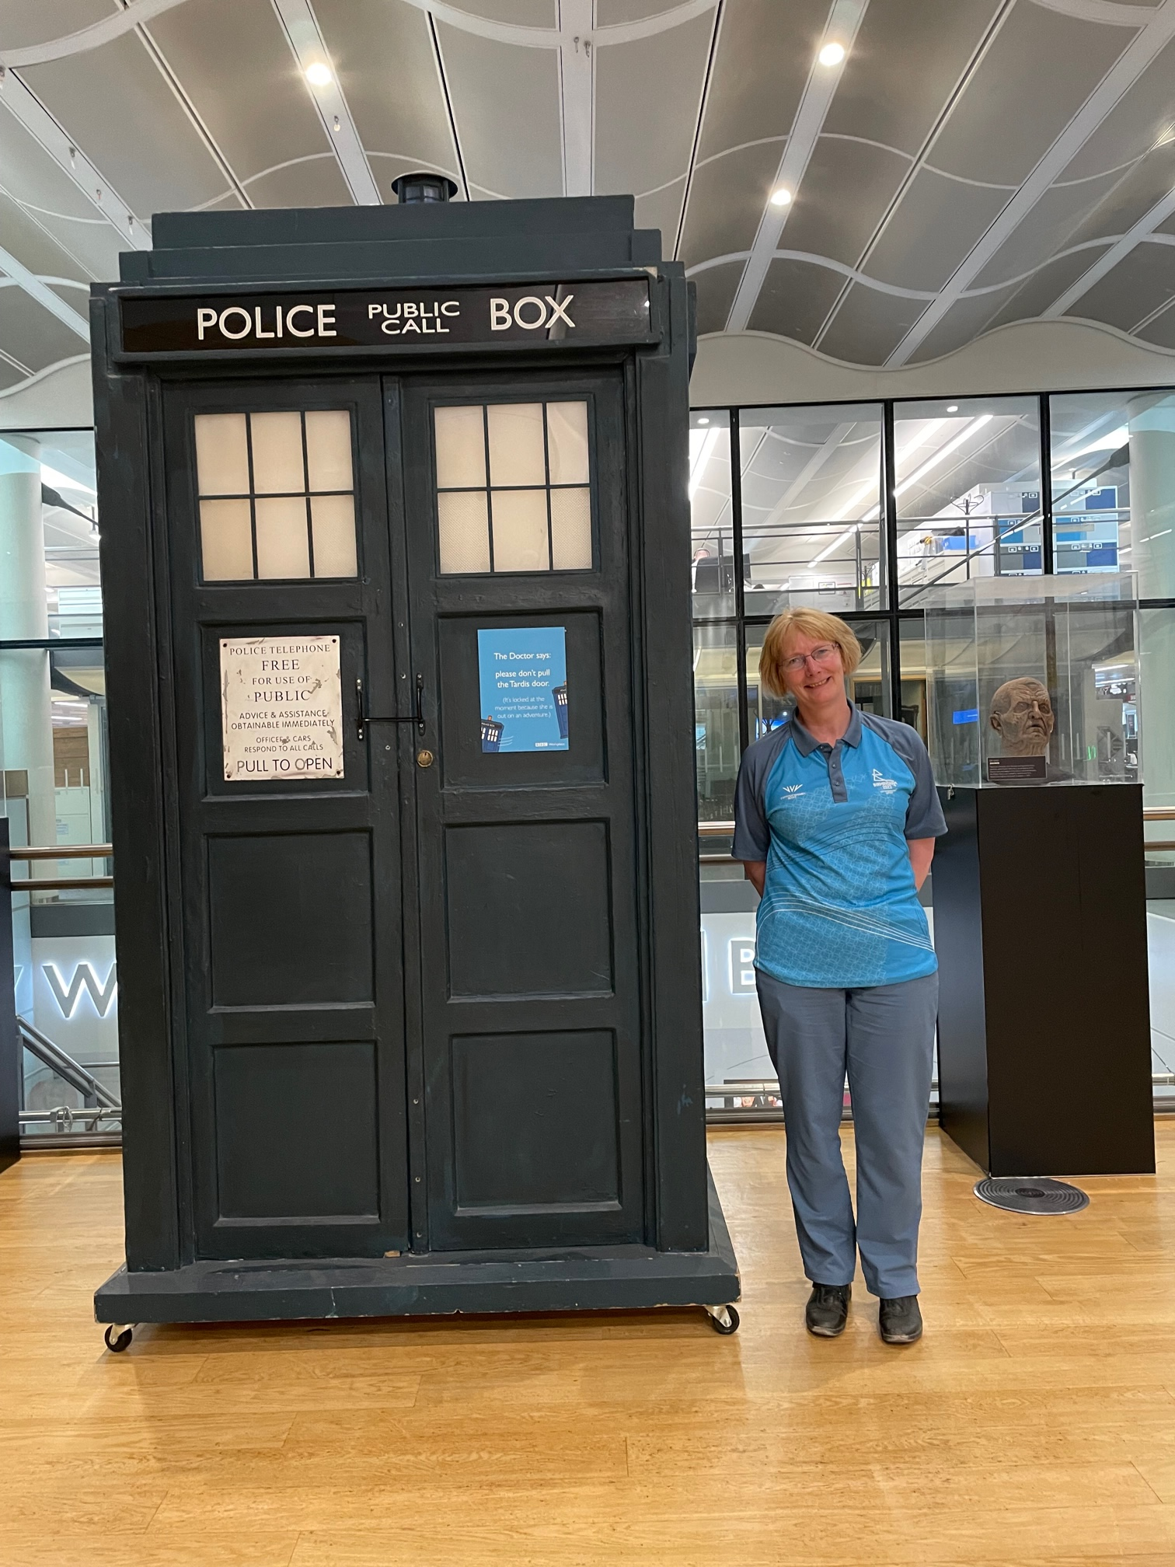
Favourite Bit?

